Slide 1


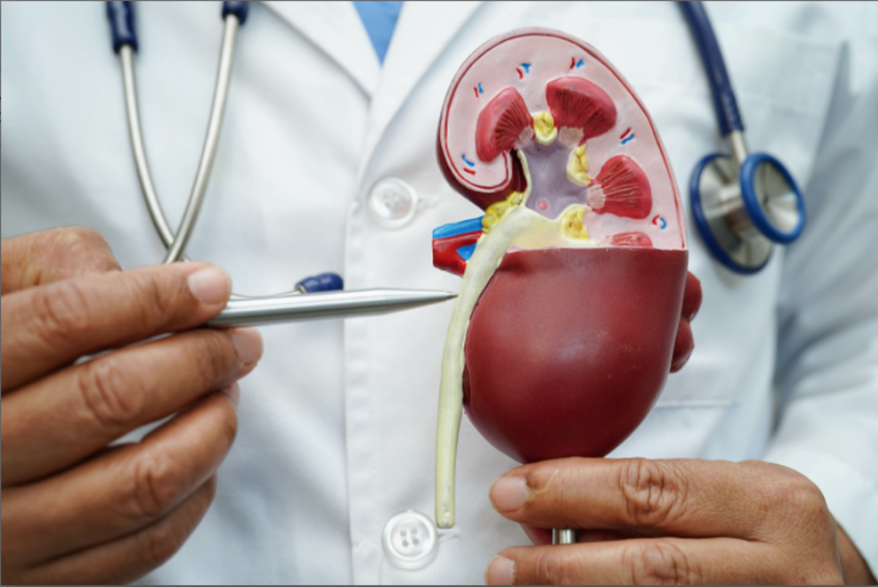
Mentouri Brothers University Constantine I
Institute of Veterinary Sciences
Academic year 2025-2026
WATER BALANCE
Dr. KELLALI Narimane
Assistant Professor "A"

Slide 2
Course outline
Water balance
Factors involved in the regulation of hydro-electrolytic metabolism
hormone (ADH)
The sensation of thirst
The sympathetic nervous system
The SRAA
Atrial natriuretic peptide (ANP )
Sodium balance
Potassium balance

Slide 3
WATER BALANCE

Slide 4
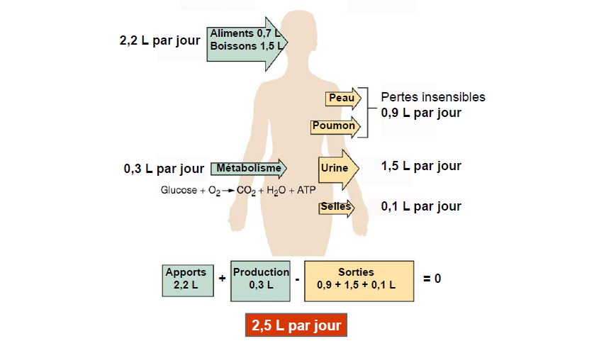
Water balance
Notes:
The body's water balance compares the gains and losses which should normally be in equilibrium.
The body's water content is the result of a dynamic balance between intake (drinks, water contained in solid foods, water produced by cellular metabolism) and losses (urine, feces, perspiration)

Slide 5
Water balance
WATER SAVINGS
WATER LOSS
Drinking water
Metabolic
The thirst center regulates entry
Insensible perspiration
Water excreted in feces
Urine production ;
Thermal
Variations in urine volume are the only modifiable pathway for water

Slide 6
Water balance
Body
Dry matter 40%
Total water
60% of the body
Intracellular sector
40% LIC
Extracellular sector
LEC 20%
Plasma 5%
Interstitial sector 15%
Notes:
From a functional point of view, water and mineral ions in solution are distributed into two large sectors separated by cell membranes.
The extracellular sector, however, plays an essential role in the regulation of water and ionic capital.
The interstitial sector fills the intercellular spaces: cerebrospinal fluid, synovial fluid, lymph and all the fluids of the cellular interstices.

Slide 7
Water balance
Extracellular sector
Plasma ions:
- K ⁺ = 4 mmol /L
- Na ⁺ = 145 mmol /L
- Cl- ⁼ 110 mmol /L
- HCO3- ₌ 26 ^{mmol} / L
Ca+2 and Mg+2 small amount
- plasma ultrafiltrate
- Low in protein
Intracellular sector
Cations:
- K ⁺ = 140 mmol /L
- Na ⁺ = 10-15 mmol /L
Anions:
- Cl- ⁼ 2 mmol L
- HCO3- ₌ 8 ^{mmol} / L
Liquid sectors
Plasma
Interstitium
Notes:
The respective chemical compositions of the main fluid compartments of the body are not identical.
The intracellular concentration of magnesium (Mg++) is higher than that of extracellular fluids. The main anions are divalent inorganic anions and organic anions and proteins, while chlorides and bicarbonates are relatively much less significant than in the ECF

Slide 8
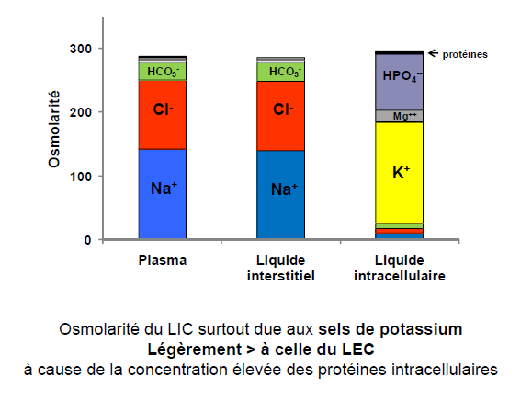
Water balance

Slide 9
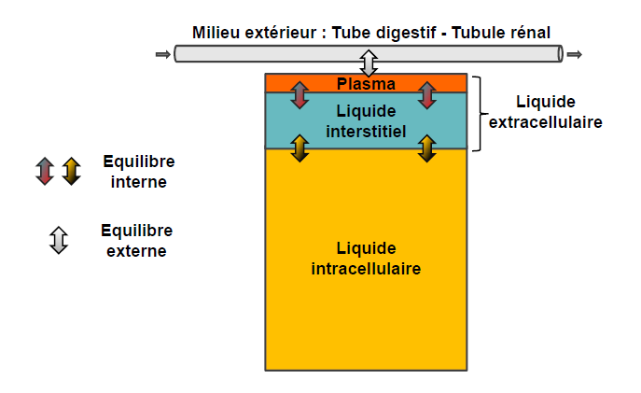
Water balance
The exchange of fluids and electrolytes between the different fluid compartments of the body is governed by three forces :
Osmotic pressure : is the pressure exerted by particles in solution, and is responsible for osmosis .
Oncotic pressure : generated by proteins in solution. It is the pressure that attracts water towards the proteins .
Hydrostatic pressure : generated by the cardiovascular system
Notes:
Even at equilibrium, there are exchanges between the different sectors. This equilibrium is dynamic and not static, reflecting a continuous hydro- electrolytic exchange across the membranes separating the various compartments.

Slide 10
Water balance
Water exchange between the intracellular and extracellular compartments occurs across the cell membrane and depends on osmotic pressure gradients .
Water exchange between blood plasma and interstitial fluid occurs across the capillary wall according to hydrostatic and oncotic pressure gradients . represented by the Starling equation .

Slide 11
Water balance
PNF = K _{f} × [(P _{C} -P _{I} )-( π _{C} - π _{I} )]
Kf : filtration coefficient: This is the water permeability of the capillary wall
PC: Capillary hydrostatic pressure
PI : interstitial hydrostatic pressure
π _{C} capillary oncotic pressure
π _{I} Interstitial oncotic pressure
PNF positive Filtration
Negative PNF Absorption

Slide 12
Water balance
PC​ Capillary hydrostatic pressure:
Promotes filtration out of the capillary.
It is determined by arterial and venous pressures and by resistances.
It is higher at the arterial end of the capillary (25 mm Hg) than at the venous end (10 mm Hg).
precapillary sphincter and the increase in postcapillary resistance increase hydrostatic pressure.
precapillary resistance and the decrease in postcapillary resistance reduce this pressure.
Notes:
Capillary hydrostatic pressure is relatively insensitive to variations in arterial pressure. Its stability is linked to variations in the resistance of the precapillary sphincters, which determine the fraction of arterial pressure transmitted into the capillary.

Slide 13
Water balance
PI : Interstitial hydrostatic pressure:
It opposes filtration outside the capillary.
It is normally zero or slightly negative, around -3 mm Hg.
π _{C} : Capillary oncotic pressure:
It is 28 mm Hg and opposes filtration out of the capillary.
It increases with an increase in the level of proteins in the plasma.
π _{I} : Interstitial oncotic pressure:
Promotes filtration out of the capillary.
It is approximately 8 mm Hg, resulting from small amounts of protein leaking from the vascular space and remaining inside the interstice.
Notes:
Interstitial oncotic pressure is determined by the main interstitial solutes, which are mucopolysaccharides and, above all, filtered proteins, particularly albumin. The degree of accumulation of filtered proteins is determined by two factors:
– The permeability of the capillary wall,
– The rate of elimination by the lymphatic vessels.

Slide 14
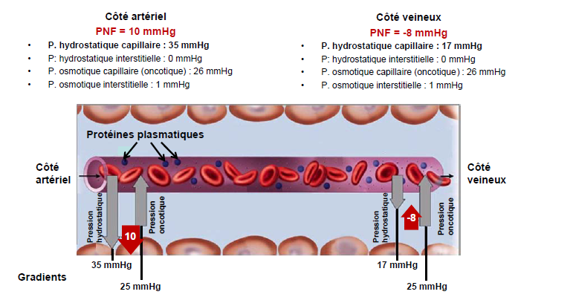
Water balance

Slide 15
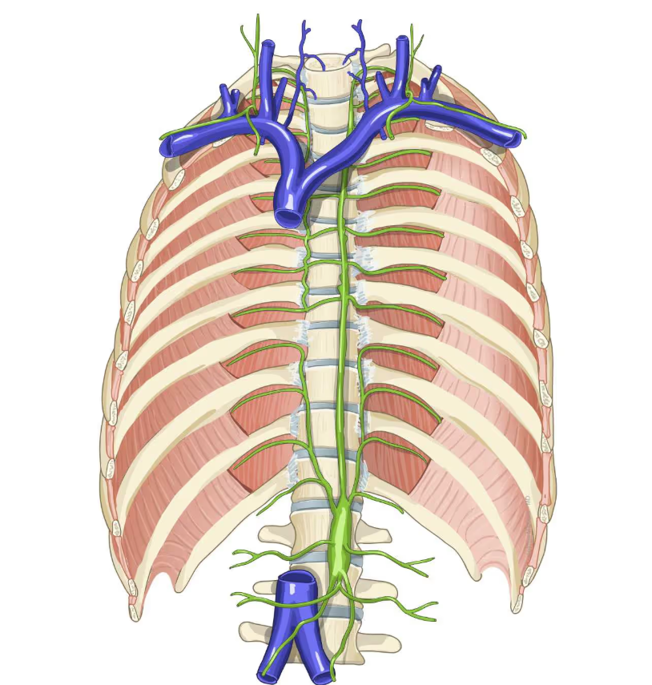
Water balance
Water balance
Fluid filtered into the interstitial compartment and not reabsorbed is drained by the lymphatic vessels and then returns via the thoracic duct to the plasma compartment at the level of the venous circulation ( subclavian vein ).
Consistency of plasma and blood volumes at equilibrium :
Expansion of plasma volume, transfer of this fluid to the interstitial compartment
Contraction of plasma volume; transfer of interstitial fluid into the vascular space

Slide 16
Water balance
The kidney can easily modulate the urinary elimination of salts and water to adapt them to intake and loss in order to maintain the water balance and the sodium content at its physiological value.
Urine osmolarity can range from 50 to 1200 mOsm /L and its volume varies from 0.15 to 20L/day.
Changes in urine volume and osmolarity depend on:
Antidiuretic hormone (ADH)
The sensation of thirst
The sympathetic nervous system
The Renin System (RAS)
natriuretic peptide (ANP)

Slide 17
Water balance
Antidiuretic hormone ADH
Antidiuretic hormone or ADH or vasopressin is a 9-amino-acid peptide synthesized by two groups of neurons present in the hypothalamus .
These neurons are grouped into two nuclei , the supraoptic and paraventricular nuclei .
These neurons synthesize ADH in their cell body and store it in secretory granules.
Within these granules, ADH is bound to a protein transporter called neurophysin II .

Slide 18
Water balance
Antidiuretic hormone ADH
When the neuron is stimulated, an action potential travels along the axon from the hypothalamus to the posterior pituitary gland (posthypophysis) and causes the release of the granule contents by exocytosis.
ADH then dissociates from its transporter in the surrounding interstitial fluid. Neurophysin II and ADH pass into the pituitary capillaries and enter the systemic circulation
Neurophysin has no effect .
Only ADH has the following activities :

Slide 19
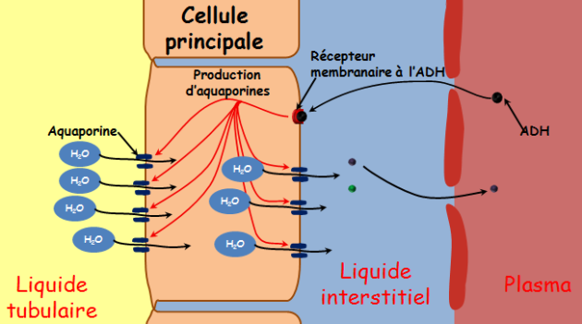
Water balance
Antidiuretic hormone ADH
ADH binds to its receptor located on the basal pole of cells.
This activates an adenylyl cyclase which increases the intracellular level of cyclic AMP.
AMP- cyclic activates one or more kinases which increases water permeability, following the insertion into the cell membrane of the apical pole of water channel proteins.
In the absence of ADH, these channel proteins are removed, and the cells become impermeable to water again.

Slide 20
Water balance
Antidiuretic hormone ADH
DHA increases the permeability of the collecting duct to water and urea.
This results in the production of hypertonic urine at a low flow rate.
At high non-physiological doses, ADH causes an increase in blood pressure by arteriolar vasoconstriction.
This action led to it being named vasopressin.

Slide 21
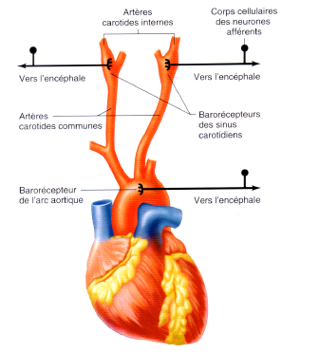
Water balance
Antidiuretic hormone ADH
ADH secretion is stimulated by:
The decrease in blood volume (hypovolemia) detected in the right atrium .
The decline in blood pressure detected by aortic and carotid baroreceptors .
An increase in plasma osmolarity ( hyperosmolarity ) is detected by hypothalamic osmoreceptors when osmolarity exceeds 280mOsM/l .

Slide 22
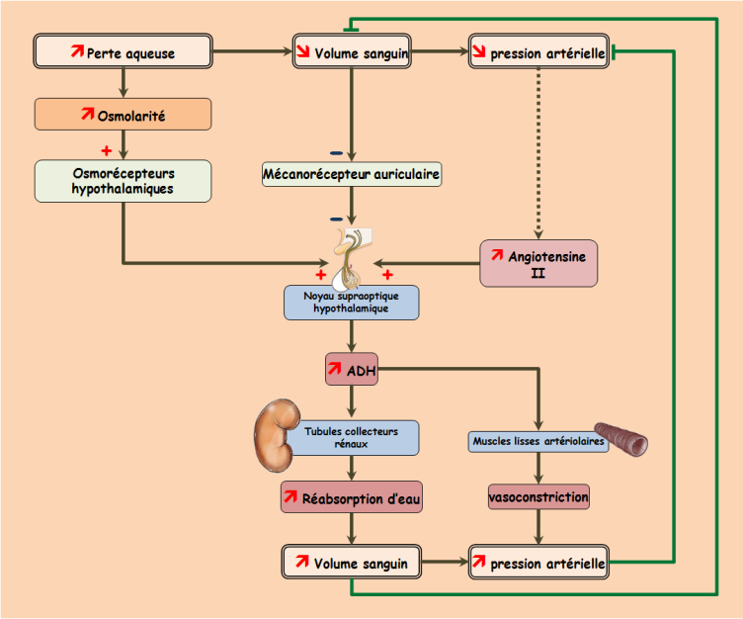
Water balance
Antidiuretic hormone ADH
The regulation of ADH secretion occurs via neuronal receptors:
Osmoreceptors​ sensitive to the osmolarity of the interstitial fluid
Baroreceptors sensitive to intravascular pressures .
Volume receptors sensitive to variations in blood volume.

Slide 23
Water balance
Antidiuretic hormone ADH
Hyperosmolarity​ of the extracellular fluid , therefore the increase in the concentration of Na+ in this fluid leads to the exit of water from the cells.
This cellular dehydration stimulates hypothalamic neurons that are osmoreceptors .
These neurons are particularly sensitive to any variation in the osmolarity of the extracellular fluid. As soon as it increases by 1% , they are excited and stimulate the ADH-producing neurons.
The ADH release threshold is at an osmolality of 280 mOsm ./L .
The released ADH reaches the kidney (CDT and collecting duct of long nephrons) where it causes water reabsorption in an attempt to dilute the excess Na+ ions from the extracellular fluid.

Slide 24
Water balance
Antidiuretic hormone ADH
ADH release is also stimulated by hypovolemia.
this second mechanism is less sensitive than hypothalamic osmoreceptors .
Indeed , a 5 to 10% reduction in blood volume, cardiac output and blood pressure is required to achieve ADH release.
Hypovolemia also leads to the release of renin by the juxtaglomerular apparatus and therefore the formation of angiotensin II.
Angiotensin II stimulates the supraoptic and paraventricular nuclei for the secretion of the antidiuretic hormone ADH.
Notes:
Volume receptors are located in the left atrium, the vena cava, and the pulmonary circulation .

Slide 25
Water balance
Antidiuretic hormone ADH

Slide 26
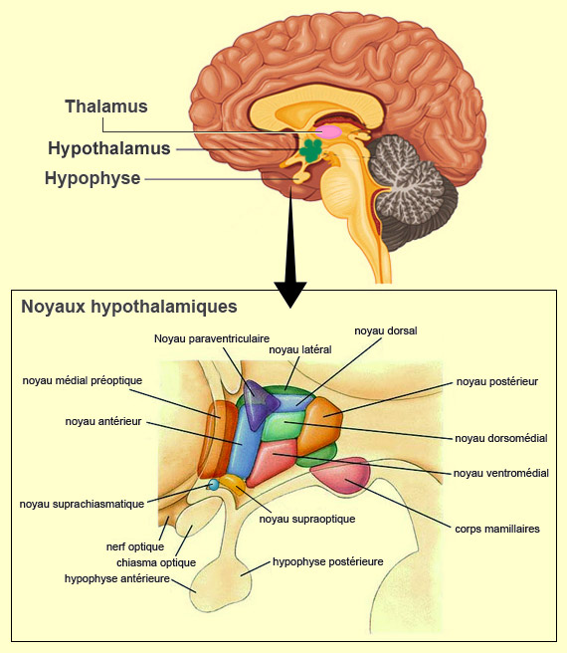
Water balance
Mechanism of thirst
Hypothalamic osmoreceptors also excite neurons in the preoptic nucleus which form the hypothalamic thirst center .
This excitation appears for osmolality values of 290 to 295 mOsm /L .
The response threshold for thirst (the conscious sensation of needing water) is therefore slightly higher than that of ADH release (280 mOsm . /L).
This sensation of thirst appears or is reinforced by the resting of baroreceptors and voloreceptors following hypovolemia.
It is also triggered by angiotensin II.

Slide 27
Water balance
Mechanism of thirst
This sensation of thirst is modulated by the level of moisture in the mouth.
Dryness of the oral cavity causes the sensation of thirst.
Conversely, humidifying the oral cavity inhibits it, as does introducing water into the stomach.
A dehydrated person experiences thirst through hyperosmolarity . extracellular fluid , hypovolemia and the accompanying
He drinks to suppress this sensation and correct the osmolarity of the extracellular fluid .

Slide 28
Water balance
Mechanism of thirst
This correction can only appear after a delay: the liquid must pass through the stomach, part of the intestine, cross the wall of the digestive tract and spread throughout the body.
If the sensation of thirst is not temporarily inhibited by moistening the mouth and the presence of liquid in the stomach, the subject would continue to drink excessive amounts of liquid.
The tonicity and volume of extracellular fluid therefore link the sensation of thirst and the secretion of ADH.

Slide 29
Water balance
Sympathetic
The excitation of sympathetic fibers that reach the kidney triggers:
Vasoconstriction of the afferent arteriole,
A decrease in the glomerular filtration rate (GFR),
is released by the juxta-glomerular apparatus, leading to the formation of angiotensin II.
An increase in NaCl reabsorption by the DCT.
This results in a decrease in the excretion of water and salts.
Resting the sympathetic fibers produces the opposite effects.

Slide 30
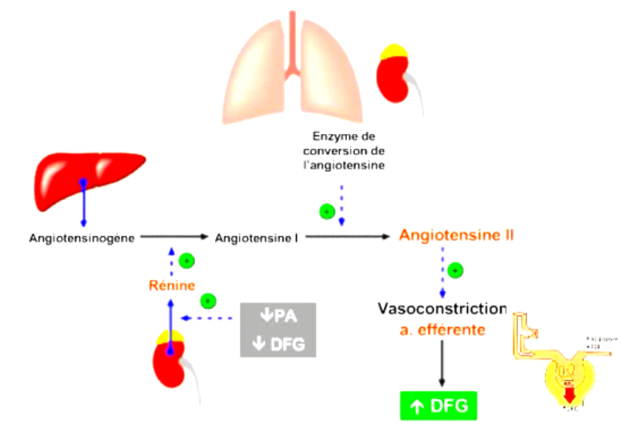
Water balance
Renin-Angiotensin-Aldosterone System

Slide 31
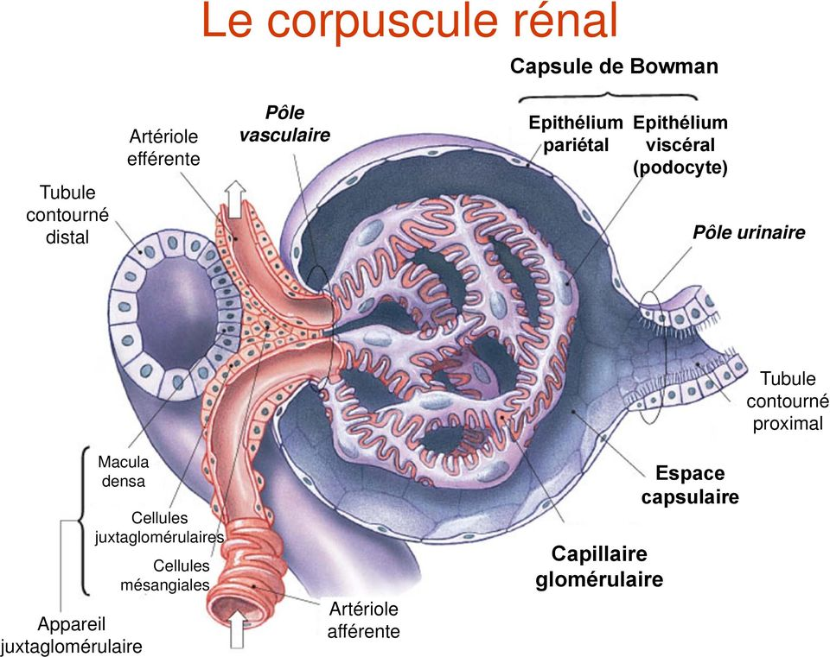
Water balance
Renin-Angiotensin-Aldosterone System
This system is triggered by the release of renin by juxtaglomerular cells .

Slide 32
Water balance
Renin-Angiotensin-Aldosterone System
Various stimuli can trigger this system :
A decrease in blood pressure leads to a reduction in the stretching of the afferent arteriolar wall, and baroreceptors trigger renin secretion. Conversely, an increase in renal perfusion pressure inhibits renin release.
The decrease in GFR that accompanies the drop in blood pressure leads to a decrease in tubular NaCl concentration ; the cells of the macula densa ( chemoreceptors) detect this decrease and stimulate the juxtaglomerular cells for the release of renin.
The sympathetic nervous system directly stimulates the release of renin by juxtaglomerular cells via β1 adrenergic receptors .

Slide 33
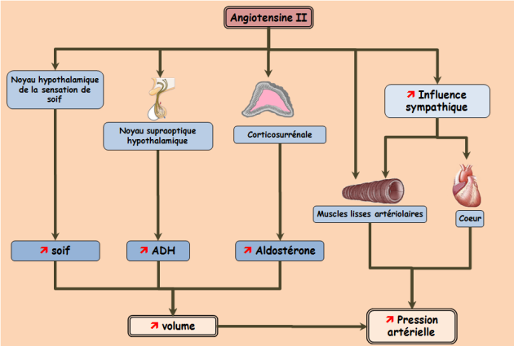
Water balance
Renin-Angiotensin-Aldosterone System
Angiotensin II performs several functions:
Vasoconstriction of the efferent arteriole
Stimulation of the thirst center and release of ADH
Release of aldosterone from the zona glomerulosa of the adrenal cortex .

Slide 34
Water balance
Renin-Angiotensin-Aldosterone System
It should be noted that despite the reduction in renal blood flow due to the vasoconstrictive action of angiotensin II, the GFR remains unchanged.
This is explained by the vasoconstriction of the efferent arteriole which brings the GFR back to its physiological value.

Slide 35
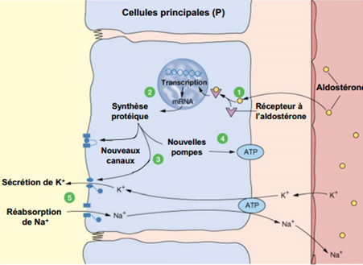
Water balance
Renin-Angiotensin-Aldosterone System
Aldosterone acts at the level of the distal convoluted tube :
Na+ reabsorption by the principal cells of the distal tubule.
K+ secretion by the principal cells of the distal tubule.
Increases H+ secretion by intercalated cells of the distal tubule.

Slide 36
Water balance
natriuretic peptide (ANP)
The myocytes in the walls of the heart's atrial chambers produce a peptide hormone made of 28 amino acids called peptide atrial natriuretic ( ANP).
ANP is released following the stretching of the atrial wall when blood volume is increased.
ANP is a vasodilator and it causes the excretion of water and Na+ by the kidney.

Slide 37
Water balance
natriuretic peptide (ANP)
Atrial Natriuretic Peptide :
dilates the afferent and efferent arterioles.
increases the glomerular filtration rate .
reduces Na+ reabsorption by the distal convoluted tubule.
inhibits renin release and aldosterone secretion, thereby further decreasing sodium reabsorption.

Slide 38
SUMMARY OF THE
SODIUM

Slide 39
SODIUM
Na + is the main extracellular cation ; it plays an essential role in maintaining extracellular osmolarity and in controlling blood volume.
The consistency of its intra- and extracellular distribution is ensured by the properties of the cell membrane.
The regulation of the body's sodium levels is ensured by the kidney and its hormonal effectors.

Slide 40
SODIUM BALANCE
99 % of the filtered Na+ is reabsorbed and only 1% will be excreted in the urine.
Most sodium reabsorption occurs in the proximal convoluted tubule (PCT) and the loop of Henle , such that only 10% of the filtered amount reaches the distal convoluted tubule (DCT) fairly consistently. This maintenance is due to :
Intrarenal autoregulation which stabilizes the GFR
The tubuloglomerular balance which adjusts the reabsorption of the proximal convoluted tubule to the GFR .
The 10% that reach the distal convoluted tubule will be subject to cellular reabsorption, which is primarily controlled by aldosterone .

Slide 41
SODIUM BALANCE
Small changes in sodium reabsorption lead to large changes in extracellular volume.
Variations in sodium levels alter blood sodium levels:
overload induces hypernatremia .
depletion induces hyponatremia.

Slide 42
SODIUM balance
Distribution of Na+
Regulation of sodium balance

Slide 43
SODIUM
DISTRIBUTION OF Na+
Total Na+
This represents 60 meq /kg of body weight, or 4200 meq in a 70kg adult.
Intracellular Na +
-Represents 5 to 10 % of total Na ⁺
-low concentration: 15 meq /L
Extracellular Na+
40 % of total Na ⁺ for plasma and interstitial compartments

Slide 44
SODIUM
DISTRIBUTION OF Na+
Plasma sector
11% of total Na
Interstitial sector
29% of total Na
The [Na ⁺ ] is close to the serum sodium level.
The [Na ⁺ ] concentration varies from 135 to 145 meq /L
Bones, connective tissue and cartilage
Contains 50% of the total Na
Transcellular
Digestive secretions, CSF, glomerular filtration: site of significant Na ^{+ movements}
Not interchangeable at the bone level.

Slide 45
SODIUM balance
SODIUM REGULATION​
The regulation of intake is dependent on salt requirements, which adapts intake to the body's needs.
The regulation of output is rapid and is dependent on the kidney, which can adapt Na+ excretion to intake.

Slide 46
SODIUM BALANCE
SODIUM REGULATION​
The factors regulating Na+ excretion are:
The glomerulotubular balance​
Peritubular
The intrarenal distribution of glomerular filtration
Aldosterone
Atrial

Slide 47
SODIUM BALANCE
SODIUM REGULATION​
The glomerulotubular balance :
There is a permanent balance between proximal Na+ reabsorption and filtered mass.
This balance limits the consequences of the variation in filtered Na+.
Peritubular factors
A decrease in oncotic pressure in the peritubular capillaries and an increase in hydrostatic pressure in the peritubular capillaries leads to a decrease in the reabsorption of Na+ and water in the proximal convoluted tubule and vice versa.

Slide 48
SODIUM BALANCE
SODIUM REGULATION​
The intrarenal distribution of glomerular filtration:
Towards the short (cortical) nephrons which reabsorb less Na + in case of salt overload.
Towards the long juxtamedullary nephrons (which have a long loop of Henle ) in case of depletion.
Aldosterone :
Controls distal sodium reabsorption , where it is exchanged for H+ or K+.
Its secretion is triggered by the Renin-Angiotensin-Aldosterone System (RAAS).
Atrial
Decreases Na+ reabsorption by decreasing Na+ K+ ATPase activity.

Slide 49
SODIUM BALANCE
SODIUM REGULATION​
We must distinguish between:
Regulation of sodium balance : Which is dependent on the kidney which adapts Na+ outputs to inputs via Aldosterone essentially .
Regulation of sodium levels : Which is dependent on the laws of osmosis and ADH secretion.

Slide 50
SODIUM
SODIUM REGULATION​
Changes in blood sodium levels are rapidly corrected by water movements, as follows :
The maintenance of sodium levels is achieved at the expense of fluid movements, which are corrected by the variation in aldosterone secretion .
Changes in sodium levels and therefore osmolarity involve the secretion of ADH , which acts by allowing the reabsorption of pure water in the collecting duct .

Slide 51
SUMMARY OF THE
POTASSIUM

Slide 52
Potassium balance
90 % of potassium is intracellular .
Potassium in ionized form (K+) plays a fundamental role in many enzymatic systems and in neuromuscular excitability.
Its regulation and distribution are governed by precise physiological laws.

Slide 53
Potassium balance
POTASSIUM
The total body quantity is 3200 meq , of which 90% is exchangeable and 10% is non-exchangeable and located in the bone.
Intracellular potassium :​
Represents 90% of the total K+.
Its intracellular concentration is high, ranging from 100 to 160 meq .
It is found primarily in muscle, myocardium, and red blood cells.
It plays an important role in :
respiration .
Enzymatic activities.
Protein synthesis
Notes:
The total quantity is 3200 meq , of which 90% is exchangeable and 10% is non-exchangeable and located in the bone.

Slide 54
Potassium balance
POTASSIUM
Extracellular potassium :
2% of total potassium.
K +: serum potassium varies within narrow limits between 3.5 and 5 meq /l .
Potassium levels are a poor indicator of potassium levels due to the deficiency of K+ in the extracellular sector.
However , hypokalemia is often accompanied by potassium depletion and hyperkalemia by potassium overload.
Notes:
The total quantity is 3200 meq , of which 90% is exchangeable and 10% is non-exchangeable and located in the bone.

Slide 55
Potassium balance
REGULATION
The entrances:
Primarily food-related .
They are 50 to 100 meq = 2 – 4 g/24h,
The minimum requirements are 12 meq /24h = 1g of KCl .
Therefore, there is no deficiency in K+, which is widely supplied in fruits and vegetables.
Its intestinal absorption is complete.
The outings:
Kidneys Most importantly, it is the kidney that regulates potassium balance by adjusting the excretion of K+. This accounts for 90% of the K+ absorbed in the intestine.
Fecal matter : low unless diarrhea, vomiting or excessive laxatives.
Sweat : minimal.

Slide 56
Potassium balance
REGULATION
balance is achieved when urinary excretion is exactly equal to dietary intake.
K+ is filtered, reabsorbed and secreted by the nephron .
80% of K+ is actively reabsorbed at the level of the proximal convoluted tubule and the loop of Henle.
K+ excretion is primarily distal, varies considerably from 1% to 110% of the filtered amount, and depends on:
Dietary intake ,
Aldosterone levels​
The acid-base state .
The sodium content of the tubule
Chlorine

Slide 57
Potassium balance
REGULATION
Potassium content of distal cells :
In case of potassium deficiency, the K+ content of the cell decreases.
ions are preferentially secreted, leading to alkalosis accompanying hypokalemia with aciduria .
In cases of potassium overload, there is excretion of K+ ions, with retention of H+ ions, which exacerbates the acidosis accompanying hyperkalemia.

Slide 58
Potassium balance
REGULATION
Aldosterone:
Its activation depends more on the RAAS activated by hypovolemia than on ionic variations of Na+ and K+ .
Indeed , a decrease in the plasma Na+/K+ ratio can directly stimulate the zona glomerulosa of the adrenal cortex for the secretion of aldosterone.
Aldosterone : increases the reabsorption of Na+ at the CDT , while increasing the elimination of H+ and K+ ions.

Slide 59
Potassium balance
REGULATION
Acid-base balance:
In the distal convoluted tubules and collecting ducts, there are two types of intercalated cells: type A and type B
These two cell types are rich in carbonic anhydrase and contain H+ ATPases , H+/K+ exchangers, and HCO3-Cl
Type A cells are involved in cases of acidosis, while type B cells are activated in cases of alkalosis.

Slide 60
Potassium balance
REGULATION
Acid-base balance:
In case of acidosis : the A intercalated cells excrete H+ and reabsorb bicarbonate and K+.
This increase in potassium levels worsens the hyperkalemia associated with acidosis (due to intracellular buffering of H+).

Slide 61
Potassium balance
REGULATION
Acid-base balance:
In the case of alkalosis : the B intercalated cells excrete bicarbonate and K + and reabsorb H+.
This leads to a decrease in potassium levels, worsening the hypokalemia secondary to alkalosis.

Slide 62
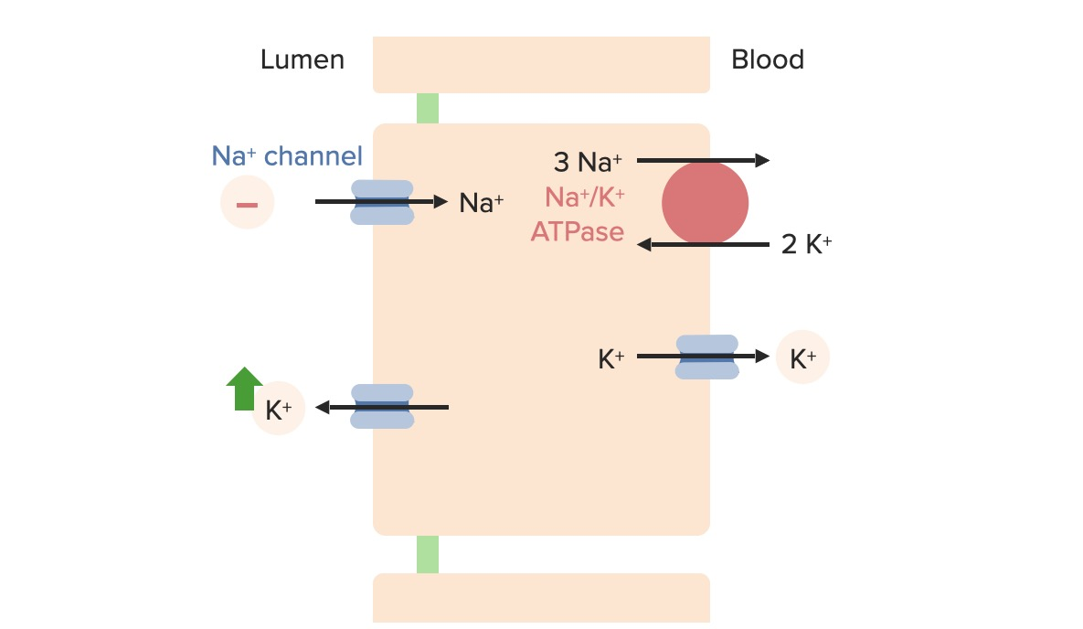
Potassium balance
REGULATION
The sodium content of the tubule:
depletion is accompanied by a decrease in K+ excretion due to a decrease in the transmembrane electrochemical gradient .
Sodium overload has the opposite effect: increased excretion of K+.

Slide 63
Potassium balance
REGULATION
Chlorine content:
Hypochloremia​ This is accompanied by a decrease in [Cl-] in the distal convoluted tubule, with an increase in the electrochemical gradient and increased K+ elimination. " Hypokalemic alkalosis pattern" hypochloremic​
The increase in Cl- in the tubule has the opposite effect, with potassium retention (" Hyperkalemic acidosis picture ") hyperchloremic »

Slide 64
Potassium balance
It turns out that potassium levels are a poor indicator of potassium levels because the extra sector The cell is poor in K+.
However , it must vary within narrow margins, otherwise neuromuscular and especially cardiac disorders can occur , which can be fatal .
The kidney is the key organ in the regulation of potassium excretion, which is influenced by aldosterone.
Similarly , potassium levels and potassium balance are closely linked to acid-base balance.
All these concepts are fundamental in pathology for understanding and treating K+ disorders.

Slide 65
END…

