Slide 1

PATHOPHYSIOLOGY
OF EDEMA
Course in Pathophysiology
3rd year Veterinary Doctor
Dr. KELLALI Narimane
Assistant Professor "A"
Institute of Veterinary Sciences of Constantine
Montouri Brothers University Constantine I
Academic year 2025-2026

Slide 2
COURSE OUTLINE
Generalities
Pathophysiology of edema formation
  Alteration of capillary hemodynamics
  Renal retention of sodium and water
Pathophysiology according to etiology
  Edema in heart failure
  Edema associated with nephrotic syndrome
  Edema of liver cirrhosis
  Idiopathic edema

Slide 3
GENERAL INFORMATION
Edema is defined as palpable swelling caused by the expansion of interstitial fluid volume. Edema can be:
  Generalized: such as congestive heart failure , decompensated liver cirrhosis and nephrotic syndrome .
  Localized: venous obstruction ( central vein thrombosis), acute left ventricular failure , allergic reactions (laryngeal edema).

Slide 4
PATHOPHYSIOLOGY OF EDEMA
Two main steps are necessary for the formation of edema :
  A alteration of capillary hemodynamics which promotes the movement of fluids from the vascular space into the interstitium .
  A renal water-sodium retention leading to the expansion of extracellular fluid volume.

Slide 5
ALTERATION OF CAPILLARY HEMODYNAMICS

Slide 6
ALTERATION OF HEMODYNAMIC
exchange between the plasma and the interstitium are done by filtration according to the gradients of hydrostatic and oncotic pressures.
The relationship between these forces can be expressed by Starling 's Law

Slide 7
EXCHANGES BETWEEN
PLASMA AND THE INTERSTITIUM
PNF = K _{f} × [(P _{C} -P _{I} )-( π _{C} - π _{I} )]
Kf : filtration coefficient: This is the water permeability of the capillary wall
PC: Capillary hydrostatic pressure
PI : interstitial hydrostatic pressure
π _{C} capillary oncotic pressure
π _{I} Interstitial oncotic pressure
PNF positive Filtration
Negative PNF Absorption

Slide 8
EXCHANGES BETWEEN
PLASMA AND THE INTERSTITIUM
PC​ Capillary hydrostatic pressure :
  Promotes filtration out of the capillary .
  It is higher at the arterial end of the capillary (25mm Hg) than at the venous end (10 mm Hg).
  It is determined by arterial and venous pressures and by precapillary resistances .
  The relaxation of the precapillary sphincter and the increase in postcapillary resistance increase hydrostatic pressure .
  The increase in precapillary resistance and the decrease in postcapillary resistance reduce this pressure.
Notes:
Hydrostatic capillary pressure is relatively insensitive to variations in arterial pressure. The stability of capillary pressure is linked to variations in the resistance of the precapillary sphincters, which determine the fraction of arterial pressure transmitted into the capillary.

Slide 9
EXCHANGES BETWEEN
PLASMA AND THE INTERSTITIUM
PI : Interstitial hydrostatic pressure :
  It opposes filtration outside the capillary.
  It is normally zero or slightly negative, around -3 mm Hg.
π _{C} : Capillary oncotic pressure :
  It opposes filtration outside the capillary, it is 28mmHg.
  It increases with an increase in the level of proteins in the plasma .
π _{I} : Interstitial oncotic pressure :
  Promotes filtration out of the capillary.
  It is approximately 8 mm Hg, resulting from small amounts of protein leaking from the vascular space and remaining inside the interstice.
Notes:
Interstitial oncotic pressure is determined by the main interstitial solutes, which are mucopolysaccharides and, above all, filtered proteins, particularly albumin . The degree of accumulation of filtered proteins is determined by two factors:
– The permeability of the capillary wall,
– The rate of elimination by the lymphatic vessels.

Slide 10
HEMODYNAMIC ALTERATION
The development of edema requires the alteration of one or more STARLING forces in a direction that favors an increase in net filtration pressure:
  Increase in PC (venous side)
  Decrease in plasma oncotic pressure
  Increased capillary permeability

Slide 11
HEMODYNAMIC ALTERATION
Increase in capillary hydrostatic pressure:
  An increase in Pc is usually induced by a persistent increase in venous pressure.
  This can occur following an increase in blood volume , which increases the volume on the venous side , or following a venous obstruction.
This can be observed in cases of heart failure, thrombosis, compression, Functional venous insufficiency , portal hypertension ...

Slide 12
HEMODYNAMIC ALTERATION
Decrease in capillary oncotic pressure:
  Hypoalbuminemia due to renal loss of albumin or decreased hepatic synthesis of albumin is a potential cause of edema.
EX: malnutrition , malabsorption, hepatocellular insufficiency, nephrotic syndrome

Slide 13
HEMODYNAMIC ALTERATION
Increased capillary permeability:
  The increased capillary permeability observed in inflammatory states or by vascular injury can promote the development of edema both directly by fluid leakage and also by allowing the transfer of albumin to the interstitium , which decreases the oncotic pressure gradient .
  EX : inflammatory reaction, insect bites, medications….

Slide 14
ALTERATION OF HEMODYNAMIC
Lymphatic obstruction and/ or an increase in interstitial oncotic pressure:
  obstruction is an unusual cause of edema formation ; it is most often secondary to malignant lymphadenopathy.
  During hypothyroidism there is a significant increase in the interstitial accumulation of albumin and other proteins (myxedema ).
  In this case, lymphatic drainage is abnormally normal or low; perhaps the excess filtered proteins are binding to interstitial mucopolysaccharides, preventing lymphatic drainage.
Notes:
Often associated with an increase in interstitial hydrostatic pressure

Slide 15
DEFENSIVE FACTORS AGAINST HEMODYNAMIC ALTERATIONS
Since the existence of a low gradient favors filtration, one might expect that small changes in hemodynamic forces at the capillary level would lead to the formation of edema.
However , experimental and clinical data show that an increase in the gradient of 15 mm Hg favoring filtration is required before edema is detectable.

Slide 16
DEFENSIVE FACTORS AGAINST HEMODYNAMIC ALTERATIONS
Three factors contribute to protection against the formation of edema:
  The increase in lymphatic drainage initially removes the excess filtrate.
  The entry of fluids into the interstitium will gradually increase the interstitial hydrostatic pressure .
  The entry of fluids into the interstitium also decreases oncotic pressure by diluting interstitial proteins .

Slide 17
KIDNEY RETENTION
OF SODIUM

Slide 18
RENAL SODIUM RETENTION
The second stage in the formation of edema is the expansion of extracellular volume by renal sodium retention.
This process results from one of the following two mechanisms:
  Decrease in effective circulating volume
  renal sodium retention .

Slide 19
  RENAL SODIUM RETENTION.
  effective circulating volume
Effective circulating volume is a non-measurable entity that corresponds to the arterial volume, or about 15% of the total blood volume that effectively perfuses the tissues.
Heart failure is a common clinical example of reduced effective circulating volume .
In this case, the retention of Na and water leading to the formation of edema represents an appropriate compensatory response with a urinary Na concentration often less than 15 mmol /l.

Slide 20
  RENAL SODIUM RETENTION.
  Decrease in effective circulating volume.
Myocardial dysfunction initially decreases cardiac output, leading to the release of hypovolemic hormones:
  Norepinephrine ,​
  The SRAA
  Antidiuretic hormone ( ADH ) .

Slide 21
  RENAL SODIUM RETENTION.
  Decrease in effective circulating volume.
These hormones exert various effects, increasing the reabsorption of sodium and water and promoting the formation of edema :
  A reduction in glomerular filtration rate due to renal vasoconstriction,
  An increase in proximal Na reabsorption mediated by angiotensin II and norepinephrine,
  An increase in water reabsorption in the collecting duct related to ADH and of Na and water in the distal convoluted tubule related to aldosterone.

Slide 22
  RENAL SODIUM RETENTION.
  Decrease in effective circulating volume.
The creation of an arteriovenous fistula (AVF) does not initially affect cardiac output, although tissue perfusion is decreased since some of the blood flowing through the fistula bypasses capillary circulation.
In response to this peripheral hypoperfusion , the kidney retains sodium and water, which helps to increase circulating volume and cardiac output.
A new equilibrium state is reached and is characterized by an increased cardiac output, exceeding the initial cardiac output level by an amount equivalent to the fistula output.

Slide 23
  RENAL SODIUM RETENTION.
  Decrease in effective circulating volume.
A similar situation is represented by hepatic cirrhosis with ascites.
These patients often have high cardiac output but behave as if they were in effective hypovolemia, with a progressive increase in hypovolemic hormones and renal sodium retention
This discrepancy between high cardiac output and renal and neuroendocrine response is related to splanchnic vasodilation and the presence of multiple arteriovenous fistulas.
The net result is a marked decrease in systemic vascular resistance and a drop in blood pressure .
Most of the cardiac output circulates inefficiently for tissue perfusion.

Slide 24
  RENAL SODIUM RETENTION.
  Decrease in effective circulating volume.
retention of sodium and water observed in heart failure and liver cirrhosis results from both :
  A decrease in glomerular filtration linked to hypovolemia,
  An increase in mediated tubular reabsorption by increasing the activity of the renin-angiotensin-aldosterone system, ADH and the sympathetic nervous system.

Slide 25
A DETENTION PRIMARY SODIUM KIDNEY
​
A primary defect in renal sodium excretion can occur during advanced renal failure or during glomerular diseases (acute glomerulonephritis or nephrotic syndrome).
The decrease in sodium excretion probably results from an increase in its distal reabsorption .
In all cases, the renal response is the same as that which occurs in the event of volume depletion. i.e. - d sodium and water retention .
Notes:
Glomerulonephritis :
GFR ↓ → decreased filtered Na+ → perceived as hypovolemia → increased RAAS activation → increased Na⁺ reabsorption → increased water retention
Nephrotic syndrome:
Main mechanism: hypoalbuminemia → decrease in oncotic pressure → leakage of water into the interstitial space

Slide 26
A DETENTION PRIMARY SODIUM KIDNEY
The mechanism of this response is complex and involves several factors:
  A decrease in glomerular filtration,
  An increase in tubular reabsorption that manifests itself throughout the nephron.
The factors involved are:
  Vasomotor activity , of sympathetic origin , in response to decreased blood flow, which affects various areas including the kidney, with an increase in the filtered fraction.
  Intrarenal redistribution of blood flow in favor of long nephrons (especially in cirrhotic patients),
  This involves the secretion of aldosterone, which plays a role in sodium retention.
Notes:
The filtered fraction is the proportion of renal plasma that is actually filtered by the glomeruli .
In other words:
FF = (Glomerular filtration rate) / (Renal blood flow)
FF=DFG/DSR

Slide 27
PATHOPHYSIOLOGY ACCORDING TO ETIOLOGY

Slide 28
PATHOPHYSIOLOGY ACCORDING TO ETIOLOGY
Edema due to heart failure
Edema associated with nephrotic syndrome
Edema of liver cirrhosis

Slide 29
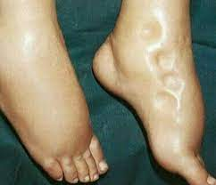
HEART FAILURE
The edema that appears during heart failure can be due to various pathologies:
  Coronary artery disease .
  Valvular heart disease (mitral stenosis)
  Cardiomyopathies .
The factor directly responsible for the edema is the increase in capillary hydrostatic pressure linked to the persistent increase in venous pressure .

Slide 30
HEART FAILURE
Edema develops in the lungs if the increase in venous pressure is pulmonary, as in the case of left ventricular failure due to valvular insufficiency or myocardial infarction (MI).
The increase in venous pressure is also due to the increase in actual blood volume secondary to sodium and water retention caused by an initial decrease in cardiac output.

Slide 31
HEART FAILURE
This decrease in cardiac output leads to several compensatory mechanisms:
  An increase in peripheral resistance, due to increased sympathetic tone, as evidenced by the elevated urinary excretion of catecholamines .
  retention of sodium and water increases circulating mass and creates an expansion of blood volume, especially in venous territories , with an increase in venous pressure, hence edema.

Slide 32
HEART FAILURE
Renal sodium retention involves several mechanisms :
  Increased aldosterone secretion and decreased catabolism due to reduced hepatic blood flow,
  The role of decreased filtration, linked to vasomotor activity (vasoconstriction), is of little importance.
  Intrarenal circulatory changes .

Slide 33
HEART FAILURE
Two types of intrarenal circulatory changes can occur:
  Vasoconstriction of afferent and efferent arterioles, which acts not on oncotic pressure but on peritubular hydrostatic pressure , which decreases, thus promoting reabsorption.
  The redistribution of blood to the benefit of the juxtamedullary nephrons.

Slide 34
NEPHROTIC SYNDROMES
They are characterized by an alteration of the renal filter resulting in an increase in the permeability of the glomerular capillaries to proteins.
Albumin and, to a lesser extent, globulins are excreted in the urine.
In addition to this phenomenon, there is... the increase in the catabolism of filtered albumin by tubular cells.
All of these factors lead to hypoproteinemia , especially hypoalbuminemia , and therefore to a decrease in capillary oncotic pressure .

Slide 35
NEPHROTIC SYNDROMES
This results in fluid displacement from the vascular compartment to the interstitial space, thus decreasing the effective circulating volume.
Effective hypovolemia stimulates Na retention by the kidney.
As in heart failure, peripheral resistance may be increased and catecholamine excretion may be increased due to hypovolemia.
blood flow and glomerular filtration are not constantly decreased, except in cases of advanced renal impairment.

Slide 36
NEPHROTIC SYNDROMES
filtration can vary in value due to the impact of two concurrent factors:
  On the one hand, the decrease in oncotic pressure increases the net filtration pressure .
  On the other hand, and especially if hypovolemia is significant, vasoconstriction of the afferent arteriole reduces capillary hydrostatic pressure and therefore PNF.
So filtration is either normal or reduced, but the filtered fraction is most often lowered.
A decrease in glomerular filtration is never sufficient to account for sodium and water retention.

Slide 37
NEPHROTIC SYNDROMES
In subjects suffering from nephrotic syndrome, the aldosterone level is always high because the effective blood volume fails to rise to a normal level.
These subjects have a marked decrease in proximal sodium reabsorption.
This alteration is linked to the _{decrease} in πC peritubular.

Slide 38
NEPHROTIC SYNDROMES
These subjects therefore have a relatively large water and Na load delivered to the TCD.
This explains the importance of the fraction of Na+ excreted in these patients compared to cirrhotic or heart failure subjects.
In general, these subjects respond better to distal diuretics than those with heart failure or cirrhosis.

Slide 39
NEPHROTIC SYNDROMES
These facts suggest that the main site of pathological Na+ retention is the CDT.
There is no pulmonary edema because the lung is vascularized under low pressure and the oncotic pressure, even when lowered, is sufficient to prevent pulmonary edema .

Slide 40

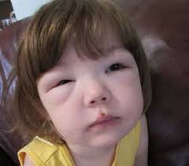
NEPHROTIC SYNDROMES
The cause of edema in nephrotic syndrome is systemic; it affects all areas of the body, but primarily those where tissue pressure is low (the face).

Slide 41
NEPHROTIC SYNDROMES
Hyponatremia due to impaired water excretion occurs during nephrotic syndrome.
The abnormal water excretion is due to an increase in ADH secretion due to hypovolemia.

Slide 42
LIVER CIRRHOSIS
Ascites is a fluid accumulation in the peritoneal cavity.
It can appear in various circumstances such as acute or chronic liver failure.
In cirrhosis, several mechanisms are involved in the development of ascites and edema .
The most important factor is the increase in venous pressure in the portal vein.

Slide 43
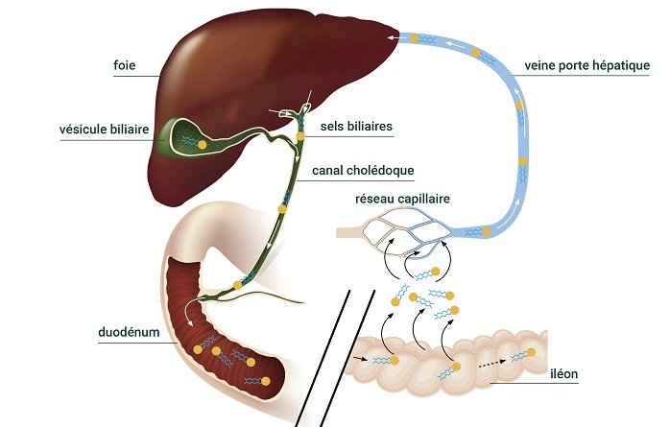
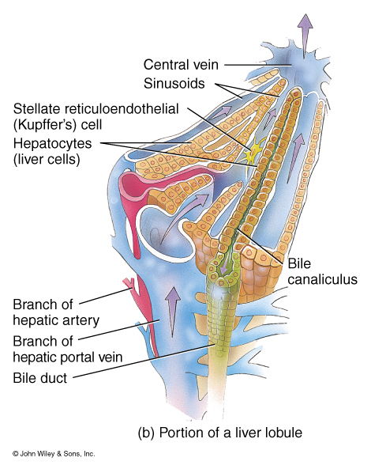
LIVER CIRRHOSIS
Most often it is a pre -sinusoidal venous blockage or obstruction .
The obstruction is therefore located before the sinusoids, that is to say in the portal vein or its branches .
The consequence will be a filtration of fluid from the intestinal capillaries which are drained by the portal vein.

Slide 44
LIVER CIRRHOSIS
But it could also be a post-sinusoidal venous blockage
The obstacle is located after the sinusoids.
In this case, filtration occurs from the hepatic sinusoidal capillaries.

Slide 45
LIVER CIRRHOSIS
In addition to this obstructive, mechanical factor, others are also present:
  The cirrhotic liver has generally lost a large part of these functional capacities, in particular the ability to synthesize albumin.
  As in nephrotic syndrome, hypoalbuminemia promotes fluid transudation at the level of the capillaries.
  Furthermore , the extent of abdominal effusion depends on the ability of the lymphatics to increase their drainage.
  Abnormalities of the thoracic duct may play a role in the development of ascites.

Slide 46

LIVER CIRRHOSIS
The combination of these factors causes and maintains ascites.
pressure increases.
This increase in pressure affects the venous pressure in the lower limbs, which increases.

Slide 47
LIVER CIRRHOSIS
The formation of ascites is favored by:
  Hypoalbuminemia​
  retention ,
  An increase in capillary permeability to albumin.
  Swelling appears in the lower limbs.

Slide 48
END…

Slide 49
IDIOPATHIC EDEMA
edema is a common disorder that occurs in young women of reproductive age, in the absence of kidney, liver, or heart disease.
Obesity and psychological problems are the backdrop against which fluid retention develops, the disorder generally having started in the premenstrual period and gradually becoming permanent.
gain is usually 2-3 kg, but can sometimes be greater.
Tolerance ranges from simple aesthetic discomfort to functional signs that can be felt as real handicaps (heavy legs, feeling of swelling, shortness of breath, etc.).

Slide 50
IDIOPATHIC EDEMA
Several mechanisms have been invoked:
  Increased capillary permeability
  Role of diuretics
  Resuming eating after fasting.
In a normal subject, standing leads to a slight degree of volume depletion due to extracellular fluid storage in the extremities, resulting in decreased renal sodium excretion, and weight gain at the end of the day can reach 0.5 to 1.5 kg.

Slide 51
IDIOPATHIC EDEMA
Increased capillary permeability
In women with idiopathic edema syndrome , this response to standing is exaggerated: fluid loss from the vascular space is greater, with the involvement of sodium- retention hormones.
Increased plasma renin and ADH activity levels,
Weight gain between morning and evening can amount to several kilos.
edema syndrome would therefore be due to capillary hyperpermeability with leakage of fluid from the vascular space.

Slide 52
IDIOPATHIC EDEMA
Increased capillary permeability
The exact mechanism of this excessive permeability remains unclear .
abnormality at the level of the hypothalamus (involving prolactin),
Decreased dopamine secretion (a hormone with natriuretic action ), etc.

Slide 53
IDIOPATHIC EDEMA
Role of diuretics
The aesthetic discomfort caused by weight gain leads many women to take diuretics, hence:
Hypovolemia​
Activation of the renin-angiotensin-aldosterone system: if the diuretic is stopped, the "deactivation" of the hormonal system is not immediate, hence the rapid reappearance of edema .
Very often, after 2 to 3 weeks of stopping all diuretic use, the edema will disappear spontaneously, sometimes after a marked increase in diuresis.

Slide 54
IDIOPATHIC EDEMA
Resuming eating after fasting .
Women affected by edema syndrome Idiopathic edema can suddenly begin a fast of a few days to lose weight, and the edema will reappear when food is resumed.
An increase in insulin secretion is implicated , which is capable of increasing sodium retention by stimulating tubular reabsorption and inducing hypokalemia (by promoting the passage of potassium into cells).

Slide 55
END…

