Slide 1


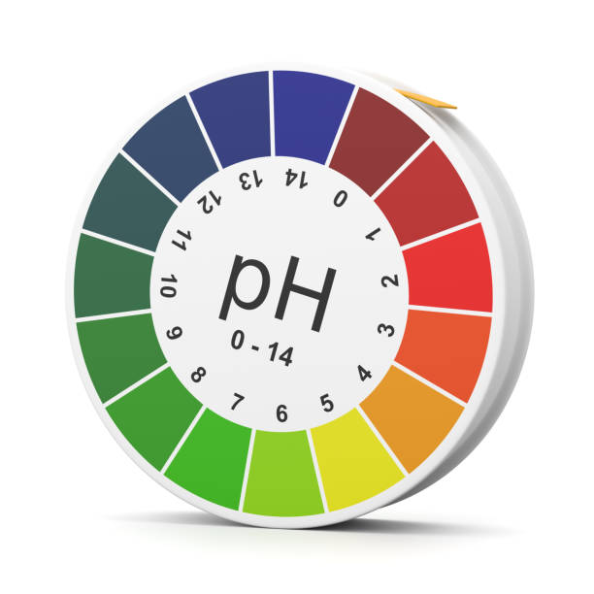
Mentouri Brothers University Constantine I
Institute of Veterinary Sciences
Academic year 2025-2026
DISORDERS
ACID-BASES
Dr. KELLALI Narimane
Assistant Professor "A"

Slide 2
Plan
Buffer systems
Respiratory system
Renal system
Digestive system
Hepatic system
Measurement methods
Acid-base disorders

Slide 3
ACID-BASE BALANCE
The body produces more acids than bases . Therefore, it needs to excrete excess acids .
Many metabolic intermediates and ingested foods are organic acids that will ionize and provide H+ ions (e.g. , amino acids, fatty acids, products of anaerobic metabolism ).
The most important source of acid is the production of CO2 linked to aerobic metabolism.
CO2 combines with water to form carbonic acid, H2CO3
Carbonic anhydrase
CO2 + H2O H2CO3 H+ + HCO3-

Slide 4
ACID-BASE BALANCE
balance is assessed by the concentration of protons (H+) :
Plasma [H+] = 38 – 42 nmol/l
pH = 7.38 - 7.42
The body's adaptation to pH changes is ensured by :
  the body's buffer systems ,
  primarily the respiratory and renal systems
  digestive and hepatic systems , as well as blood electrolytes incidentally.

Slide 5
ACID-BASE BALANCE
There is a timeline for implementing these mechanisms:
  Buffer systems are the first line of defense, limiting large pH variations.
  Ventilation is a rapid response, capable of handling nearly 75% of acid-base balance disturbances.
  The kidneys are much slower to get going. They take care of all the residual pH disturbances.

Slide 6
Buffer systems
systems are solutions containing substances that have the ability to stabilize pH changes by absorbing either strong acids or strong bases.
Acid-base buffers provide resistance to changes in the pH of a solution when hydrogen ions (protons) or hydroxide ions are added or removed .

Slide 7
Buffer systems
Buffer = mixture of weak acid + strong base or mixture of strong acid + weak base
An acid-base buffer typically consists of a weak acid and its conjugate base :
HA + H2O → H3O+ + A-
HA = Acid, H3O + = Acid
H2O = Base, A- = Conjugate Base

Slide 8
Buffer systems
systems make it possible to neutralize an excess or compensate for a lack of H+ concentration, in order to maintain a plasma concentration [H+] between 38 and 42 nmol /L .
Buffer systems can be activated within seconds in case of disturbance of blood pH balance; they represent the body's first line of defense and limit large variations.
Notes:
The body's buffers are able to take in or release H+ ions , thus changing the concentration of free H+ are reduced to a minimum.

Slide 9
Buffer systems
Buffer systems are of two types:
  Extracellular buffers
  Intracellular buffers

Slide 10
Buffer systems
EXTRACELULAR
This system is represented mainly by bicarbonate ions ( HCO3- ).
Bicarbonate ions combine with excess H+ ions to form carbonic acid ( H2CO3 ).
The CO2/HCO3- buffer system is considered very efficient due to the large amount of bicarbonate present in the body and the ability to excrete CO2 formed by the respiratory system (ventilation).

Slide 11
Buffer systems
EXTRACELULAR
This system is responsible for 80% of the extracellular buffering capacity; it is the main player in balancing metabolic acids, but it does not intervene in acid-base imbalances of respiratory origin.
This buffer system is open, does not saturate , is controlled by the lungs and kidneys, and interacts with the hemoglobin/ hemoglobinate system .

Slide 12
Buffer systems
EXTRACELULAR
The acidic component of the carbonic acid/bicarbonate buffer sodium is represented by:
The basic component of the carbonic acid/sodium bicarbonate buffer is represented by:
NaHCO3 H + + NaCO3-
CO2 + H2O H2CO3 H+ + HCO3-

Slide 13
Buffer systems
EXTRACELULAR
At pH 7.4 the concentration of H2CO3 is only a tiny fraction of the concentration of HCO3- and therefore, in appearance, one might think that the blood pH is poorly protected against an influx of OH- ions , but this imbalance is compensated by the CO2 buffer system of the lungs.
Extracellular buffer systems represented by plasma proteins and inorganic phosphates are also found, but in very low activity .

Slide 14
Buffer systems
INTRACELULAR
Cells actively transport H+ and HCO3- across the plasma membrane
A delay of two to four hours is required for buffering from the cells, due to the slowing down caused by cellular penetration.
Hemoglobin​ is a very important intracellular buffer particularly involved in the buffering of carbonic acid .
Hb NH2 + CO2 Hb NHCOO- + H+

Slide 15
Buffer systems
INTRACELULAR
This erythrocyte system is three times more active than the protein system.
Hemoglobin exists in reduced form ( Hb ), oxidized form (HbO2) and bound to CO2 (HbCO2).
At the cellular level, HbO2 releases its O2 and binds an H+ without changing cellular pH, while at the lung level, its oxygenation decreases its buffering capacity: the formation of HbO2 releases H+ which combines with HCO3- and gives H2O and CO2 which will be eliminated by the lung.

Slide 16
Buffer systems
INTRACELULAR
Fabrics:
CO2 + H2O → HCO3- + H+
HbO2 + H+ → HbH + O2
Lungs :
HbH + O2 → HbO2 + H+
HCO3- + H+ → CO2 + H2O

Slide 17
Buffer systems
INTRACELULAR
The phosphate buffer system is important in the intracellular compartment and in the renal glomerulus, due to its high concentration.
It possesses three acidic functions , allowing it to buffer the environment:
H3PO4 H+ + H2PO4- (acts as a weak acid)
H+ + HPO42- (acts as a weak base ) PO43- + H+

Slide 18
Respiratory system
The second regulatory system that kicks in to compensate for an acid-base imbalance is the respiratory system, which acts through alveolar ventilation.
It is a rapid regulation that comes into play within a few minutes if there are sudden variations in pH, and remains optimal between 12 and 24 hours.
It helps to ensure almost 75% of the management of acid-base imbalances.
The lungs compensate for acid-base imbalances by eliminating more or less CO2, in order to prevent the formation of H +

Slide 19
Respiratory system
Hypoventilation (decrease in alveolar ventilation) leads to an increase in PCO2, therefore dissolved CO2, and shifts the equation to the right with an increase in [H+] and a decrease in pH.
Carbonic anhydrase
CO2 + H2O H2CO3 H+ + HCO3-

Slide 20
Respiratory system
Hyperventilation (Increased alveolar ventilation) leads to a decrease in PCO2, and therefore in dissolved CO2 . The equation shifts to the left, thus decreasing [ H +]. and therefore increasing the pH.
Carbonic anhydrase
CO2 + H2O H2CO3 H+ + HCO3-

Slide 21
Respiratory system
To regulate pH, the medullary respiratory center reflexively adjusts alveolar ventilation in response to variations in plasma [H+] and PCO2
This occurs following the stimulation of central and peripheral chemoreceptors.

Slide 22
Respiratory system
Peripheral aortic and carotid chemoreceptors are sensitive to an increase in plasma [H+].
The bulbar respiratory centers are stimulated and cause an increase in alveolar ventilation with an increase in the rate and amplitude of respiratory movements, in order to eliminate excess CO2.

Slide 23
Respiratory system
Central chemoreceptors are stimulated by an increase in PCO2 .
H+ does not cross the blood-brain barrier, but changes in pH alter PCO2 and CO2 stimulates central chemoreceptors.
Central chemoreceptors transmit information to the bulbar respiratory center, which causes an increase in alveolar ventilation and the elimination of CO2.
Notes:
The ventilation adapts very quickly (in 5 seconds), even when the variation in CO2 is minimal.

Slide 24
Respiratory system
Noticed:
While respiration is a mechanism for regulating pH, it can also be a disruptive element in cases of respiratory failure.

Slide 25
Renal System
Maintaining acid-base balance is one of the essential functions of the kidney.
The kidneys constitute a slower (48h) but more durable regulatory system over time than the lungs.
The kidneys take over the 25% of compensation that the lungs did not perform.
They do it in two ways:
  by excreting or reabsorbing H+ ions
  by increasing or decreasing the rate of reabsorption of HCO3- ions

Slide 26
Renal System
Acid-base regulation takes place at the level of the PCT and the DCT.
In the distal convoluted tubules and collecting ducts, there are two types of intercalated cells: type A and type B
These two cell types are rich in carbonic anhydrase and contain H + ATPases . H+/K+ and HCO3 - Cl- exchangers
Type A cells are involved in cases of acidosis, while type B cells are activated in cases of alkalosis.

Slide 27
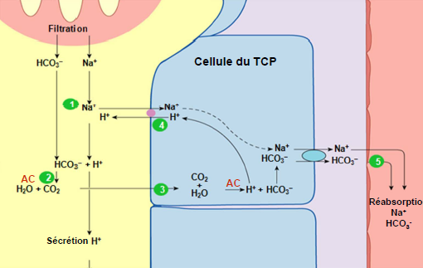
Renal System
Bicarbonate (HCO3-) reabsorption
Occurs in the proximal convoluted tubule.
H+ and HCO3- are produced in proximal cells according to the following reaction:
CO2 + _{H2O} → _{HCO3​}
The reaction is catalyzed by intracellular carbonic anhydrase .
H is secreted by the H-Na exchanger and the HCO3 is reabsorbed .

Slide 28
Renal System
Bicarbonate (HCO3-) reabsorption
In the tubular lumen, the reaction occurs in the reverse direction.
H + _{HCO3 →} CO2 + _{H2O}
The reaction is catalyzed by carbonic anhydrase from the brush border .
CO2 ₊ H2O diffuse inside the cell to restart the cycle .
The result : net reabsorption of filtered HCO3 . However, no net secretion of H+ results from this process.

Slide 29
Renal System
Bicarbonate (HCO3-) reabsorption
_{HCO3} reabsorption .
However, at high plasma concentrations of HCO3 ₍ as in the case of alkalosis) the amount filtered exceeds the renal reabsorption capacity.
The excess HCO3 is therefore excreted in the urine.

Slide 30
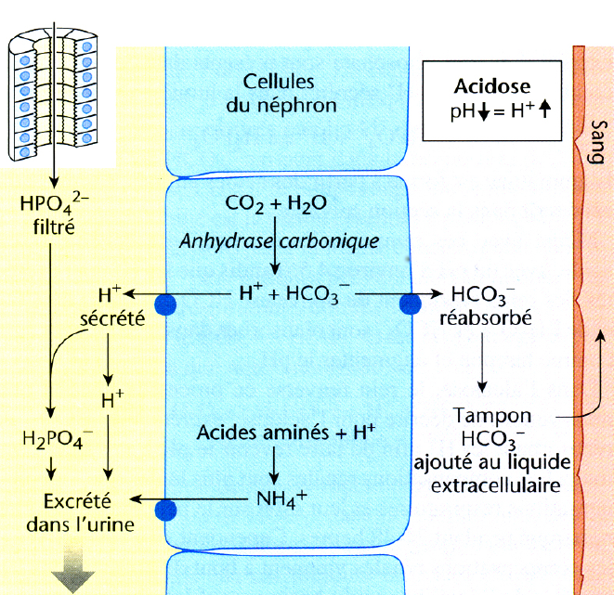
Renal System
The excretion of H+ ions occurs in two ways:
  _{in the} form of titratable acidity NaH2PO4
  in the form of NH4

Slide 31
Renal System
Renal System
  EXCRETION OF H+ IONS IN THE FORM OF ACIDITY
  TITRABLE NaH ₂ PO ₄
  EXCRETION OF H+ IONS IN THE FORM OF ACIDITY
  TITRABLE NaH ₂ PO ₄
It is a mechanism that extracts the fixed H+ produced by the catabolism of proteins and phospholipids.
H+ and HCO3- are produced in the intercalated cell A from CO2 and H2O.
H+ is secreted by an H-ATPase or in exchange for K+ and the HCO3- is reabsorbed into the blood.

Slide 32
Renal System
  EXCRETION OF H+ IONS IN THE FORM OF ACIDITY
  TITRABLE NaH ₂ PO ₄
  The _{secreted H} + combines with Na2HPO4 to form NaH2PO4 which is excreted _{as titratable} acidity .
Result: net secretion of H+ and net reabsorption of newly synthesized HCO3- .
Note : As a consequence of this H+ excretion, the pH of the urine gradually decreases.
Notes:
Their excretion takes place in the form of titratable acidity by the first urinary buffer: disodium phosphate (Na2HPO4) which binds the secreted H+ in exchange for Na+ which is reabsorbed to give monosodium phosphate (NaH2PO4) which is excreted;

Slide 33
Renal System
EXCRETION OF H+ IONS IN THE FORM OF NH4
This is another mechanism that extracts the fixed H+ produced by the catabolism of proteins and phospholipids.
H and HCO3 are produced in the intercalated cell A from _{CO2} and _{H2O} .
THE HCO3 is reabsorbed into the blood and H is secreted by an H-ATPase or in exchange for K+

Slide 34
Renal System
EXCRETION OF H+ IONS IN THE FORM OF NH4
NH3 produced in tubular cells from glutamine passes into the tubular lumen following its concentration gradient .
H+ combines with NH3 to give NH4 + which is excreted.

Slide 35
Renal System
EXCRETION OF H+ IONS IN THE FORM OF NH4
The decrease in tubular pH increases the excretion of H in the form of NH4 + .
  Result: net secretion of H+ and net reabsorption of newly synthesized HCO3- .
Note : In the case of acidosis , there is an adaptive increase in NH3 synthesis in order to increase the elimination of H+.

Slide 36
Renal System
IN CASE OF ACIDOSIS
Intercalated cells A reabsorb HCO3- and K+ ions, which increases the pH and leads to hyperkalemia .
ions are secreted into the tubular lumen using direct and indirect active transport

Slide 37
Renal System
IN CASE OF ALKALOSIS
Intercalated B cells reabsorb H+ ions, which tends to decrease the pH.
Excess HCO3- ions and K+ are excreted
The secretion of potassium, which occurs at the same time as that of bicarbonate, leads to hypokalemia.

Slide 38
In the bicarbonate/carbonic acid buffer system , the pH depends on a ratio between:
The base: bicarbonate (HCO₃⁻)
The acid : dissolved CO₂ ( PCO₂ × 0.03)
This ratio is given by the Henderson- Hasselbalch equation :
pH=6.1+log ([ HCO3−​] ​/0.03×PCO2)
So, what determines pH is not an absolute value of acid or base, but the balance between the two.
This is exactly the ratio that the organism is trying to maintain.

Slide 39
Acid-base balance depends on the ratio :
[ HCO3−]/ 0.03×PCO2
How does Kussmaul hyperventilate ? Can she correct metabolic acidosis if she consumes even more bicarbonate ?
What matters is the HCO₃⁻ / CO₂ ratio, not the total amount of HCO₃⁻ .
  HCO₃⁻ decreases slightly
  PCO₂ drops dramatically
  The ratio increases ⇒ the pH increases ⇒ acidosis is corrected
That's the whole logic behind respiratory compensation.
Notes:
On the other hand, in respiratory acidosis:
HCO₃⁻ ↑ slightly
PCO₂ ↑ enormously
The ratio decreases ⇒ the pH decreases ⇒ acidosis.

Slide 40
Digestive system
Food is transformed throughout the gastrointestinal tract by digestive secretions.
The digestive tract releases massive amounts of acidic or basic solutions. These secretions are then reabsorbed at other levels of the digestive tract.
Salivary secretion provides a significant amount of HCO3-.
At the gastric level, the food that enters the stomach acts as a buffer, the gastric pH rises, which promotes the secretion of gastrin and therefore HCl by the parietal cells.

Slide 41
Digestive system
In return, the parietal cells release HCO3- into the blood, which is responsible for the “ postprandial alkaline wave ”.
These bicarbonates return to the lumen of the DT via pancreatic secretions ( 7.0 < pH < 9.0), which helps to correct the pH of the duodenum and optimize the activity of enzymes in the small intestine .
Thus, each time the digestive system secretes an ion into the lumen, it sends the opposite ion into the blood, thereby maintaining the AB balance.

Slide 42
LIVER SYSTEM
diseases are often associated with imbalances in acid-base balance.
The liver plays a role in regulating protein metabolism .
Proteins are first broken down into amino acids and then into NH3 (ammonia), which in aqueous environments is found in the form of NH4OH.
In water, NH4OH dissociates to give NH4+ and OH-.
The ammonium ion (NH4+) is potentially toxic to the central nervous system, therefore it must be eliminated.
There are two main methods for this elimination:

Slide 43
LIVER SYSTEM
The glutamine cycle :
Glutamine is then transported to the kidney where it is broken down into NH4+ and HCO3-
NH₄⁺ is eliminated in the urine ( acid removal ) and HCO₃⁻ is returned to the blood ( correction of acidosis)
This mechanism is an alkalizing pathway which allows the elimination of NH4+ while sparing HCO3-
In cases of acidosis, the body activates glutamine synthesis more frequently.
Glutamine synthetase​
Glutamate+NH4 +​+ATP ​Glutamine
Notes:
Therefore, glutamine is a kind of vehicle that allows the ammonium ion (acidifying agent) to be transported in a non-toxic form.
down to the kidney, where the body eliminates acid and regenerates bicarbonate .

Slide 44
LIVER SYSTEM
The urea cycle :
This system works when NH4+ concentrations are already high with a risk of toxicity.
This cycle specific to hepatocytes allows the elimination of NH4+ but by carrying away HCO3-, it is an acidifying pathway .
urea synthesis , consumes more HCO₃⁻ and helps to normalize pH .
The liver also plays a role in the metabolism of lactates, which involves the consumption of H+ and therefore, in parallel, the production of HCO3-.
NH4 +​+HCO3−​+3ATP⟶Urea+H2​O+ADP+AMP

Slide 45
Measurement methods

Slide 46
Measurement methods
pH : Potential of hydrogen
Arterial: 7.38 to 7.42,
Venous: 7.35 to 7.37.
PCO2 :
Arterial: 38 to 42 mmHg .
Venous: 45 to 48 mmHg .
Total plasma CO2 : 25 mmol/L
Standard whole blood bicarbonate : This is the amount of bicarbonate measured in vivo at PO2=100, PCO2=40 and T°=37°. Normal value: 24 to 26 meq /L.

Slide 47
Measurement methods
Alkaline reserves : This is a biochemical entity corresponding to the total CO2 content of the plasma . It corresponds to 95% of the bicarbonate level .
Base excess or deficit : Amount of base that must be added to whole blood to bring the pH back to its physiological value.
Total buffering capacity : This is the sum of total blood bicarbonate, proteinates , and hemoglobin : Normal value: 45 to 50 Meq /L

Slide 48
Measurement methods
Anion gap : This is the fraction of unmeasured anions required for the balance of positive charges of Na + (and K+).
  TA = (Na+ + K+) - (Cl- + HCO3-): ~ 12-16 mmol/L
  It corresponds primarily to serum proteins.
  It represents the concentration of anions present in the plasma and classically not measured in the normal ionogram (lactic acid, ketone bodies, organic acids ...).
When an endogenous anion ( not measured in the ionogram) increases or an exogenous anion appears, the anion gap increases.

Slide 49
ACID-BASE DISORDERS

Slide 50
ACID-BASE
DISORDERS
Changes variously associated with blood concentrations of H+ ions, bicarbonates and PCO2, responsible for variations in blood pH value.
Acid-base imbalances are found in multiple situations and involve multiple mechanisms.
  are minor and do not require specific treatment other than treating the underlying cause.
  Major , they can be life-threatening and require treatment aimed at correcting the disorder simultaneously with etiological treatment

Slide 51
ACID-BASE
DISORDERS
Acidosis and alkalosis are defined according to their etiology.
If they are a consequence of a variation in PCO2, then they are respiratory.
If they result from a variation in bicarbonate levels, they are metabolic.

Slide 52
Metabolic acidosis: DEFINITION
Lowering of blood pH below 7.38 and of plasma bicarbonates below 21 mEq /L.
The decrease in pH is due to an increase in plasma (arterial) H+ concentration by overproduction or increased ingestion of fixed acids or insufficient elimination.
HCO3- is used to buffer excess fixed acids, therefore [HCO3-] decreases.

Slide 53
Metabolic Acidosis : Etiology
Excess production of H+:
Ketotic acidosis (diabetes, fasting)
Lactic acidosis : tissue anoxia during acute hypoxemia (pulmonary edema, asthma), acute circulatory failure (shock, circulatory arrest)

Slide 54
Metabolic Acidosis : Etiology
Excessive intake :
  Food (meat, egg yolk ), Iatrogenic (transfusion)
Insufficient elimination :
  Hypochloremic acidosis : Chronic or Acute Renal Failure
  acidosis : hyperparathyroidism, vitamin D intoxication
  Hyperchloremic acidosis : interstitial nephropathy .

Slide 55
Metabolic Acidosis : Pathophysiology
Remarks:
Urinary pH is low in cases of metabolic acidosis (<5.3).
A high pH (>6) indicates a kidney abnormality.

Slide 56
Metabolic ACIDOSIS: Clinical signs
Typical functional signs
The fundamental sign is dyspnea of Kussmaul , ample, deep and slow.
It is a manifestation of alveolar hyperventilation intended to eliminate CO2.
The general signs and physical signs depend on the etiology of the acidosis.

Slide 57
Metabolic ACIDOSIS: Clinical signs
By complication
Torpor, coma or sudden collapse due to myocardial depression and vasodilation are only seen at very low pH levels.
Indeed , the catecholamines secreted in cases of acidosis become ineffective due to the acidosis itself.

Slide 58
Metabolic ACIDOSIS: Biological signs
Biology allows for diagnosis by showing a concomitant decrease in pH, bicarbonates, and PCO2 .
Hyperkalemia is common.
The plasma anion gap must be determined in any case of metabolic acidosis.

Slide 59
Metabolic ACIDOSIS: Biological signs
acidoses with increased anion gap (18 mEq /l) are due to abnormal retention of phosphates , sulfates or organic acids .
The increase in unmeasured anions is equivalent to the decrease in bicarbonate and the chloremia remains normal .
Conversely, metabolic acidoses with a normal anion gap are always hyperchloremic because the consumed HCO3- is replaced by chloride.

Slide 60
Metabolic ACIDOSIS:
REGULATION
Initially : buffering of H+ ions : by bicarbonates and non-bicarbonate bases (Na+ lactate )
In a second stage : Respiratory compensation : Küssmaul hyperventilation following stimulation of chemoreceptors thus eliminating CO2.
In a third stage : if the cause of acidosis persists: the kidney intervenes by eliminating H+ and supplying bicarbonates.

Slide 61
Metabolic ACIDOSIS:
Diagnosis
Biology :
Uncompensated acidosis:
  pH↓,
  PO2 Normal
  Normal PCO2
  Bicarbonates ↓↓
Compensated acidosis :
  Normal pH
  PO2 Normal
  PCO2↓,
  Bicarbonates ↓

Slide 62
Metabolic ACIDOSIS: treatment
Etiological treatment +++
Extra renal purification (in case of IR)
Alkalization : HCO3Na, Sodium lactate.

Slide 63
RESPIRATORY ACIDOSIS
Due to a primary decrease in respiratory flow and CO2 retention, leading to an increase in arterial PCO2 and consequently an increase in H + and HCO3- concentrations
Etiology :
  Global alveolar hypoventilation :
    central (head trauma, cerebral)
    neuromuscular (myasthenia gravis)
  hypoventilation of bronchopulmonary origin :
    failure , Tuberculosis, Asthma.

Slide 64
RESPIRATORY ACIDOSIS: Regulation
Initially : buffering of H + ions by bicarbonates and non-bicarbonate bases ,
Secondly : Compensation by the kidney.
There is no respiratory compensation for respiratory acidosis

Slide 65
RESPIRATORY ACIDOSIS: CLINICAL PRESENTATION
Signs of hypercapnia:
  tachycardia ,
  sweats ,
  arterial hypotension
Signs of hypoxia:
  polypnea ,
  cyanosis ,
  anxiety , agitation,

Slide 66
RESPIRATORY ACIDOSIS
Biology:
  PH ↓,
  PCO2 ↑,
  HCO3- ↑ (compensatory)
  PaO2 or ↓
Treatment :
  Oxygen therapy
  artificial ventilation

Slide 67
METABOLIC ALKALOSE
A decrease in plasma (arterial) H+ concentration therefore leads to an increase in pH following an increase in buffer bases in the blood.

Slide 68
alkalosis : etiology
Primary bicarbonate overload :
  intake of alkalis: excessive bicarbonate infusion
  Reventilation alkalosis : artificial ventilation of a subject in chronic hypercapnia with hyperbasemia .
Loss of H+:
  vomiting ,

Slide 69
alkalosis : etiology
Loss :
  depletion : diuretic abuse
  Potassium depletion
  Hyperaldosteronism (dehydration).
alkalose :
  extracellular dehydration

Slide 70
METABOLIC ALKALOSIS : REGULATION
It uses buffer acids,
Respiratory compensation is limited by hypoxemia.
The kidney intervenes within 24 hours by decreasing the reabsorption of bicarbonates and increasing the reabsorption of H+.

Slide 71
Metabolic alkalosis : diagnosis
Clinical presentation: inconsistent
  Bradypnea ,
  tetany ,
  signs of hypercapnia and hypoxia.
Biology:
  pH ↑,
  Bicarbonates ↑,
  PCO2 and PO2

Slide 72
METABOLIC ALKALOSIS : TREATMENT
treatment +++
therapy :
  KCl , (restitution of capital Cl and K)
  Hydro-sodium intake

Slide 73
RESPIRATORY ALKALOSIS
Increase in pH following increased CO2 elimination caused by a primary increase in ventilatory flow rate .

Slide 74
ALKALOSIS : ETIOLOGY
Alveolar hyperventilation :
  Mechanical (Artificial Ventilation),
  Central (Trauma )
  metabolic (intoxication, hepatic encephalopathy)
Acute hypoxemia :
  Acute Pulmonary Edema (APE),
  Stay at high altitude
  Acute pneumonia.

Slide 75
ALKALOSIS : REGULATION
Intervention of buffer acids.
Later the kidney intervenes by eliminating bicarbonates and decreasing H+ secretion
There is no respiratory compensation for respiratory alkalosis

Slide 76
ALKALOSIS :
Clinic :
  polypnea ,
  headache ,
  vertigo ..
Biology:
  pH ↑,
  PaCO2 ↓,
  PaO2 (Normal, ↓ or ↑)
  Normal Bicarbonates
  K +↓,
  Cl –↑,
  Na + Normal.

Slide 77
