Slide 1
STRUCTURAL
BIOCHEMISTRY
Biochemistry course A1 DV ; Prof A. MEKROUD , 2025/2026
By
A MEKROUD
Teacher
Institute of Veterinary Sciences
University Mentouri brothers Constantine 1

Slide 2
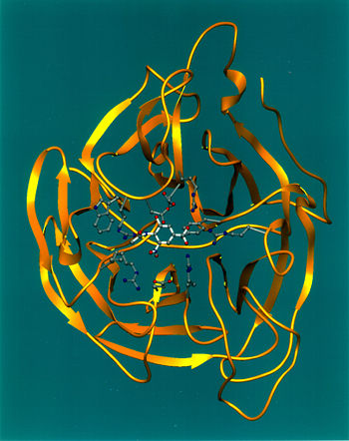
What is biochemistry?
Biochemistry course A1 DV ; Prof A. MEKROUD , 2025/2026
This is the chemistry of life. A very ancient science . It studies the main organic molecules ( the major groups: carbohydrates, lipids, proteins, enzymes, vitamins, and minerals ).
Their structural aspects, their interactions, their physicochemical properties, and the ways in which these molecules are transformed within the organism

Slide 3
Biochemistry course A1 DV ; Prof A. MEKROUD , 2025/2026
HISTORICAL
The term was coined in 1903 by Carl Neuberg according to the Greek root Βιοχημεί α
( biochemia )
Several major subdivisions of this discipline can be distinguished:
energy ( energy production by the cell )
enzymology​ (or study of biological catalysts )
Metabolism , divided into
anabolism, reactions for the synthesis of molecules
Catabolism , reactions that break down molecules.
These large groups then subdivide into increasingly specialized areas.
As an example, modern enzymology attempts to link the three-dimensional structure
of a protein with its function.
The main categories of molecules studied in biochemistry are carbohydrates ,
lipids , proteins​ and nucleic acids . These molecules are made up of
essentially carbon, oxygen, and nitrogen. These classes of molecules represent
The fundamental elements of the cell; moreover, the mineral elements are
divided into two groups, macroelements, and microelements (also called
trace elements) that is to say gold, iron, zinc which exist in trace amounts in our
body.

Slide 4
Biochemistry course A1 DV ; Prof A. MEKROUD , 2025/2026
HISTORICAL
The idea that the activity of "living matter" arising from chemical reactions is
quite old ( Réaumur, Spallanzani , etc.). The synthesis of urea , achieved in 1828
by the German chemist Friedrich Wöhler , will be one of the most significant confirmations of this.
decisive actions carried out at 19th century .
Another German, Justus Von Liebig will be the promoter of a new science,
biochemistry , which will be a field in which several of his compatriots will
to distinguish themselves up until the Second World War. Among the most famous, we will remember Hermann Emil Fischer (the famous Fischer projection of carbohydrates), Eduard Buchner
(biochemistry of fermentation) and Richard Willstätter ( mechanism of reactions
enzymatic).
From this period onwards, the exploration of the cell experienced a new boom.
but we will focus primarily on its chemical constituents and the way in which
which they react with each other to carry out metabolism at the cellular level.

Slide 5
Biochemistry course A1 DV ; Prof A. MEKROUD , 2025/2026
HISTORICAL
Otti Warburg introduced cellular chemistry and the microrespirometer at the
at the disposal of researchers. This device will help the German Hans Adolph Krebs to elucidate the energy of a single molecule, adenosine triphosphate or ATP,
discovered in 1929 by K Karl Lohmann .
In the early 1940s , Albert Claude shows that ATP synthesis
unfolds at the level of the inner mitochondrial membrane . In the same
time, the British Peter Michell explains the mechanism of this reaction, which is accompanied by the formation of water.

Slide 6





Biochemistry course A1 DV ; Prof A. MEKROUD , 2025/2026
GENERAL DATA
CHEMICAL FUNCTIONS
In organic chemistry , a functional group is a sub -molecular structure
consisting of an assembly of atoms data that provides its own
to the molecule that contains it.
Hydroxyl group (OH):
This grouping can be found in two main classes of compounds :
Alcohols and phenols
Carbonyl group R-CO-R' or
If R' = H
= Aldehydes
If R' ≠ H and OH
= Ketones

Slide 7

Biochemistry course A1 DV ; Prof A. MEKROUD , 2025/2026
Carboxyl group R-COOH
Group that characterizes acidic compounds
Amine groups and nitrogen compounds
Amines are nitrogenous compounds that are formally derived from ammonia _{NH3} by
replacement of one or more hydrogen atoms by carbon groups. The number
The number of hydrogen atoms bonded to nitrogen defines the class of the amine.
Sulfur groups
The main ones among these are the THIOLS (--SH) groups. They are capable of
to give salts with heavy metals, thio-esters with carboxylic acids,
Dithioacetals with aldehydes

Slide 8
Biochemistry course A1 DV ; Prof A. MEKROUD , 2025/2026
GENERAL CONCEPTS ABOUT WATER , ELECTROLYTES,
ACIDS AND BASES
WATER :​
It is the main constituent of living organisms since it represents on average
over 80% of their mass. In addition , this liquid exhibits reactive properties .
Of vital importance in all biological processes. Water is an excellent solvent
For ions and molecules with polar groups that can contract with it.
Water is a vital element for all living organisms because most reactions
biochemical processes take place in an aqueous environment.
ELECTROLYTES:
These are sets of chemical structures that can undergo dissociation under
form of ions , and this occurs when they are dissolved in a solution. This mechanism of
Electrolytic dissociation is fundamental to understanding metabolism .​​​
They are made up of atoms joined together by electrostatic bonds .
When they are dissolved in certain solvents called ionizing solvents, these ions...
They partially or totally dissociate into positively or negatively charged ions .

Slide 9
Biochemistry course A1 DV ; Prof A. MEKROUD , 2025/2026
ACIDS AND BASES; AMPHOTORES:
An acid is an element which , in solution, is capable of releasing a proton (H + ⁾ .
A base is an element that can release hydroxyl groups ( ^{OH-} ) in solution .
(according to Arrhenius , late ^{19th} century ⁾ (sci è cle )
Brønsted has somewhat modified this notion:
Acid, releases one or more protons
Base, accepts one or more protons
AH + B: A ⁻ : + BH
(acid) (base) acid base
conjugated conjugated​​​​

Slide 10
THE CARBOHYDRATES
Biochemistry course A1 DV ; Prof A. MEKROUD , 2025/2026
1. DEFINITION & ROLES
Carbohydrates constitute a group of substances whose basic units are simple sugars called monosaccharides.
Carbohydrates are present everywhere in the biosphere and represent by weight the predominant class among organic molecules.
Carbohydrates play several key roles in cells:
They serve as energy reserves in polymerized form: starch and glycogen . Starch is the primary form of energy storage.

Slide 11
Biochemistry course A1 DV ; Prof A. MEKROUD , 2025/2026
THE CARBOHYDRATES
They play a role as structural elements of the cell: mucopolysaccharides in higher animals, cellulose in plants.
They act as elements of recognition and communication between cells: blood group polysaccharides, antigenic polysaccharides of bacteria.
Finally, they are an integral part of the structure of many fundamental biological macromolecules such as glycoproteins, nucleic acids (ribose and deoxyribose), coenzymes and antibiotics.

Slide 12
Importance in Biology
Biochemistry course A1 DV ; Prof A. MEKROUD , 2025/2026
Energy role
  40 to 50% of the calories provided by human food are carbohydrates.
  They have a role as an energy reserve in the liver and muscles (glycogen).
Structural role
Carbohydrates play a role in:
  Supporting (cellulose), protective and recognition elements in the cell.
  Reserve elements of plants and animals (glycogen, starch).
  Components of fundamental molecules: nucleic acids, coenzymes, vitamins, …
Economic role
  Cellulose: billions of tons/year
  Starch, sucrose: millions of tons/year.

Slide 13
Carbohydrates
Biochemistry course A1 DV ; Prof A. MEKROUD , 2025/2026
SIMPLE SUGARS
COMPLEX SUGARS
DARE
OSIDES

Slide 14
THE OSES
Biochemistry course A1 DV ; Prof A. MEKROUD , 2025/2026
Definition :
Compounds with n Carbons possessing n-1 OH functions and a carbonyl function.
Nomenclature:
relies on the number of carbon atoms in the sugar and the nature of the carbonyl.
The number of carbon atoms: 3C ( triose ); 6C ( hexose )
The nature of the carbonyl: Aldehyde = Aldose; Ketone = Ketose
The combination of these two criteria characterizes the disease:
  Aldopentose, Aldohexose , …
  Ketopentosis , Ketohexosis , …

Slide 15
Biochemistry course A1 DV ; Prof A. MEKROUD , 2025/2026
Dare
H
H
O
HC-OH
C
C=O
HC-OH
HC-OH
HC-OH
H
H
glyceraldehyde
(aldose)
dihydroxyacetone
(ketosis)

Slide 16
Biochemistry course A1 DV ; Prof A. MEKROUD , 2025/2026
CARBOHYDRATES
carbohydrates are
polyhydroxyaldehydes
polyhydroxyketones
The chemical formula of carbohydrates is generally C _{<sub>m</sub>} (H _{<sub>2</sub>} O) _{<sub>n</sub>,} hence the name carbohydrate.
They are also called saccharides.
(Greek: sakkharon means sugar)
We can distinguish:
monosaccharides
1
10
>10
oligosaccharides
polysaccharides

Slide 17
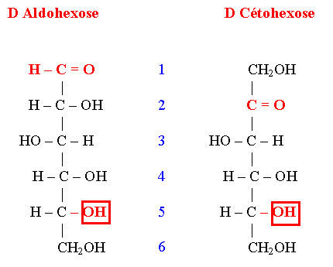
THE OSES
Linear structure of sugars
Biochemistry course A1 DV ; Prof A. MEKROUD , 2025/2026

Slide 18
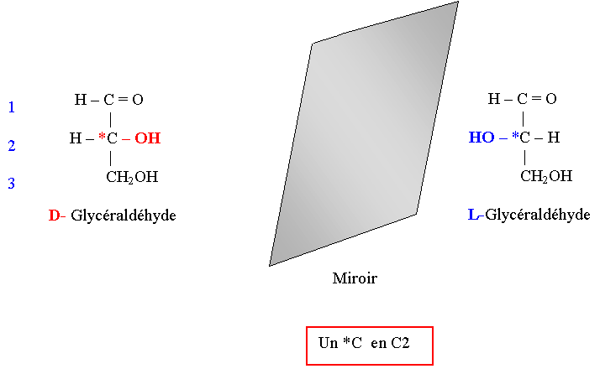
Glyceraldehyde Structure
Biochemistry course A1 DV ; Prof A. MEKROUD , 2025/2026

Slide 19
Biochemistry course A1 DV ; Prof A. MEKROUD , 2025/2026
H
O
1
C
glyceraldehyde
(aldose)
2
HC-OH
3
HC-OH
H
C2 is a carbon atom that has 4 different substituents. This molecule therefore has 2 optical isomers, or enantiomers, or stereoisomers.

Slide 20
Asymmetric
Biochemistry course A1 DV ; Prof A. MEKROUD , 2025/2026
It carries 4 different radicals (example: C2 of glyceraldehyde)
Therefore, for each asymmetric carbon , there is an uncertainty on the orientation of the OH group (either on the right or on the left = 2 possibilities).
To calculate the number of isomers: 2*
( 2: positions of the OH groups on the asymmetric carbon; *: number of asymmetric carbons in the sugar)
Examples for glyceraldehyde = 2 ¹ isomers
For 1 aldopentose =
For an aldohexose =
For ketoheptosis =
For ketotetrosis =
In the case of ketoses, the possibility of lineage is the same but the number of isomers is lower than for aldoses with the same number of C. This is related to the fact that in ketoses, there is one less asymmetric C than in aldoses (C which carries the ketone function).
Example: xylose and ribulose

Slide 21
A reminder about asymmetric carbon
Biochemistry course A1 DV ; Prof A. MEKROUD , 2025/2026
Optical isomers or enantiomers
  Dextrorotatory isomer (+)
  Levorotatory isomer (-)
  Equimolecular mixture of the 2 isomers: Racemic (DL) inactive on polarized light.
A chiral molecule is an optically active molecule:
  It contains at least 1 asymmetric carbon
  It has no plane of symmetry.
Stereochemical configuration and optical rotation of a sugar
Apart from glyceraldehyde, there is no relationship between the stereochemical configuration of the sugar and its optical rotation.

Slide 22

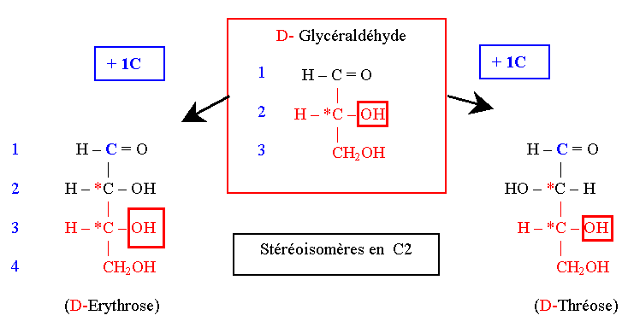
Chemical parentage of sugars according to Fischer
Biochemistry course A1 DV ; Prof A. MEKROUD , 2025/2026
1. Formation from D-Glyceraldehyde (by adding successive Cs)
2. One Triose Two Tetroses

Slide 23
Consequences of the lineage of the oses
Biochemistry course A1 DV ; Prof A. MEKROUD , 2025/2026
Since each sugar (specifically the aldoses ) is attached
has an initial glyceraldehyde molecule ;​​​​ the molecules in
The flowing ones will all be from the D or L series depending
on whether the OH is carried
by the C _{n-1} , is carried Right or left . All carbons
appearing during the elongation of the carbon chain will be
asymmetric​​ and therefore creates two possibilities per carbon
asymmetric​​ added :​
Number of possible isomers : 2n​
2: represents the two possible positions of the OH
n : represents the number of
Example : Ketohexose , aldoheptose , ketotetrose , aldopentose

Slide 24
Series D and L of the oses
Biochemistry course A1 DV ; Prof A. MEKROUD , 2025/2026
Dares from the D series
  They are related to D-Glyceraldehyde: the spatial configuration of the hydroxyl group carried by the subterminal C of the sugar (or Carbon n-1) is identical to that of D-Glyceraldehyde.
  The vast majority of natural sugars are of the D series.
Dares from the L series
  They are chemically derived from L-Glyceraldehyde.
  By successive addition of a carbon, at each step the formation of 2 isomers is obtained (1 triose 2 tetroses 4 pentoses 8 hexoses).

Slide 25
Biochemistry course A1 DV ; Prof A. MEKROUD , 2025/2026
CARBOHYDRATES
Fisher's projections
CHO
CHO
horizontal connection above the plane
of the sheet
*
*
HC-OH
HO-CH
CH2OH​​
CH2OH​​
vertical connection below the
sheet plan
D-glyceraldehyde
D
L-glyceraldehyde
L
Formulas in perspective
CHO
CHO
CHO
R
CHO
S
*
*
HC OH
HO CH
H
OH
OH
C
CH2OH​​
CH2OH​​
C
H
D-glyceraldehyde
L-glyceraldehyde
CH2OH​​
CH2OH​​

Slide 26
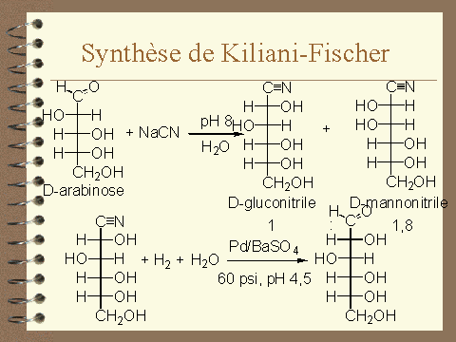
Chemical parentage of sugars according to Fischer
Biochemistry course A1 DV ; Prof A. MEKROUD , 2025/2026
Chain elongation by the addition of successive carbons (action of hydrogen cyanide HC=N), on the side of the carbonyl group
Summary by KILIANI-FISCHER
CHO + HCN CHOH—C=N

Slide 27
Biochemistry course A1 DV ; Prof A. MEKROUD , 2025/2026
CARBOHYDRATES
3 carbons
4 carbons
5 carbons
CHO
CHO
CHO
CHO
HC-OH
HC-OH
HO-CH
HO-CH
HC-OH
HC-OH
HO-CH
CHO
CHO
HO-CH
HC-OH
HC-OH
HO-CH
CHO
HO-CH
HC-OH
HC-OH
HO-CH
HO-CH
HC-OH
HC-OH
HC-OH
HC-OH
HC-OH
HC-OH
HC-OH
CH2OH​​
CH2OH​​
CH2OH​​
CH2OH​​
CH2OH​​
CH2OH​​
CH2OH​​
D-glyceraldehyde
D-erythrosis
D-threosis
D-ribose
D-arabinose
D-xylose
D-lyxose
6 carbons
CHO
CHO
CHO
CHO
CHO
CHO
CHO
CHO
HC-OH
HC-OH
HO-CH
HO-CH
HC-OH
HC-OH
HO-CH
HO-CH
HC-OH
HC-OH
HO-CH
HO-CH
HC-OH
HC-OH
HO-CH
HO-CH
HC-OH
HC-OH
HO-CH
HO-CH
HC-OH
HC-OH
HO-CH
HO-CH
HC-OH
HC-OH
HC-OH
HC-OH
HO-CH
HO-CH
HO-CH
HO-CH
HC-OH
HC-OH
HC-OH
HC-OH
HC-OH
HC-OH
HC-OH
HC-OH
CH2OH​​
CH2OH​​
CH2OH​​
CH2OH​​
CH2OH​​
CH2OH​​
CH2OH​​
CH2OH​​
D-allose
D-altrose
D-glucose
D-mannose
D-gulose
D-idose
D-galactose
D-talose

Slide 28
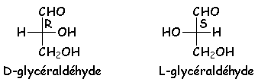
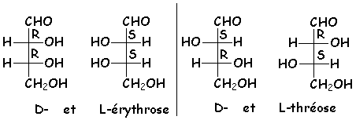
Biochemistry course A1 DV ; Prof A. MEKROUD , 2025/2026
Glyceraldehyde​​​​
It is the simplest of the sugars. A single asymmetric carbon . : two
enantiomers , R and S , represented in Fischer in the following way :
aldehyde function will always be placed at the top of the vertical line,
the _{terminal CH2OH} , at the bottom for all sugars , the position of the OH of the
( n-1) ^{th carbon} allows us to define the nomenclature according to Fischer :D
if this OH is to the right of the vertical line, and L if it is to the left.
It will be noted that in Fischer, and for all bones whatsoever , the
Carbons are R if OH is to the right , and S if OH is to the left of this
vertical line .
The tetroses​​
There are 4 stereoisomers , grouped together​​​​
in two pairs of enantiomers : the two erythroses
(D : 2R3R and L : 2S3S) and the two threoses ( D : 2S3R and L (2R3S) :

Slide 29
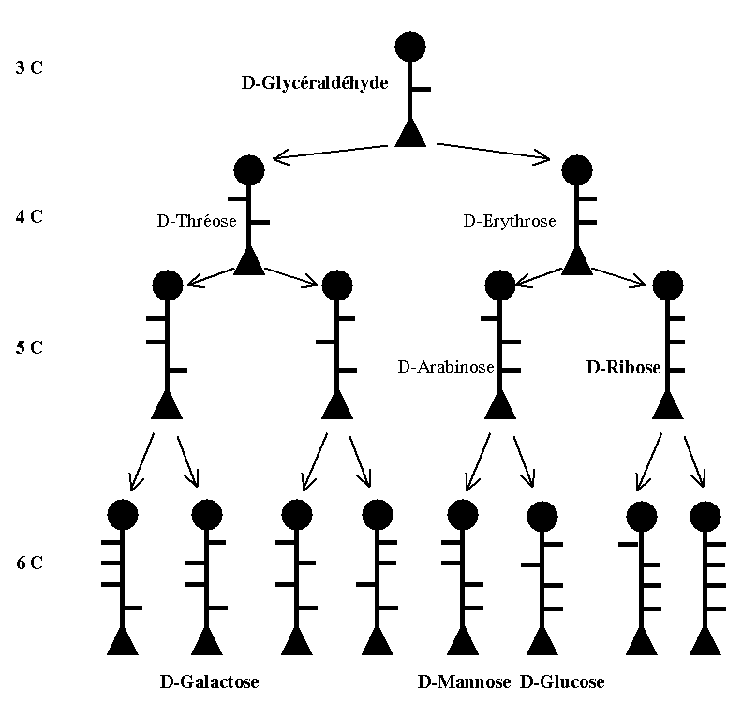
Biochemistry course A1 DV ; Prof A. MEKROUD , 2025/2026

Slide 30
Biochemistry course A1 DV ; Prof A. MEKROUD , 2025/2026
Starting from ketosis
3 carbons
4 carbons
5 carbons
CH2OH​​
CH2OH​​
CH2OH​​
C=O
C=O
CH2OH​​
C=O
HC-OH
HO-CH
C=O
HC-OH
HC-OH
HC-OH
CH2OH​​
CH2OH​​
CH2OH​​
CH2OH​​
dihydroxyacetone
D-erythrulose
D-ribulose
D-xylulose
6 carbons
CH2OH​​
CH2OH​​
CH2OH​​
CH2OH​​
C=O
C=O
C=O
C=O
HC-OH
HO-CH
HC-OH
HO-CH
HC-OH
HC-OH
HO-CH
HO-CH
HC-OH
HC-OH
HC-OH
HC-OH
CH2OH​​
CH2OH​​
CH2OH​​
CH2OH​​
D-psicosis
D-fructose
D-sorbose
D-tagatose

Slide 31
Biochemistry course A1 DV ; Prof A. MEKROUD , 2025/2026
Glucose epimers
1
1
1
CH O
CH O
CH O
H O -CH
HC- O H
HC- O H
H O -CH
H O -CH
H O -CH
HC- O H
HC- O H
H O -CH
HC- O H
HC- O H
HC- O H
CH2OH​​​
CH2OH​​​
CH2OH​​​
6
6
6
D-mannose
D-glucose
D-galactose
epimer at C2
C4 epimer​

Slide 32
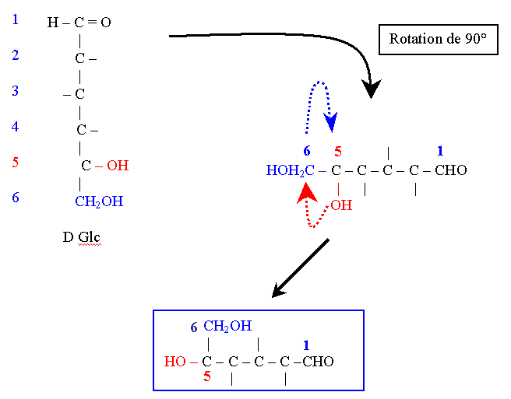
Cyclic structure of sugars:
Haworth structure
Biochemistry course A1 DV ; Prof A. MEKROUD , 2025/2026
The structure is
convex towards
the observer.
By this convexity
C1 and C6 are
relatives in
space. The
rotation of
valences around
The C5 allows
put on a
same plan
participating atoms
to cycling, that is
: the C1, the C5 and
C5 Oxygen .

Slide 33
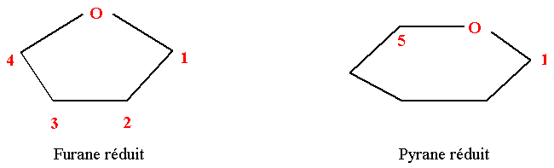
Cyclic structure of sugars according to Haworth
Biochemistry course A1 DV ; Prof A. MEKROUD , 2025/2026
Two cyclic structures are possible.
The pyranic shape corresponds to a heterocycle with 6 vertices ( 5 C and 1 O).
The furanic form corresponds to a heterocycle with 5 vertices ( 4 C and 1 O).

Slide 34
Biochemistry course A1 DV ; Prof A. MEKROUD , 2025/2026
GLUCOSE CYCLIZATION
H
6
5
C
CH2OH​​
H
OH
C ₅
4
C
CHO
C ₄
OH
H
1
HO
C
C
3
2
H
HO

Slide 35
Biochemistry course A1 DV ; Prof A. MEKROUD , 2025/2026
GLUCOSE CYCLIZATION
CH2OH​​
5
6
C
OH
H
H
4
C
CHO
OH
H
1
HO
C
C
3
2
H
HO

Slide 36
Biochemistry course A1 DV ; Prof A. MEKROUD , 2025/2026
CYCLING
GLUCOSE
H
1
C=O
6
CH2OH​​
2
HC-OH
5
3
C OH
H
HO-CH
H
H
4
C
C=O
HC-OH
4
OH
H
5
1
HC -OH
HO
C
C
6
3
2
CH2OH​​
H
HO
D-glucose
linear form

Slide 37
Biochemistry course A1 DV ; Prof A. MEKROUD , 2025/2026
CYCLING
GLUCOSE
+
H
H
1
C=O
6
CH2OH​​
2
HC-OH
5
3
C OH
H
HO-CH
H
H
4
C
C=O
HC-OH
4
OH
H
5
1
HC -OH
HO
C
C
6
3
2
CH2OH​​
H
HO
D-glucose
linear form

Slide 38
Biochemistry course A1 DV ; Prof A. MEKROUD , 2025/2026
CYCLING
GLUCOSE
H
1
C=O
6
CH2OH​​
2
HC-OH
5
+
3
C OH
H
HO-CH
H
H
H
4
C
CO
HC-OH
4
OH
H
5
1
HC -OH
HO
C
C
6
3
2
CH2OH​​
H
HO
D-glucose
linear form

Slide 39
Biochemistry course A1 DV ; Prof A. MEKROUD , 2025/2026
CYCLING
GLUCOSE
H
1
C=O
6
CH2OH​​
2
HC-OH
5
3
C
O
H
H
HO-CH
H
H
H
+
4
C
CO
HC-OH
4
OH
H
5
1
HC -OH
HO
C
C
6
3
2
CH2OH​​
H
HO
D-glucose
linear form

Slide 40
Biochemistry course A1 DV ; Prof A. MEKROUD , 2025/2026
CYCLING
GLUCOSE
H
1
C=O
6
CH2OH​​
2
HC-OH
H
5
3
C O
H
HO-CH
H
H
H
4
C
+
CO
HC-OH
4
OH
H
5
1
HC -OH
HO
C
C
6
3
2
CH2OH​​
H
HO
D-glucose
linear form

Slide 41
Biochemistry course A1 DV ; Prof A. MEKROUD , 2025/2026
CYCLING
GLUCOSE
H
1
6
C=O
CH2OH​​
2
HC-OH
H
5
3
C O
H
HO-CH
H
H
+
H
4
C
CO
HC-OH
4
OH
H
5
1
HC -OH
HO
C
C
6
3
2
CH2OH​​
H
HO
D-glucose
linear form

Slide 42
Biochemistry course A1 DV ; Prof A. MEKROUD , 2025/2026
CYCLING
GLUCOSE
H
1
+
C=O
6
H
CH2OH​​
2
HC-OH
5
3
C O
H
HO-CH
H
H
H
*
4
C
CO
HC-OH
4
OH
H
5
1
HC -OH
HO
C
C
6
3
2
CH2OH​​
H
HO
D-glucose
linear form

Slide 43
Biochemistry course A1 DV ; Prof A. MEKROUD , 2025/2026
CH2OH​​
6
CYCLING
GLUCOSE
β -D-glucopyranose
5
C O
OH
H
H
H
1
4
C
C
1
C=O
6
OH
H
CH2OH​​
HO
H
2
C
C
HC-OH
2
5
3
3
C OH
H
HO-CH
H
H
HO
H
mutarotation
Pyrenean
4
C
C=O
6
CH2OH​​
HC-OH
4
OH
H
5
1
5
HC -OH
HO
C O
C
C
H
H
6
3
2
CH2OH​​
H
HO
H
4
C
C
1
OH
H
D-glucose
linear form
HO
OH
C
C
3
2
α -D-glucopyranose
H
HO

Slide 44
Biochemistry course A1 DV ; Prof A. MEKROUD , 2025/2026
The anomer called α is the compound for which, in linear representation, the OH group attached to the anomeric carbon (carbon 1 for glucose) projects to the same side that the OH carried by the carbon which defines the series (carbon 5 for glucose).
H
OH
6
CH2OH​​
1
C
5
C O
H
2
H
HC-OH
SAME SIDE
H
3
4
C
C
1
HO-CH
ηασ
OH
H
HO
OH
4
C
C
HC-OH
3
2
5
H
HO
HC -O
6
α -D-glucopyranose
CH2OH​​

Slide 45
Biochemistry course A1 DV ; Prof A. MEKROUD , 2025/2026
FORMATION OF A HEMIACETAL
OH
*
R'-C=O + HO-R
R'-C-OR
H
H
aldehyde
alcohol
hemiacetal
6
CH2OH​​
6
CH2OH​​
β -D-glucopyranose
5
5
C O
H
C O
OH
H
H
H
H
4
C
C
1
ANOMERES
4
C
C
1
OH
H
OH
H
HO
OH
HO
H
C
C
C
C
3
2
3
2
H
HO
α -D-glucopyranose
H
HO

Slide 46
Biochemistry course A1 DV ; Prof A. MEKROUD , 2025/2026
Page 10
The cyclization of sugars results in the appearance of a
New possibility of asymmetry at the C1 level
α AND β
This is a form of isomerism. It is a consequence of the cyclic structure . Depending on whether the hydroxyl group is positioned above or below the plane of the heterocycle, it is referred to as alpha or beta anomerism .
IT IS IMPORTANT TO REMEMBER THAT ANOMERIA DOUBLES THE NUMBER OF ISOMERS
EX: aldohexose = 2 ⁴ = 16. Considering the anomeric effect , there are (16 α and 16 β = 32 ).

Slide 47
Biochemistry course A1 DV ; Prof A. MEKROUD , 2025/2026
CYCLING
FRUCTOSE
1
CH2OH​​
1
2
H
6
CH2OH​​
C=O
CH2OH​​
3
5
C
C=O
HO-CH
H
HO
2
4
HO
HC-OH
C
C
4
3
5
H - C - OH
OH
H
6
CH2OH​​
D-fructose
linear form

Slide 48
Biochemistry course A1 DV ; Prof A. MEKROUD , 2025/2026
CYCLING
FRUCTOSE
1
CH2OH​​
6
1
2
CH2OH​​
CH2OH​​
C=O
OH
3
C
C=O
cycling
HO-CH
5
H
HO
2
4
H
HC-OH
C
C
4
3
5
H - C - OH
OH
H
6
CH2OH​​
D-fructose
linear form

Slide 49
Biochemistry course A1 DV ; Prof A. MEKROUD , 2025/2026
CYCLING
FRUCTOSE
HOH ₂ C
6
OH
β -D-fructofuranose
O
5
C
C
H
HO
2
1
H
CH2OH​​
CH2OH​​
6
C
C
1
4
3
1
2
HOH ₂ C
CH2OH​​
C=O
OH
OH
H
3
5
C
C=O
mutarotation
HO-CH
H
HO
2
Furan cycle
4
H
HC-OH
C
C
4
3
5
6
1
HC -OH
OH
H
HOH ₂ C
CH2OH​​​
6
O
CH2OH​​
C
C
5
H
HO
2
D-fructose
linear form
H
OH
α -D-fructofuranose
C
C
4
3
OH
H

Slide 50
Biochemistry course A1 DV ; Prof A. MEKROUD , 2025/2026
FORMATION OF A HEMICETAL
OH
*
R'-C=O + HO-R
R'-C-OR
R''
R''
ketone
alcohol
hemicetal
6
1
HOH ₂ C
6
HOH ₂ C
CH2OH​​
OH
O
O
5
C
C
5
C
C
H
HO
2
H
HO
2
H
OH
H
CH2OH​​
C
C
C
C
4
3
4
3
1
OH
H
OH
H
α -D-fructofuranose
β -D-fructofuranose

Slide 51
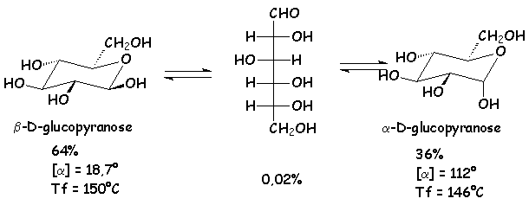
CYCLIC STRUCTURE
Biochemistry course A1 DV ; Prof A. MEKROUD , 2025/2026

Slide 52
Biochemistry course A1 DV ; Prof A. MEKROUD , 2025/2026
Cyclical structure of sugars
PYRANIC CYCLE BOAT AND CHAIR CONFORMATIONS
has
has
has
e
e
e
O
e
e
O
has
has
has
e
e
e
has
e: equatorial
a: axial
e
has
has
e
BOAT
CHAIR
has
H
CH2OH​​
HO
O
H
H
HO
H
HO
H
OH
α -D-glucopyranose

Slide 53
Biochemistry course A1 DV ; Prof A. MEKROUD , 2025/2026
Pyranic heterocycles offer their substituents
Possible positions :
Either axial : ( The substituents and especially the OH are substantially
perpendicular to the equatorial plane of the molecule , and
consequently quite close to each other , of the
less so for OH groups in C2 and C3)
This
between identical groups , which will have the
an instability of the molecule and therefore , a low probability
of existence .​
Let equatorial : (The (OH) substituents are
parallel to the equatorial plane of the molecule in
stretching outwards .​​​​​

Slide 54
Biochemistry course A1 DV ; Prof A. MEKROUD , 2025/2026
The direct consequence of such a situation is a distancing of identical groups from each other, which gives the molecule greater stability .
Coefficients are assigned to each type of spatial position of the substituents:
Equatorial position of OH and _{CH2OH} = 0
Axial position of OH = 1
Axial position of _{CH2OH} = 2
Note : the higher the added value of each component , the more the molecule
will be unstable. The maximum stability of a molecule has a coefficient = 0

Slide 55
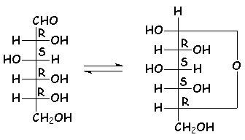
CYCLIC STRUCTURE
Biochemistry course A1 DV ; Prof A. MEKROUD , 2025/2026
Warning! The absolute configuration of carbon 4 changes during the formation of the hemiacetal :
bD- glucopyranose is the most stable of all pyranoses , because all the large substituents are in the equatorial position.

Slide 56
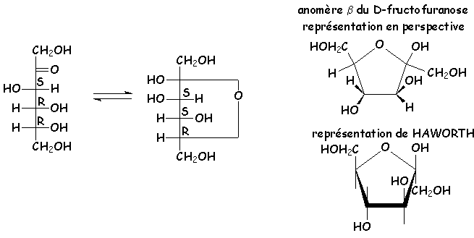
CYCLIC STRUCTURE
hemiacetals exist for sugars, for example, 5-membered rings called furanoses . The most interesting example is fructose, a ketone sugar, which exists primarily in a fructofuranose form :
Biochemistry course A1 DV ; Prof A. MEKROUD , 2019/2020

Slide 57
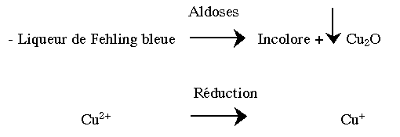
Main Physicochemical Properties of Sugars
Biochemistry course A1 DV ; Prof A. MEKROUD , 2025/2026
Some sugars (fructose) or polysaccharides (sucrose) have a sweet taste.
Sugars are very water-soluble due to their numerous alcohol functions.
Aldoses are reducing agents due to their hemiacetal ( pseudoaldehyde ) function. Ketoses are very weakly reducing agents.

Slide 58

Main Physicochemical Properties of Sugars
Biochemistry course A1 DV ; Prof A. MEKROUD , 2025/2026
properties due to the carbonyl function​
Redox
Glucose oxidase specifically oxidizes glucose into gluconic acid.
Sugars are reduced to polyols by chemical or enzymatic means.
  The aldehyde or ketone function is reduced to alcohol
    Glucose Glucitol (or Sorbitol)
    Galactose Galactitol (or Dulcitol)
    Mannose Mannitol
    Ribose Ribitol
  Fructose yields 2 polyols because the reduction of C=O leads to the formation of an asymmetric *C:

Slide 59
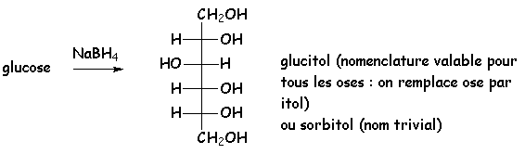
Oxidation by NaBH4
Biochemistry course A1 DV ; Prof A. MEKROUD , 2025/2026
Reduction

Slide 60
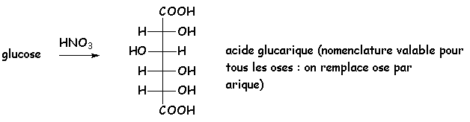
Oxidation by HNO3
Biochemistry course A1 DV ; Prof A. MEKROUD , 2025/2026

Slide 61
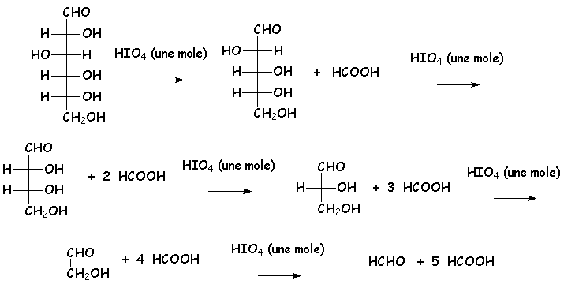
periodic
Biochemistry course A1 DV ; Prof A. MEKROUD , 2025/2026
SOLUBILITY:
Sugars are very soluble in water. They are said to be
WATER SOLUBLE; they do not easily form crystals in the medium
They are aqueous, but the presence of alcohol promotes this phenomenon. They are poorly soluble.
in ethanol but are more readily soluble in methanol and pyridine

Slide 62
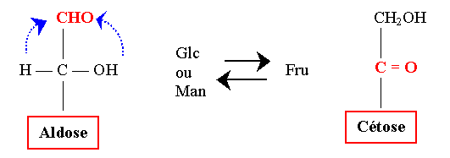


Biochemistry course A1 DV ; Prof A. MEKROUD , 2025/2026
CHEMICAL STABILITY
Case of pentosis, case of hexosis
Sugars undergo interconversion and epimerization in an alkaline environment.
Interconversion
  Epimerization : C2 epimers :
As we saw previously, epimerization can occur
enzymatically via an epimerase

Slide 63
Biochemistry course A1 DV ; Prof A. MEKROUD , 2025/2026
Physicochemical properties of sugars
CARBON OXIDATION 1
ALDONIC ACID
CARBON OXIDATION 6
URONIC ACID
OXIDATION OF CARBONS 1 AND 6
ALDARIC ACID

Slide 64
Biochemistry course A1 DV ; Prof A. MEKROUD , 2025/2026
Oxidation of sugars
CHO
COOH
6
CH2OH​​
OH
OH
HO
HO
H
5
O
OH
OH
H
1
OH
[oxy]
OH
cycling
4
O
HO
OH
H
CH2OH​​
CH2OH​​
3
2
H
OH
D glucose
D-gluconic acid
D gluconolactone
6
CH2OH​​
HC-OH
O
CHO
COOH
5
1
OH
OH
O
HO
HO
4
OH
OH
H
OH
OH
3
2
COOH
COOH
HO
OH
ascorbic acid (vitamin C)
D-glucuronic acid
D-glucaric acid

Slide 65
Biochemistry course A1 DV ; Prof A. MEKROUD , 2025/2026
Addition and substitution reactions :
Action of alcohols and phenols
linear alcohol ( Methanol )
With cyclic alcohol ( Phenol )
Action with hydrogen cyanide
Chain elongation by the addition of successive carbons (action of hydrogen cyanide HC=N), on the side of the carbonyl group
Summary by KILIANI-FISCHER
CHO + HCN CHOH--C=N

Slide 66
Biochemistry course A1 DV ; Prof A. MEKROUD , 2025/2026
properties due to hydroxyl groups
Ester formation​
Acid + Alcohol
Case of phosphoric esters of sugars
Monophosphoric , cyclic ,
triphosphoric , … .
Formation of ether oxides
Methylation of alcohol groups
Action of trityl chloride ( tritylation )
Oxidation of the primary alcohol function
Production of uronic acids

Slide 67
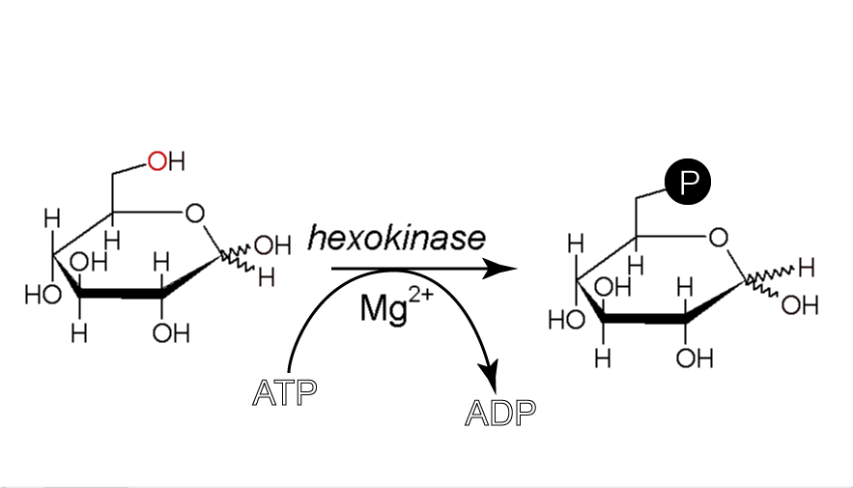
G6P Training
Biochemistry course A1 DV ; Prof A. MEKROUD , 2025/2026
In this case, it is mainly a matter of esterification on the alcohol functional group
primary sugar at C6 with one of the alcohol functions of the acid
Phosphoric _{( H3PO4-} ⁾ .​

Slide 68
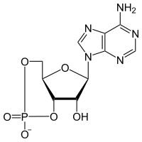
Cyclic Adenosine Monophosphate ( cAMP )
Biochemistry course A1 DV ; Prof A. MEKROUD , 2025/2026
Phosphate
Adenine
ADENOSIN
Cyclic
Ribose
In this case, the same phosphoric acid molecule contracts
two ester bonds with two alcohol functions of the same sugar
( in this case ribose), which gives rise to a cycle

Slide 69
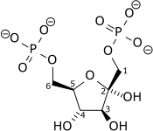
Diphosphoric ester : Fructose 1,6 diPhosphate (F1,6diP)
Biochemistry course A1 DV ; Prof A. MEKROUD , 2025/2026
diphosphoric esters , two phosphate molecules attach to two different alcohol groups belonging to the same sugar .

Slide 70
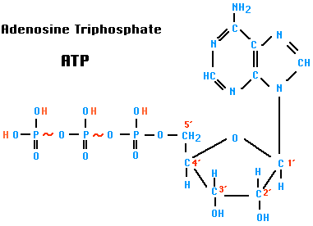
Polyphosphoric ester : Adenosine Triphosphate (ATP)
Biochemistry course A1 DV ; Prof A. MEKROUD , 2025/2026
In this type of posphoric sugar ester, three or more phosphate molecules combine with one or more alcohol groups of the same sugar .

Slide 71
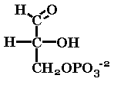

Sugars, glycosides and sugar derivatives of biological
Biochemistry course A1 DV ; Prof A. MEKROUD , 2025/2026
THE BONES:
TRIOSE:
GLYCERALDEHYDE
It exists primarily in the form of 3 PGA
( 3 Phospho​ G high school Aldehyde )
It is an intermediate compound of glycolysis
DIHYDROXYACETONE PHOSPHATE
Often abbreviated by the symbol DHAP.
This is a case of ketotriosis of equal importance.
That the 3PGA. Also found within
Glycolysis metabolism

Slide 72
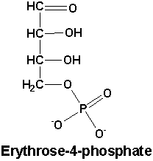
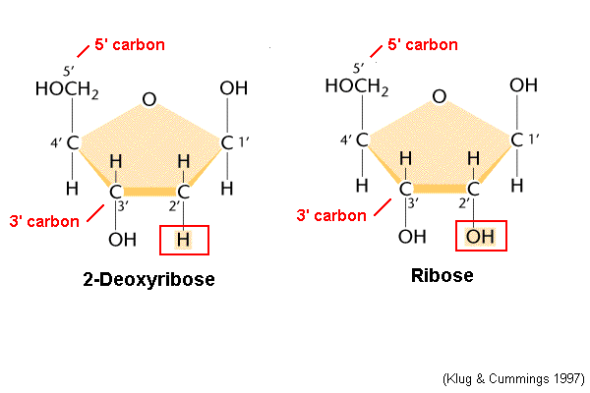
Sugars, glycosides and sugar derivatives of biological
Biochemistry course A1 DV ; Prof A. MEKROUD , 2025/2026
TETROSIS:
ERYTHROSIS 4 PHOSPHATE
This compound has metabolic interest
In the pentose-phosphate pathway .
PENTOSIS:
The D-RIBOSE This is one of the
Main components of nucleotides
and nucleic acids (RNA). It
also plays a role in the structure
of certain enzymes. The 2-deoxyribose,
plays a role in DNA synthesis.

Slide 73
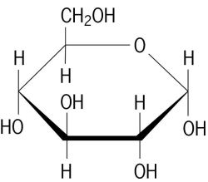
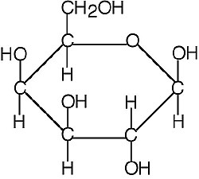
Sugars, glycosides and sugar derivatives of biological
Biochemistry course A1 DV ; Prof A. MEKROUD , 2025/2026
HEXOSE
GLUCOSE:
A compound that is very widespread in nature.
It is the main blood-reducing betaine. It is especially
phosphorylated form (G6P, G1P) This is the main one
fuel for the body and universal fuel for
fetus . .
GALACTOSE :
It is the most common sugar after glucose. It is
Present in milk and certain glycoproteins

Slide 74
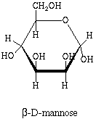
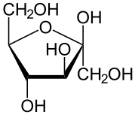
Sugars, glycosides and sugar derivatives of biological
Biochemistry course A1 DV ; Prof A. MEKROUD , 2025/2026
HEXOSE
MANNOSE:
It is the main constituent of
Glycoproteins. It is present mainly in the
plants.
FRUCTOSE:
This is a ketosis of vital importance.
is also called Levulose. It is found
Especially in abundant quantities in the
Fruits .

Slide 75
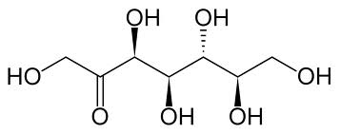
Biochemistry course A1 DV ; Prof A. MEKROUD , 2025/2026
SEDOHEPTULOSE 7 PHOSPHATE

Slide 76
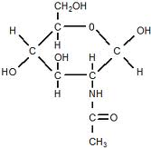
Biochemistry course A1 DV ; Prof A. MEKROUD , 2025/2026
HEXOSAMINES:
Glucosamine (or 2 amino acids)
2 deoxyglucose ). That is
A compound of
Glycoproteins, as well as
Chitin from crustaceans
(in its acetylated form =
N- acetyl- D-glucosamine.)

Slide 77

Biochemistry course A1 DV ; Prof A. MEKROUD , 2025/2026
URONIC ACIDS:
GLUCURONIC ACID:
He is the main representative. He intervenes.
In the phenomena of glucurono-
Conjugation at the level of the liver. (phenomenon
( Detoxification )

Slide 78
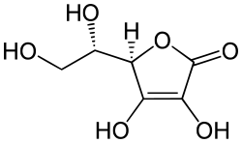
Biochemistry course A1 DV ; Prof A. MEKROUD , 2025/2026
ASCORBIC ACID
Better known as vitamin C
Possesses a strong oxidizing power
reducer. It is easily manufactured.
Through plants.

Slide 79

D Glucopyranose
Biochemistry course A1 DV ; Prof A. MEKROUD , 2025/2026
Natural glucose (D(+) glucose) is very widespread in nature. It is the body's main fuel and the universal fuel for the fetus .
Glucose polymerization leads to Glycogen (liver, muscles).
Blood glucose is the concentration of free glucose in the blood (0.80g/L or 4.4 mM /L).
Glucose is a reducing agent. Glucose oxidase oxidizes it to aldonic acid.

Slide 80
D-Galactopia
Biochemistry course A1 DV ; Prof A. MEKROUD , 2025/2026
It is a component of:
  Lactose = D Gal + D Glc
  Cerebrogalactosides of the brain
  Certain glycolipids and glycoproteins
Its rotational power is dextrorotatory.

Slide 81
D-Mannopyranose
Biochemistry course A1 DV ; Prof A. MEKROUD , 2025/2026
It is found mainly in plants.
It is a constituent of glycoproteins in humans.
Its rotational power is dextrorotatory.

Slide 82
THE OSIDS
Biochemistry course A1 DV ; Prof A. MEKROUD , 2025/2026
Definition
Glycosides are molecules that, upon hydrolysis, yield two or more monosaccharide molecules. These monosaccharides can be
identical or different.
holosides
heterosides
From 2 to 10
OLIGOSIDES
More than 10
POLYOSIDES

Slide 83
Determination of the structure of glycosides
Biochemistry course A1 DV ; Prof A. MEKROUD , 2025/2026
Determination of the nature of oses
(separation method e.g., TLC)
Determination of the connection mode some oses among themselves
(know which OH groups are involved in glycosidic bonds)
Determination of the reducing agent
(Is there a reducing power in the oside in question?)

Slide 84
CCM = Chromatography​ on Thin Diapers​​
Biochemistry course A1 DV ; Prof A. MEKROUD , 2025/2026
Separation method based on the variation in solubility between two solvents of different natures
= Partition coefficient K =
Mass of A dissolved in S1
X 100
Mass of A dissolved in S2

Slide 85
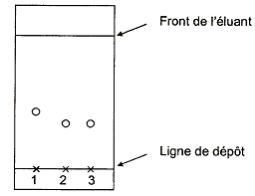
Biochemistry course A1 DV ; Prof A. MEKROUD , 2025/2026

Slide 86
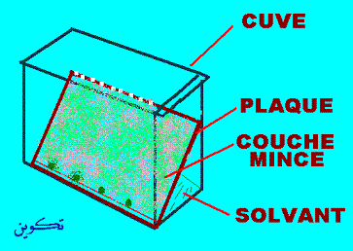
Biochemistry course A1 DV ; Prof A. MEKROUD , 2025/2026

Slide 87
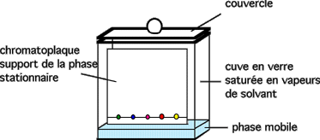
Biochemistry course A1 DV ; Prof A. MEKROUD , 2025/2026

Slide 88
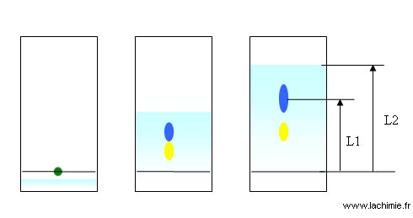
Biochemistry course A1 DV ; Prof A. MEKROUD , 2025/2026
THE SOLVENT RISES INTO THE PLATE BY CAPILLARITIALITY

Slide 89
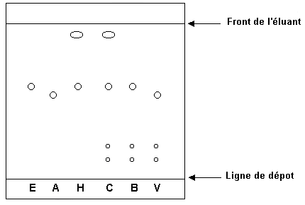
Biochemistry course A1 DV ; Prof A. MEKROUD , 2025/2026

Slide 90
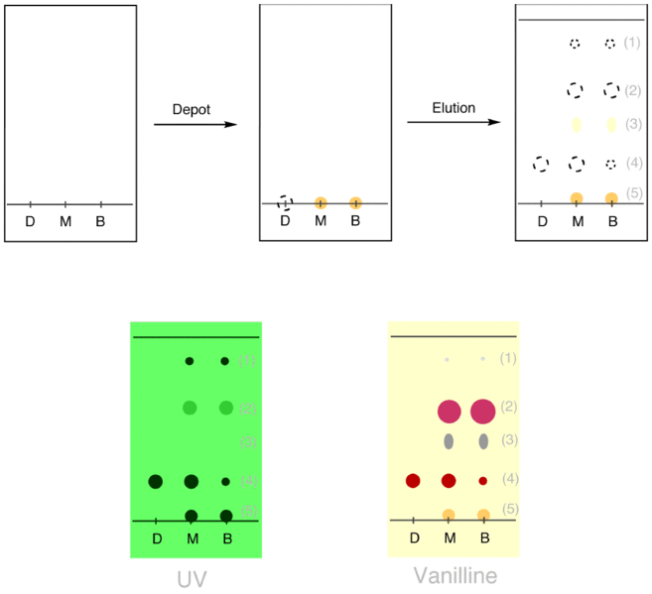
Biochemistry course A1 DV ; Prof A. MEKROUD , 2025/2026

Slide 91
Biochemistry course A1 DV ; Prof A. MEKROUD , 2025/2026
CALCULATION OF RF (Frontal Ratio)
Distance between the application line and the center of the stain
RF = -------------------------------------------------------------------
Distance between the application line and the solvent front
The results are compared with RF values of the tested compound .

Slide 92
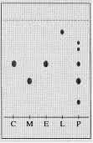
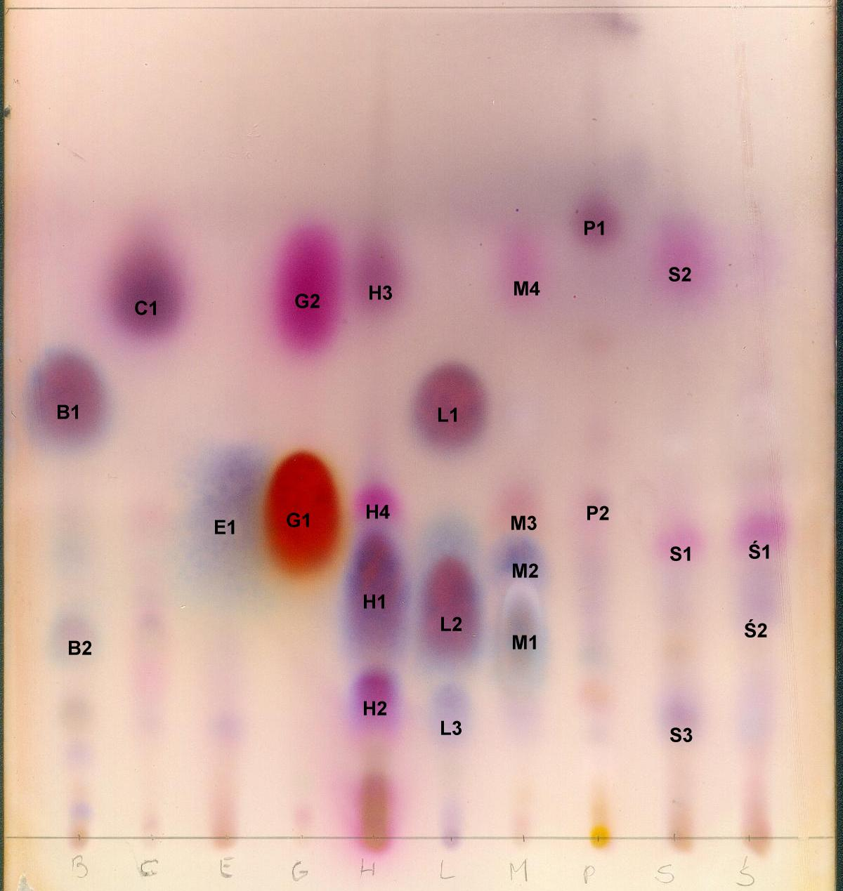
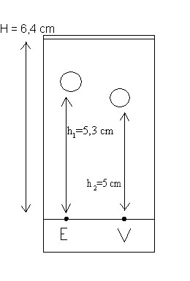
Biochemistry course A1 DV ; Prof A. MEKROUD , 2025/2026
Find 2 sample deposits ?
Comparison of
C, M, E, L (unknown)
With known witnesses (P)
S
HAS
F
G
Ga
S: Sucrose, A: arabinose, F: fructose
G: glucose, Ga: galactose
RF _{E} = h1/H=5.3/6.4 =0.82
RF calculation
(Report to
Forehead)
How many serums are there?
Is this the same animal?
RF _{A} = h2/H = 5/6.4 = 0.78
HAS

Slide 93
Biochemistry course A1 DV ; Prof A. MEKROUD , 2025/2026
HOW DO WE DETERMINE THE MODE OF BONES LINKING TO EACH OTHER?
Methylation : This involves substituting all the OH groups not involved in a bond
methyl group ( methylation ) which will give rise to the methoxy group .
controlled oxidation , which will be considered later , will allow the free OH groups to appear ;
therefore those that were involved in a glycosidic bond. Finally, by method of recurrence , we attempt
To establish an oside assembly .
Explain with examples
6
CH2OH​​
5
CH2OH​​
CH2OH​​
6
CH2OH​​
H
CO
OH
5
C
H
C
1
H
CO
H
H
CO
OH
HO
CO
4
OH
H
H
H
O
C
C
H
C
C
C
C
H
OH
H
1
4
OH
H
1
C
C
1
3
2
HO
O
H
4
OH
H
H
HO
C
C
C
C
H
C
C
H
H
HO
H
HO
3
2
O - α -D- glucopyranosyl- (1 4)- β -D- glucopyranose
H
HO
O - β -D- galactopyranosyl -(1 4)- β -D- glucopyranose
Glc ( α 1 4) Glc
Gal( β 1 4) Glc
MALTOSE
LACTOSE

Slide 94
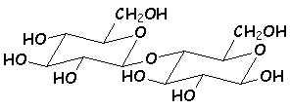
Biochemistry course A1 DV ; Prof A. MEKROUD , 2025/2026
DETERMINATION OF REDUCING POWER
Disaccharides
Reducing disaccharides​
The two monosaccharides are linked by the formation of an acetal between the OH
hemiacetic acid of the anomeric a or b of one (it is the sugar that changes in the 3
cases presented ) and the OH n°4 of bD - glucopyranose .
The hemiacet function of glucose remains free, and therefore the transition to the form
Aldehyde remains possible. These sugars are therefore reducing and react
the Fehling's solution test :
4
1

Slide 95
Biochemistry course A1 DV ; Prof A. MEKROUD , 2025/2026
Non- reducing disaccharides :
The most important is sucrose, formed from the acetalization of the two functions
hemiacids of a -D - glucopyranose and β −Δ - fructofuranose :
1
1
Sucrose is hydrolyzed to D-fructose and D - glucose by _{dilute H₂SO₄} .
the resulting mixture is called " Invert sugar " . D-glucose and D-fructose are
both composed of their two respective anomeric components in the proportions of
balance .

Slide 96
Biochemistry course A1 DV ; Prof A. MEKROUD , 2025/2026
Some sugars and glycosides and their derivatives of biological interest :
DARE :
Trio :
Glyceraldehyde​​​​ :
It exists primarily in its natural state in the form
of 3PGA (3- Phosphoglyceraldehyde ). Intermediate compound of
glycolysis.
DihydroxyacetonePhosphate​​​ (DHAP)
Ketotriosis of equal importance. Also found within glycolysis.

Slide 97
Biochemistry course A1 DV ; Prof A. MEKROUD , 2025/2026
Some sugars and glycosides and their derivatives
of biological interest
Tetrose​​ :
Erythrosis 4 Phosphate .
This compound has metabolic significance in the pathway
pentose phosphates.
Pentosis:
D-ribose :
It is one of the main compounds of
Nucleotides and nucleic acids . It also plays a role in
The structure of certain coenzymes (NAD and NADP)
Deoxyribose 2:
It acts as a sugar in DNA;

Slide 98
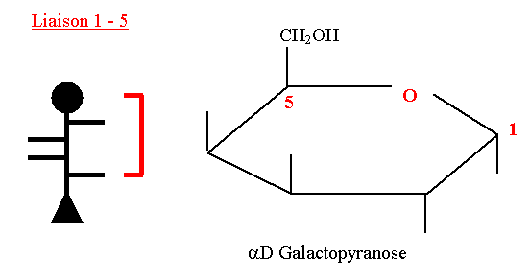
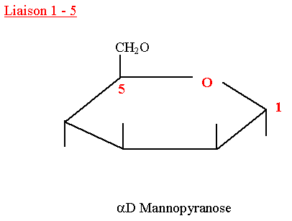
Biochemistry course A1 DV ; Prof A. MEKROUD , 2025/2026
Some sugars and glycosides and their derivatives of interest
biological :
Hexose :
Glucose:
A compound very widely used in the
nature. It is the main reducing agent of
Blood and cerebrospinal fluid . Exists
especially in the form of phosphoric ester
Galactose :
It is the most common sugar after glucose
It is present in milk and certain glycoproteins .
Mannose:
It is a major constituent of glycoproteins .
Fructose:
This is a ketohexosis of vital importance.
It is also called levulose. It is found
abundantly in the fruits.
Heptosis
Sedoheptulose 7 - phosphate:
Like erythrosis, this compound takes on its full importance
in the pentose phosphate pathway.

Slide 99
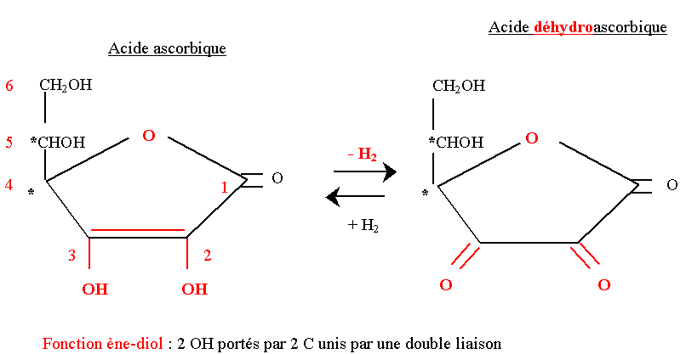
Biochemistry course A1 DV ; Prof A. MEKROUD , 2025/2026
Some sugars and glycosides and their derivatives of interest
biological :
DERIVATIVES OF OSES :
Hexosamines
Glucosamine (or 2 amino 2 Deoxy glucose):
It is a compound of glycoproteins, as well as
The chitin of insects and crustaceans (under its
Acetylated form = N- acetyl D-glucosamine
Uronic acids
Glucuronic acid :
He is the main representative. He intervenes in the
glucurono -conjugation phenomena at the level
of the liver (detoxification processes)
Ascorbic acid
Better known as vitamin C. Possesses
has a strong redox potential . It is easily
Made from plants.

Slide 100
Biochemistry course A1 DV ; Prof A. MEKROUD , 2025/2026
Some sugars and glycosides and their derivatives of interest
biological :
THE OSIDES:
Diholosides
Lactose:
Composed of galactose and glucose, it is found
Especially in milk.
Sucrose :
Composed of fructose and glucose, it is the main
A constituent of honey.

Slide 101
Biochemistry course A1 DV ; Prof A. MEKROUD , 2025/2026
Polysaccharides
Polysaccharides are high molecular weight polymers .
They are also called glycans .
They differ from each other in four aspects:
the type of monosaccharides that constitute
them
the number of monosaccharides
the type of bond between the different sugars
the degree of branching, also called the degree of interconnectedness

Slide 102
Biochemistry course A1 DV ; Prof A. MEKROUD , 2025/2026
Polysaccharides
The size of polysaccharides is not well defined. It is not fixed like the size of a protein, for example.
Polysaccharides vary in size from one molecule to another .
The mechanisms determining this size are not known.

Slide 103
Biochemistry course A1 DV ; Prof A. MEKROUD , 2025/2026
Polysaccharides
STARCH
α -D-glucose polymer
AMYLOSE
CH2OH​​
CH2OH​​
CH2OH​​
CH2OH​​
O
O
O
O
H
H
H
H
H
H
H
H
H
H
H
H
ηασ
ηασ
ηασ
ηασ
H
H
H
H
1
HO
OH
O
OH
O
OH
O
OH
OH
1
4
1
4
1
4
H
OH
H
OH
n
H
OH
H
OH
non-reducing end
reducing end

Slide 104
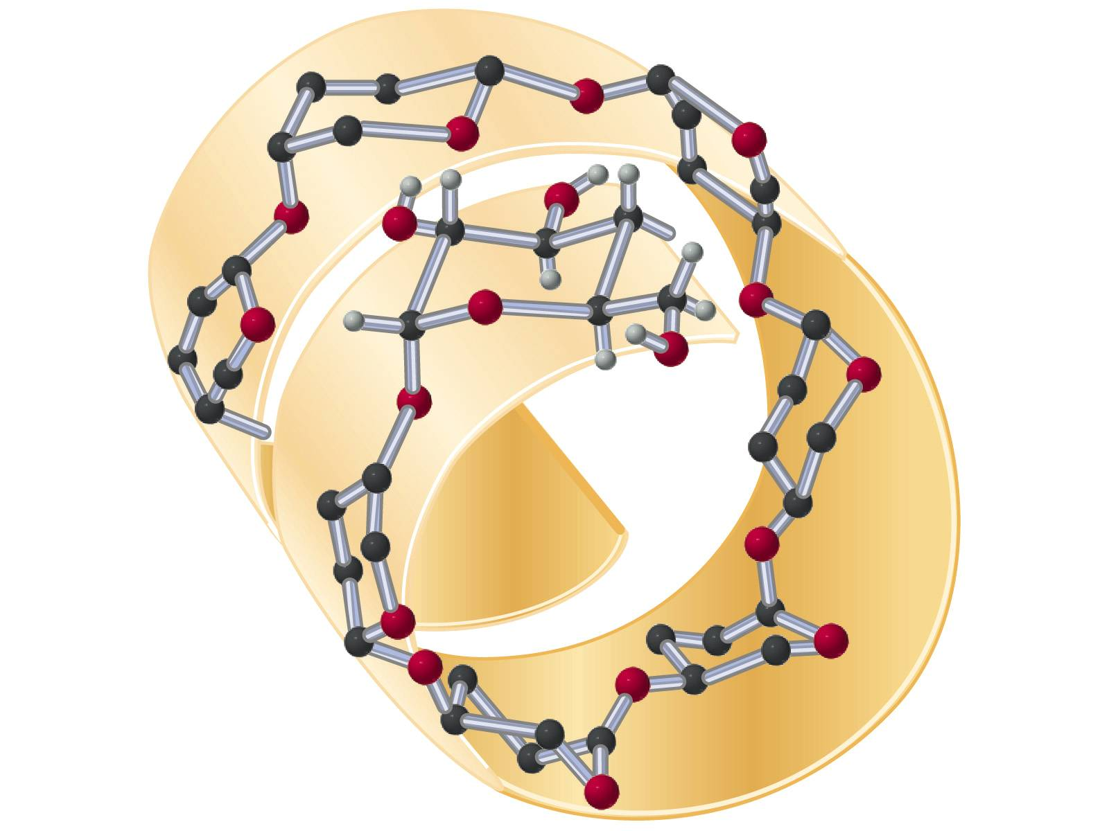
Biochemistry course A1 DV ; Prof A. MEKROUD , 2025/2026
Polysaccharides
STARCH
AMYLOSE

Slide 105
Biochemistry course A1 DV ; Prof A. MEKROUD , 2025/2026
Polysaccharides
STARCH
AMYLOPECTIN
CH2OH​​
CH2OH​​
CONNECTION
O
O
H
H
H
H
H
H
ηασ
ηασ
OH
H
O
OH
H
O
O
4
1
4
1
branching point
( α 1 6)
H
OH
H
OH
6
CH2OH​​
CH ₂
O
O
H
H
H
H
H
H
ηασ
MAIN CHANNEL
ηασ
OH
H
O
OH
H
O
O
4
1
4
1
H
OH
H
OH

Slide 106
Biochemistry course A1 DV ; Prof A. MEKROUD , 2025/2026
Polysaccharides
STRUCTURE OF GLYCOGEN AND STARCH
HO
HO
O
O
Fehling liqueur
CH2OH​​
O
HO
CH2OH​​
O
Glycogen hydrolysis time by concentrated HCl
HO
O

Slide 107
Biochemistry course A1 DV ; Prof A. MEKROUD , 2025/2026
Polysaccharides
Why store glucose in the form of polymers and not in the form of monomers?
Glycogen is insoluble in the water, which implies that it intervenes very little in the osmotic pressure of the cell's cytosol.
If glucose were in the form of monomeric molecules This would represent an intracellular concentration of 100 mmol /L .
Outside the cells (blood), the glucose concentration is 5 mmol /L : the entry glucose in the cell would be impossible and hepatocytes would not be able to store excess blood glucose!

Slide 108
Biochemistry course A1 DV ; Prof A. MEKROUD , 2025/2026
Why store glucose in the form of branched polymers?
Glycogen is composed of α -D-glucoses linked together by α 1 →4 bonds, with α 1◊6 branches every 8 to 12 residues .
Glycogen degradation occurs through recurrent release. of glucose from a non-reducing end from the sugar chain.
If we have several chains, each with a non-reducing end, we have as many glucose release points, which increases the rate of glycogen degradation .

Slide 109
Biochemistry course A1 DV ; Prof A. MEKROUD , 2025/2026
HEPATOCYTE

Slide 110

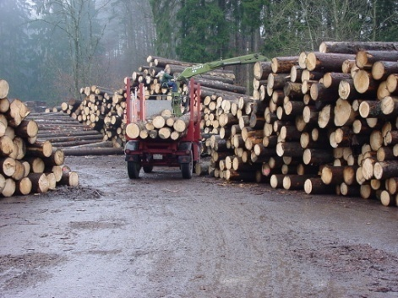
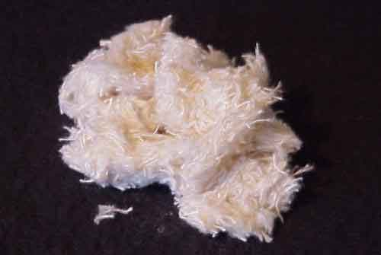
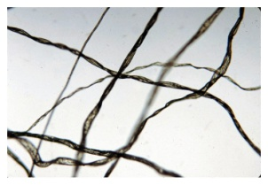
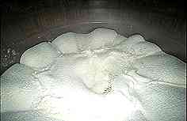



Biochemistry course A1 DV ; Prof A. MEKROUD , 2025/2026
Cellulose
TEXTILE
PAPER

Slide 111
Biochemistry course A1 DV ; Prof A. MEKROUD , 2025/2026
STRUCTURE OF CHITINE
CH ₃
CH ₃
C=O
C=O
6
6
CH2OH​​
H
NH
CH2OH​​
H
NH
O
3
2
O
3
2
H
5
O
H
H
5
O
H
H
OH
H
H
OH
H
4
1
4
1
4
1
4
1
OH
H
H
OH
H
H
H
H
O
O
H
H
O
5
O
3
5
O
3
2
2
H
NH
CH2OH​​
H
NH
CH2OH​​
C=O
6
C=O
6
CH ₃
CH ₃
N - acetyl -D-glucosamine linked by β1 βονδ 4

Slide 112





Biochemistry course A1 DV ; Prof A. MEKROUD , 2025/2026
COMPONENT OF THE ARTHROPOD CYTOSKELETON
1 million different species

Slide 113
Biochemistry course A1 DV ; Prof A. MEKROUD , 2025/2026
CARBOHYDRATES
Polymer
Repeated sugar
Size
(number of sugars)
Role
Starch
Amyloidosis
α 1 4Glc linear
2,000 to 500,000
energy storage
(plants)
α 1 4Glc with
α 1 6Glc every 24 to 30 residues
Amylopectin
<1,000,000
α 1 4Glc with
α 1 6Glc all
the 8 to 12 residues
energy storage
(animals)
Glycogen
several million
Cellulose
structure
(plants)
β 1 4Glc
up to 15,000
Chitin
structure
(insects)
β 1 4GlcNAc
very high

Slide 114
Biochemistry course A1 DV ; Prof A. MEKROUD , 2025/2026
Chondroitin sulfates​
  They are found in connective tissue and cartilage.
  They are composed of the polycondensation of disaccharide motifs :
  The bonds are also β 1-3 and β 1-4.
  The sulfates are fixed at C4 or C6 of the galactosamine .
Heparin
  It is a physiological anticoagulant that is present in many
  tissues (liver, lung, kidneys, heart).
  It is composed of the polycondensation of:
  The bonds are α 1-4.
  Sulfates are essential for biological activity; they are fixed on
  nitrogen and primary alcohol in 6 of glucosamine but some
  Heparins can contain much more.

Slide 115

Biochemistry course A1 DV ; Prof A. MEKROUD , 2025/2026
Glycosaminoglycans
These are heterogeneous polysaccharides resulting from the polycondensation of osamines and glucuronic acids .
Hyaluronic acid
  It acts as a barrier to foreign substances. It is present in the vitreous humor and in the joints where it plays a lubricating role.
  It is the simplest of the glycosaminoglycans . It is made up of disaccharide units repeated n times:
  The bonds are:
    β 1-3 in the motif
    β 1-4 between the motifs
  Hyaluronic acid has a very high molecular weight and numerous negative charges. It contains no sulfates.
  It is hydrolyzed by a depolymerizing enzyme, hyaluronidase , which acts between the links, on the β 1-4 bonds. This enzyme is found in bacteria, snake venom, and sperm, where it facilitates the penetration of the sperm into the egg during fertilization by hydrolyzing the egg's envelope.

Slide 116
Biochemistry course A1 DV ; Prof A. MEKROUD , 2025/2026
Glycoproteins​​
Definition​​
These are heteroproteins resulting from the covalent bonding of a carbohydrate (oligoside ) and protein fractions. They are very widespread in nature and have a wide variety of biological functions. They contain more than 5% carbohydrates.
Binding of carbohydrate and protein fractions
The bond is formed between the terminal reducing group of the carbohydrate fraction and an amino acid of the protein at the following point:
of an alcohol function of an amino acid (serine, threonine) = O- glycosidic bond
of an amide function of glutamine or asparagine: N- glycosidic bond

