Slide 1
PROTEINS
Biochemistry course A1 DV ; Prof A. MEKROUD , 2019/2020
AMINO ACIDS
Definition:
These are the main constituents of proteins . They generally contain an acidic functional group in their structure. ( carboxylic acid ) and an amine ( nitrogenous ) function, hence their name amino acid

Slide 2
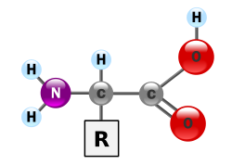
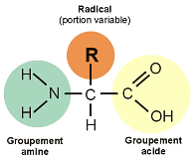
GENERAL STRUCTURE
Biochemistry course A1 DV ; Prof A. MEKROUD , 2019/2020

Slide 3
General concepts
Biochemistry course A1 DV ; Prof A. MEKROUD , 2019/2020
Natural amino acids are primarily α- amino acids conforming to the general structure shown in the previous slide
R is called radical or main chain, it is found in all amino acids. R represents a side chain characteristic of each amino acid. Amino acids are generally classified according to the properties of their side chain into five groups : acidic , basic , neutral , hydrophilic ( polar ) , or hydrophobic ( nonpolar ).

Slide 4
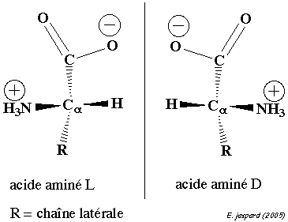
Isomerism
Biochemistry course A1 DV ; Prof A. MEKROUD , 2019/2020
Apart from glycine , where R = H, amino acids exist in the form of two enantiomers , traditionally called D and L, depending on whether the (-NH2) group is on the right or left in the Fischer projection .
These enantiomers are optically active : each isomer deflects light and is dextrorotatory or levorotatory depending on whether the rotation of the plane of polarization of the light follows a clockwise or counterclockwise direction.
L amino acids represent the
almost all of the amino acids that are
found in proteins .

Slide 5
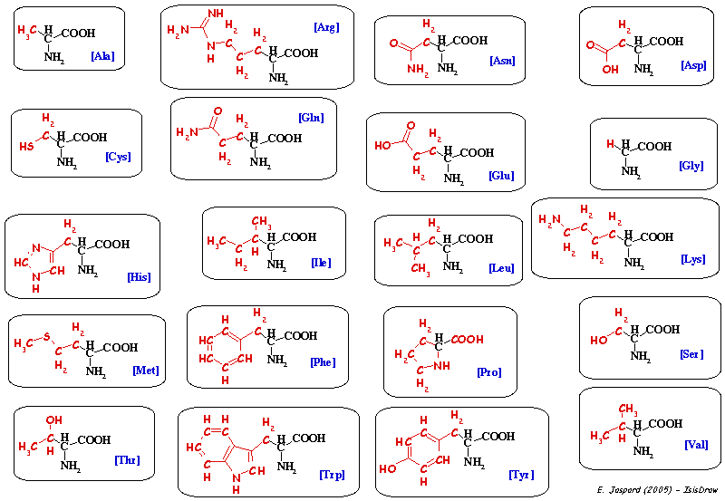
Biochemistry course A1 DV ; Prof A. MEKROUD , 2019/2020
STRUCTURE OF THE MAIN AMINO ACIDS

Slide 6







Biochemistry course A1 DV ; Prof A. MEKROUD , 2019/2020
1. Aliphatic amino acids
Monocarboxylic and monoamine amino acids
The non-hydroxylated series
Glycine Gly G, Alanine Ala A, Valine Val V, Isoleucine Ile I, Leucine Leu L
The hydroxylated series
Serine Ser S, Threonine Thr T

Slide 7








Biochemistry course A1 DV ; Prof A. MEKROUD , 2019/2020
Monoamine and dicarboxylic acids and their amides.
Monoamine acids Aspartic acid ( Asp D)
Glutamic acid Glu E
Their amides
Asparagine Asn N, Glutamine Glu Q
Dibasic amino acids (6C)
Lysine Lys K, Arginine Arg R, Histidine His H
Sulfur-containing amino acids Cysteine, Methionine Met M

Slide 8




Biochemistry course A1 DV ; Prof A. MEKROUD , 2019/2020
2. Aromatic amino acids
Phenylalanine Phe F , Tyrosine Tyr Y , Tryptophan Trp W
3. Iminoacids​
Proline Pro P, Hydroxyproline
natural amino acids
Their distribution : The most abundant are the acids.
The least abundant are the sulfur compounds .
Essential
amino acids = Not synthesized by humans but necessary for metabolism​​

Slide 9
LIST OF MAIN AMINO ACIDS
Biochemistry course A1 DV ; Prof A. MEKROUD , 2019/2020
pHi | Code has 3 letters | Code has 1 letter | Name
6.11 | To the | A | Alanine
10.76 | Arg | R | Arginine
5.41 | Asn | N | Asparagine
2.85 | Asp | D | Aspartate
5.05 | Cys | C | Cysteine
3.15 | Glue | E | Glutamate
5.65 | Gln | Q | Glutamine
6.06 | Gly | G | Glycine
7.60 | His | H | Histidine
6.05 | Island | I | Isoleucine
6.01 | Their | L | Leucine
9.60 | Lily | K | Lysine
5.74 | Met | M | Methionine
5.49 | Phe | F | Phenylalanine
6.30 | Pro | P | Proline
5.68 | Ser | S | Serine
5.60 | Thr | T | Threonine
5.89 | Trp | W | Tryptophan
5.64 | Tyr | Y | Tyrosine
6.00 | Val | V | Valine

Slide 10
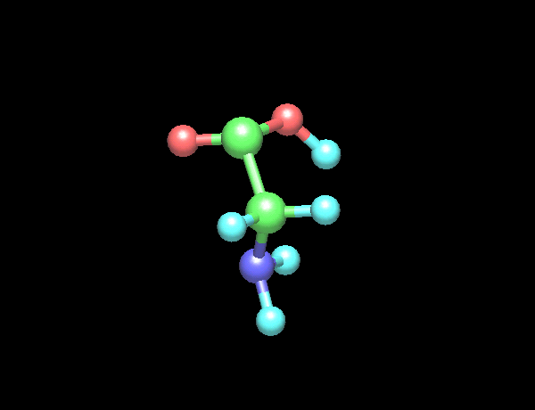
Biochemistry course A1 DV ; Prof A. MEKROUD , 2019/2020
THREE-DIMENSIONAL STRUCTURE (In space ) OF GLYCINE
O
O
C
H
C
H
H
N
H
H

Slide 11
Physicochemical properties
Biochemistry course A1 DV ; Prof A. MEKROUD , 2019/2020
Physical properties:
*Solubility:
most acids​​ aminos are soluble In water and solvents such that alcohol ( solvents) polars ) ( especially the proline and hydroxyproline ).
On the other hand, α- amino acids are soluble , but at a lower rate degree in non- polar solvents . It is necessary retain that this solubility East very dependent on the properties of the string side :
solubility​ decreases with the number of carbon atoms of the radical, but vice versa increase if this radical R is holder of functions polar (NH2, COOH) or hydrophilic (OH).

Slide 12
Physicochemical properties
Biochemistry course A1 DV ; Prof A. MEKROUD , 2019/2020
Physical Properties:
*Ionization:
Acids​ aminos contain a group carboxyl acid and a group amine basic . As a solution, these two groups exist under two shapes , one loaded , the other neutral :
R-COOH; R-COO- ⁺ H ⁺
R-NH3 ⁺ ; R-NH2+; H ⁺
Acids​ aminos are called for this diionic structure Amphoteric . Ionization varies with pH: acids Amino acids exist, in aqueous solution , in 3 forms possible :

Slide 13
Biochemistry course A1 DV ; Prof A. MEKROUD , 2019/2020
Application to amino acids
-H ⁺
Amino acid
-H ⁺
⁺ H ₃ N—CH—COO ⁻
H ₂ N—CH— COO ⁻
⁺ H ₃ N —CH COO H
+H ⁺
+H ⁺
R
R
R
Acidic environment
Ampholyte
pHi = 7.2
Basic environment
pK ₁
pK ₂
In acidic medium (pH < pHi ): The amine function ionizes in fixing a hydrogen ( proton ) and the dissociation of the carboxyl East inhibited . The acid​ amin é is found in the form of cation. .
In basic medium (pH > pHi ): The function acid ionizes By getting rid of a proton, the base of the medium inhibits the ionization of the amine group . The acid carboxylic is found in the form of an anion .
c) The pH at which both dissociations occur East called​ isoelectric point​​ : Or pHi . To At this pH, we have a dipolar ion. Or zwitterion net charge zero , therefore not migrating in an electric field .
Note : On either side of the pHi , we define pH values that correspond to a half dissociation of COOH and _{NH3} ⁺ . are the pKs . There are So , 2pK :
The isoelectric point ( or pH ) Or isoionic East equal​ to the half sum of the pKs . The radical R, when it contains a group ionizable , participates to the value of the isoelectric point .

Slide 14
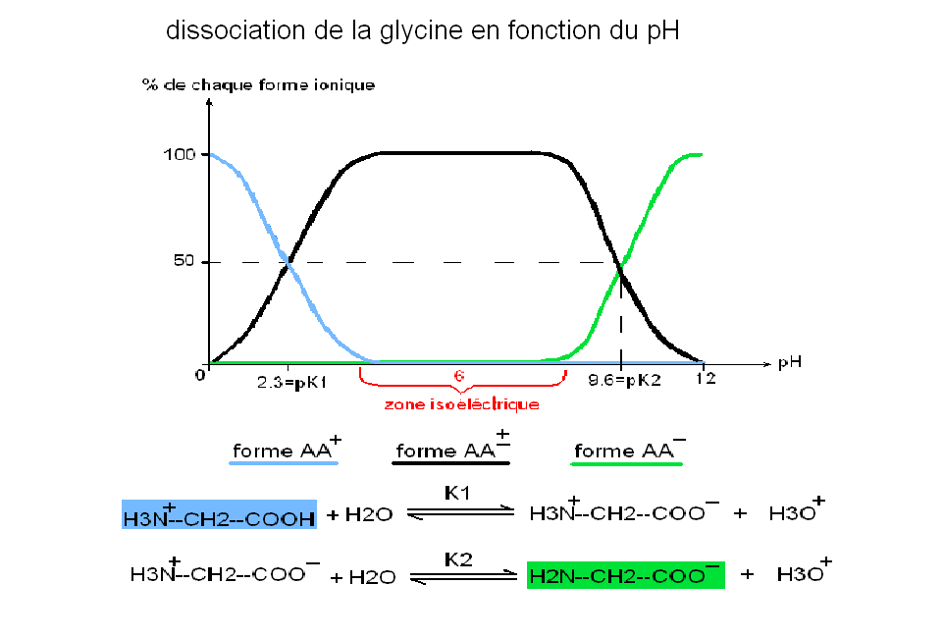
Biochemistry course A1 DV ; Prof A. MEKROUD , 2019/2020

Slide 15
Physicochemical properties
Biochemistry course A1 DV ; Prof A. MEKROUD , 2019/2020
Physical Properties:
*Light absorption
Acid solutions aminos are colorless . Acids aminos aromatics absorb in UV radiation is between 260 and 280 nm. Above 260 nm, the greatest part of the absorption ultraviolet proteins​ comes from their content of tryptophan and sometimes tyrosine .

Slide 16
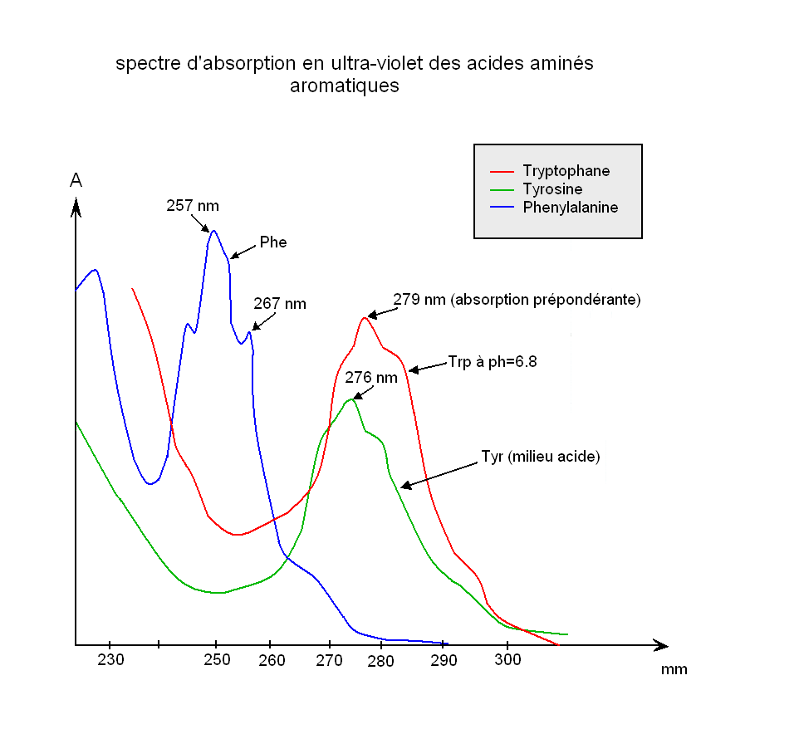
Biochemistry course A1 DV ; Prof A. MEKROUD , 2019/2020
UV ABSORPTION SPECTRUM OF AROMATIC

Slide 17
What do spectral properties, light absorption, absorption spectrum, peak, etc. mean?

Slide 18
MOLECULAR Absorption spectrophotometry​​​
​​
(mAs)

Slide 19
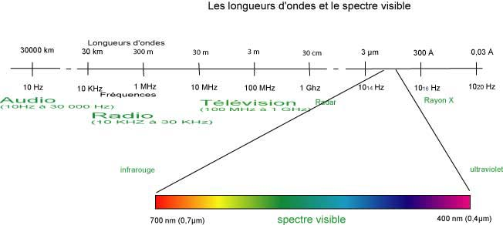
Wavelengths and the visible spectrum

Slide 20
1. Definition and principle
Monochromatic light beam passing through a tank containing dissolved substance
I 0
I
I < I 0
Dissolved substance

Slide 21
DIAGRAM OF A SINGLE-BEAM SPECTROPHOTOMETER
Photo
Electric cell
Source
bright
Monochromator
Tank
Slot
entry
Slot
exit
Amplifier
Galvanometer
Or computer

Slide 22
Requirements for good spectrophotometry
Light source stability: (i.e., constant light energy throughout the measurement period)
Quality and cleanliness of the tanks used: (Made of quartz, polyethylene, glass except for enzymatic assays; no fingerprints on the tank)
Cover the tank: (total darkness)

Slide 23
Concept of absorption spectrum
This is established in order to determine the maximum absorption of light by a given substance by varying the wavelength
For example, chlorophylls a and b absorb in the blue and red parts of the spectrum. But at what wavelength should the instrument be set to read the absorption of each chlorophyll under optimal conditions?

Slide 24
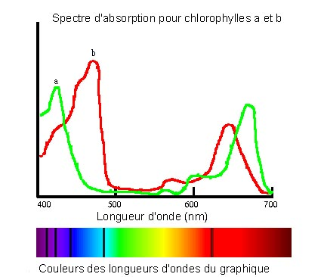
480 nm
430 nm

Slide 25
Biochemistry course A1 DV ; Prof A. MEKROUD , 2019/2020
Chemical properties of amino acids
Properties due to –COOH
Esterification: Reaction with an alcohol group to produce an ester
Amidation : Reaction with an amine group to produce an amide (CO—NH bond)
Salt formation Reaction with compounds such as NaOH or KOH, formation of salts or saponification
Decarboxylation : Release of CO2 , which gives rise to an amino compound

Slide 26
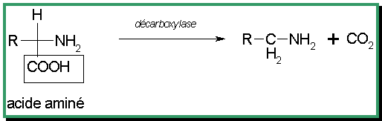
Biochemistry course A1 DV ; Prof A. MEKROUD , 2019/2020
DECARBOXYLATION REACTION

Slide 27
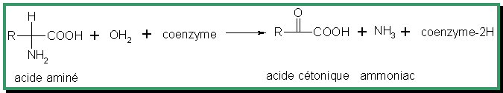
Biochemistry course A1 DV ; Prof A. MEKROUD , 2019/2020
Chemical properties of amino acids
Properties due to –NH2
The formation of N-acylated derivatives : Anhydride halides of carboxylic acids form N-acylates
R—CO—X + H ₂ N—CH—R' ----------- R—CO—HN—CH—R' + XH
Deamination using nitrous acid : This produces an acid—alcohol + nitrogen release
Oxidative deamination :
R — C H — N H ₂ + H N O ₂ ---------- R — C H O H ---COOH + N ₂ + H ₂ O
COOH

Slide 28
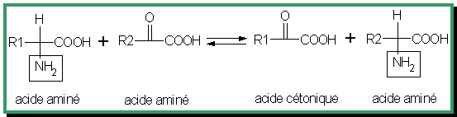
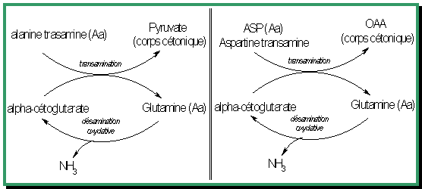
Biochemistry course A1 DV ; Prof A. MEKROUD , 2019/2020
Transamination : This involves the transfer of the amine group
of one compound on another
acid ketone

Slide 29
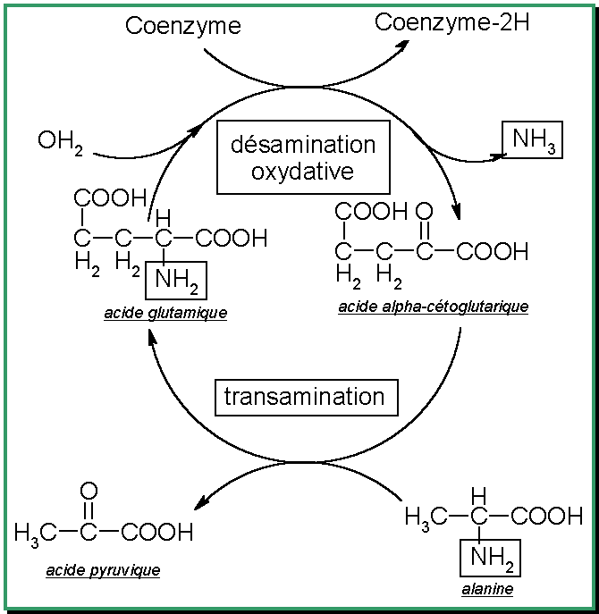
Biochemistry course A1 DV ; Prof A. MEKROUD , 2019/2020
Deamination-transamination coupling

Slide 30
Biochemistry course A1 DV ; Prof A. MEKROUD , 2019/2020
Formation of imine : formerly called " ship 's base " This is a reaction between the amine group and the oxygen of an aldehyde group to give an imine .
R '— CHO + H2N----CH — R ---------------------- R ' ---CH==N — CH---R
COOH
COOH

Slide 31
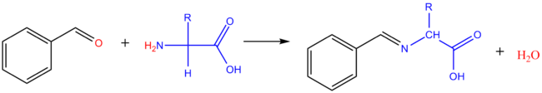
Biochemistry course A1 DV ; Prof A. MEKROUD , 2019/2020
Reaction with aldehydes​​
With the ald é hydes Aliphatics : the derivative dimethylol is formed​​
of the amino acid . With the ald é hydes aromatics , we obtain Schiff bases .
Arylation
Substituting an H from the NH2 function by a group aryl ( aromatic)
) leads to a function amine secondary.
, with 2,4-dinitro- 1- fluorobenzene ( Sanger reagent ) a colored dinitrophenyl amino acid is formed , therefore it can be measured.
This reaction can occur when the amino acid is incorporated into a protein .
Hydrolysis of a
corresponding to amino acids with NH2 groups are
( terminals).
This reaction allowed​ Frederick Sanger ( in 1953) established the first structure
primary of a protein ( insulin ) .

Slide 32
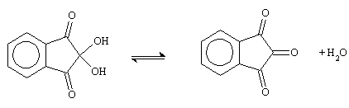
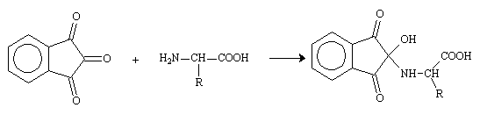
Reaction with Ninhydrin .
Very used as reagent acid developer​ amino acids in chromatography .
Ninhydrin​ East below shape hydrated 2,2-dihydroxyindan-1,3-dione, i.e .:
Biochemistry course A1 DV ; Prof A. MEKROUD , 2019/2020
The central ketone function is highly electrophilic and reacts with the amine
function amino acids

Slide 33
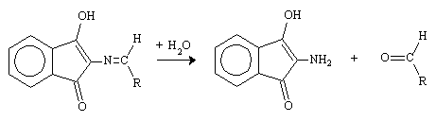
Biochemistry course A1 DV ; Prof A. MEKROUD , 2019/2020
-L' α amino alcohol loses one mole of water , then one mole of _{CO2} ,
in giving an imine,
This imine is hydrolyzed, releasing an aldehyde and an amine.

Slide 34
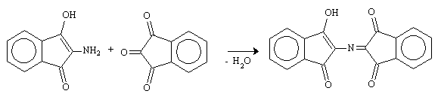
Biochemistry course A1 DV ; Prof A. MEKROUD , 2019/2020
The released amine reacts with another mole of ninhydrin to give
a new cetimine,
This highly delocalized compound is colored.
It is called Ruheman Purple.
It should be noted that only one nitrogen atom remains from
the initial amino acid in the final dye.

Slide 35
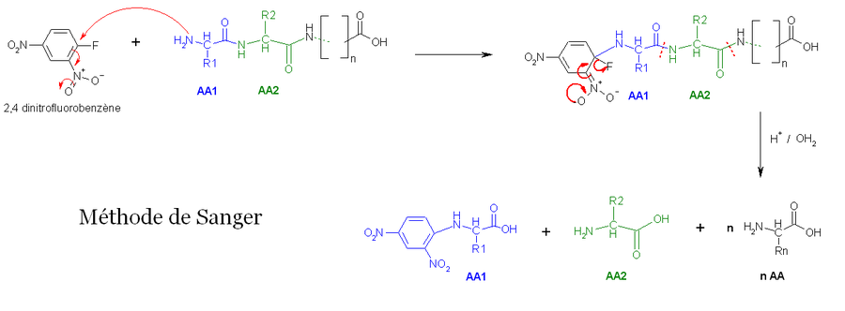
Biochemistry course A1 DV ; Prof A. MEKROUD , 2025/2026
Action of 1Fluoro 2.4DiNitroBenz ( FDNB )
This compound reacts readily with amine groups to form N , 2,4- dinitrophenyl derivatives . This compound is colored and therefore easily detectable by spectrophotometry ( Sanger reaction ) .

Slide 36
PEPTIDES
Biochemistry course A1 DV ; Prof A. MEKROUD , 2025/2026
1. Definition
Peptides are synthetic or natural compounds resulting from the limited chaining of amino acids linked together by peptide bonds.
–COOH of the functional group and
–NH2 of the functional group of the following amino acid.
By convention, a sequence is read with
The first amino acid carries a free –NH2.
The last one carries a free –COOH.
Different peptides
Oligopeptides: number of amino acids < 10
Polypeptides: 10 < number of amino acids < 100

Slide 37
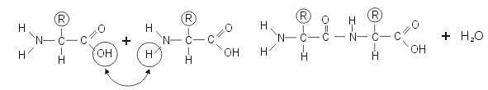
Biochemistry course A1 DV ; Prof A. MEKROUD , 2025/2026
The peptide bond
Amino acids can link to each other by a bond
peptide.
The peptide bond is formed between the acid group (COOH)
of one amino acid and the amine group (NH2) of the other
During the reaction , a water molecule is eliminated .
This is therefore once again a condensation reaction .

Slide 38
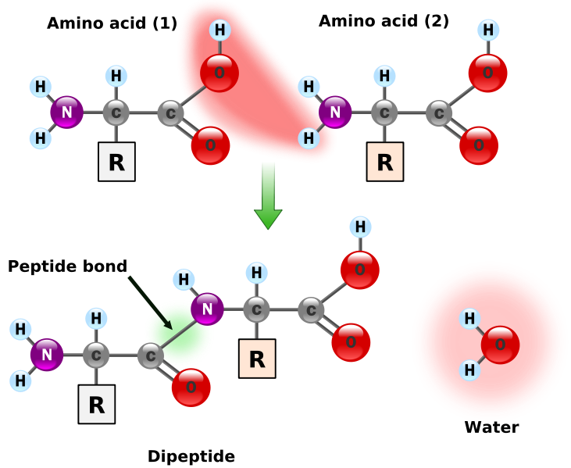
Biochemistry course A1 DV ; Prof A. MEKROUD , 2025/2026
THE PEPTIDE BOND = A DIPEPTIDE

Slide 39

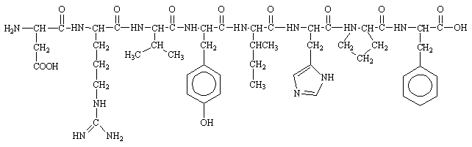
Biochemistry course A1 DV ; Prof A. MEKROUD , 2025/2026
Representation:
By convention, peptides are written with the N-terminal amino acid (which has the free -NH2 group) on the left and the C-terminal amino acid (which has the free -COOH group) on the right.
Thus Gly-Ala means:
This allows us to represent fairly complex molecules such as angiotensin II, a blood hormone that regulates blood pressure:
Asp----Arg----Val----Tyr----Ile---His---Pro----Phe

Slide 40
Biochemistry course A1 DV ; Prof A. MEKROUD , 2025/2026
Determination​​ of the structure.
The Peptides : These are the simplest to analyze because they do not present the problem of structure (relatively small size ) . The first step is to determine the nature and mass of each of the amino acids that compose them. Then , the order (the sequence ) in which these acids are linked must be determined .
purified peptides are hydrolyzed with a dilute acid solution ( 6N HCl , 110°C, 24 h). The amide bonds are broken and the amino acids are released . They are then analyzed qualitatively and quantitatively by liquid chromatography .
(such as chromatography ) ( ion exchange , or on thin layers, or on paper)
The second problem is more delicate . It was solved by Sanger in 1953 by determining the structure of insulin (Nobel Prize in Chemistry 1958) , and by Edman
The Sanger degradation uses 1 - Fluoro -2,4 - dinitrobenzene as a reagent . compound​ favors aromatic substitution by addition - elimination by character​​ strongly attractor of benzene substituents .

Slide 41



Biochemistry course A1 DV ; Prof A. MEKROUD , 2025/2026
On a peptide, it reacts with the free amino end, giving
Hydrolysis next cuts the peptide bonds but not the DNP-NH cycle bond.
We recover​​​​ thus the acid amin é N- terminal of the chain î ne . This reaction opened​​​
the path of analysis , but the rest of the chain​ is no longer connected and the information
its structure is​ lost .
The method​​ next allow Analysis of the entire sequence .
The degradation​​​​ Edman appeals​ to another​ reactive​​ phenyl isothiocyanate .​​​

Slide 42

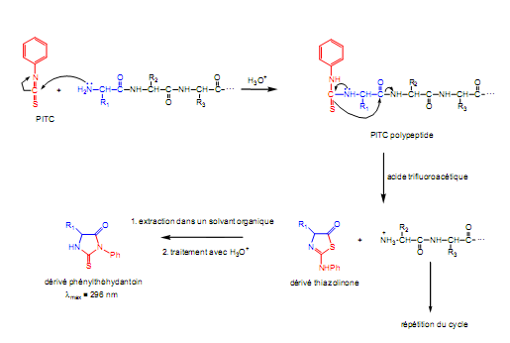
Biochemistry course A1 DV ; Prof A. MEKROUD , 2025/2026
This function isothiocyanate very sensitive to nucleophiles leads to
a thiourea , by addition of NH to the N=C double bond .

Slide 43
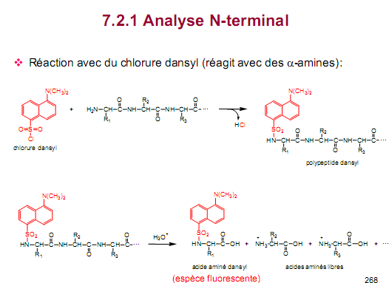
Biochemistry course A1 DV ; Prof A. MEKROUD , 2025/2026
AMINO ACID DANSYLATION
The chloride of 1 - dimethylamino -naphthalene - 5 - sulfonic acid (or dansyl chloride ) reacts readily with
It leads to highly fluorescent sulfonamide derivatives , which are therefore easily detectable .
This reaction is 100 times more sensitive than the Sanger reaction and allows the detection of minute quantities .
of an amino acid

Slide 44
Biochemistry course A1 DV ; Prof A. MEKROUD , 2025/2026
SEPARATION, QUALITATIVE AND QUANTITATIVE EVALUATION OF
AMINO ACIDS
The methods are numerous and are divided into different categories :
Separation by countercurrent
Chromatographic methods​
Electrophoretic methods​​​​​
AMINO ACID SEQUENCING
This involves knowing the sequence of amino acids
Example: an ABC tripeptide . There are no rules in the sequences of amino acids and
All probabilities are possible: ABC, ACB, BCA, BAC, CBA, and CAB. This order of
Sequence is genetically determined
Determination of terminal amino acids
This is generally the first step in any sequence study because this determination is often easy , but also because of the number of groupings
terminals allow us to obtain information about the shape of the polypeptide molecule
and on the number of polypeptide chains constituting the protein chain .
IN FRENCH LANGUAGE
FAIRE​​
F- O -IRE
FA- O -RE

Slide 45
Biochemistry course A1 DV ; Prof A. MEKROUD , 2025/2026
Determination of free terminal α -amino groups
There are many, but only three will be developed: two chemical and one enzymatic.
Fluoro Methods DiNitro Benzene (FDNB) SANGER'S METHOD
This method allows the N-terminus to be protected so that the terminal DNP-amino acid can then be recovered (e.g.,
DNP-alanine,….).
Phenylisothiocyanate (PITC) or phenylthiohydantoin method = Edman's reaction
Enzymatic degradation by aminopeptidase
This enzyme hydrolyzes the peptide bond where the N-terminal amino acid is attached. After detaching the first amino acid, it releases the second, which in turn carries the free

Slide 46
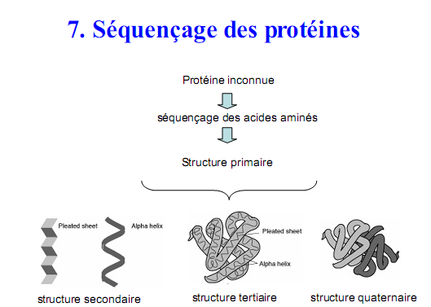
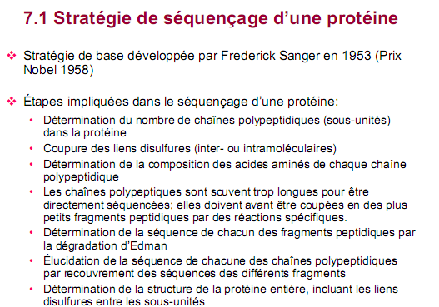
Biochemistry course A1 DV ; Prof A. MEKROUD , 2025/2026

Slide 47
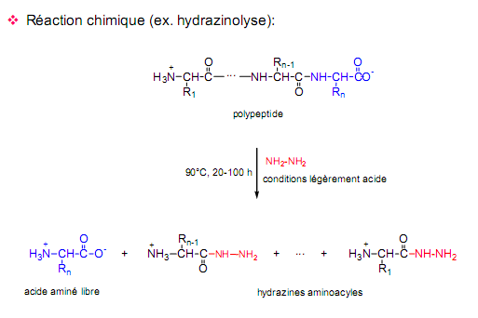
Biochemistry course A1 DV ; Prof A. MEKROUD , 2025/2026
Determination of free terminal α -carboxylic groups
We will mention a chemical method and an enzymatic method
Hydrazinolysis
If a protein is treated with hydrazine at 100°C , all peptide bonds are broken and all the
The residues are transformed into hydrazides except for the C-terminal residue which is found in the form of AA
free, easy to isolate and identify .
Enzymatic degradation using a carboxypeptidase .​​​
This enzyme of pancreatic origin acts progressively by detaching the last amino acid
C-terminal and so on.

Slide 48
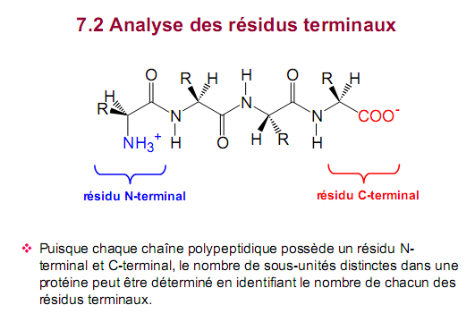
Biochemistry course A1 DV ; Prof A. MEKROUD , 2025/2026

Slide 49
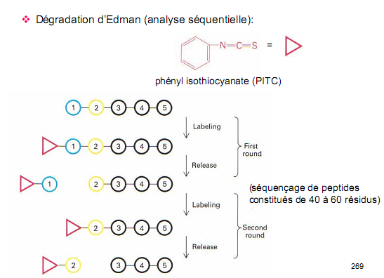
Biochemistry course A1 DV ; Prof A. MEKROUD , 2025/2026

Slide 50
Biochemistry course A1 DV ; Prof A. MEKROUD , 2019/2020
PITC = Phenylisothiocyanate

Slide 51
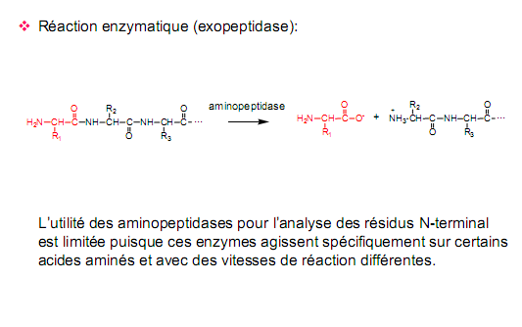
Biochemistry course A1 DV ; Prof A. MEKROUD , 2019/2020

Slide 52
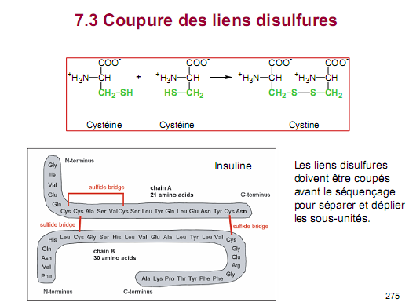
Biochemistry course A1 DV ; Prof A. MEKROUD , 2019/2020

Slide 53
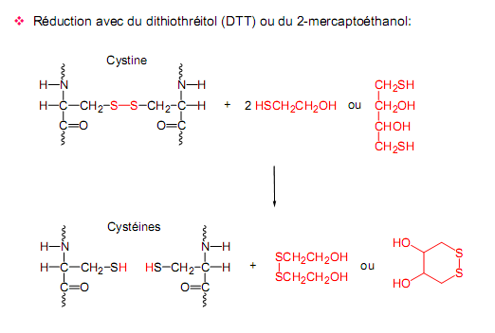
Biochemistry course A1 DV ; Prof A. MEKROUD , 2019/2020

Slide 54
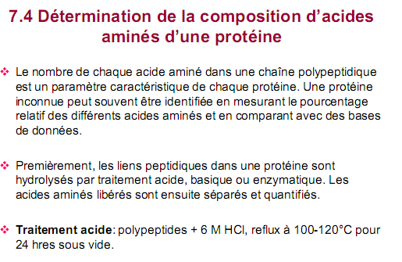
Biochemistry course A1 DV ; Prof A. MEKROUD , 2019/2020

Slide 55
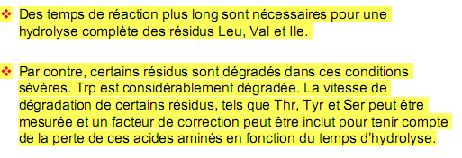

Biochemistry course A1 DV ; Prof A. MEKROUD , 2019/2020

Slide 56
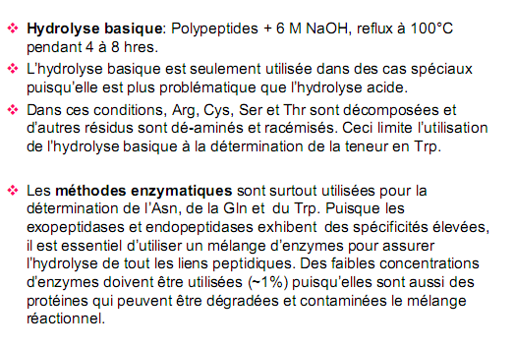
Biochemistry course A1 DV ; Prof A. MEKROUD , 2019/2020

Slide 57
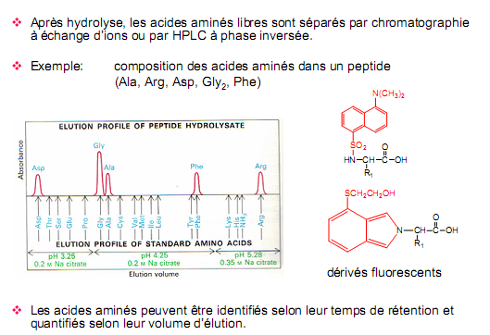
Biochemistry course A1 DV ; Prof A. MEKROUD , 2019/2020

Slide 58
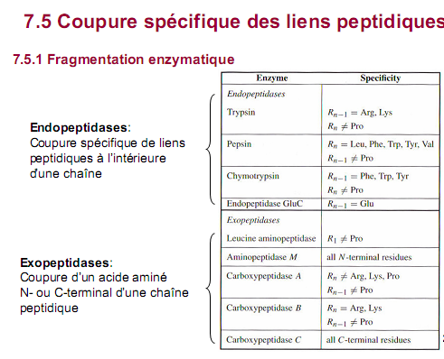
Biochemistry course A1 DV ; Prof A. MEKROUD , 2019/2020

Slide 59
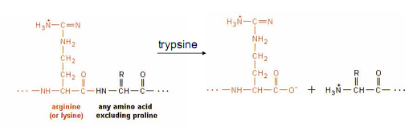
Biochemistry course A1 DV ; Prof A. MEKROUD , 2019/2020

Slide 60
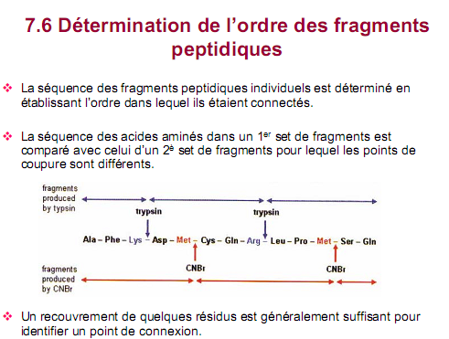
Biochemistry course A1 DV ; Prof A. MEKROUD , 2019/2020

Slide 61
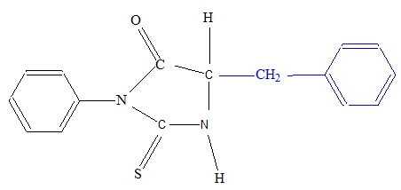
Biochemistry course A1 DV ; Prof A. MEKROUD , 2019/2020
Exercise on determining the primary sequence
proteins.
Amino acid analysis of an oligopeptide composed of 7 amino acids yields: Asp ; Leu; Lys; Met; Phe ; Tyr. The following facts were observed:
Treatment with trypsin has no apparent effect.
Edman degradation yields the following product:

Slide 62
Biochemistry course A1 DV ; Prof A. MEKROUD , 2019/2020
Exercise on determining the primary sequence
proteins.
Treatment with chymotrypsin yields a free amino acid, a dipeptide, and a tetrapeptide . The amino acid composition of the tetrapeptide is Leu, Lys, and Met.
Cyanogen bromide gives a dipeptide, a tetrapeptide and a lysine.

Slide 63
Solution
Biochemistry course A1 DV ; Prof A. MEKROUD , 2019/2020
We have an oligopeptide composed of 7 amino acids. Breakdown into amino acids yields 6 residues instead of 7. Therefore, one amino acid is duplicated. Trypsin has no effect, so lysine is in the C-terminal position. Edman degradation produces phenylalanine at the N-terminus.
Cyanogen bromide cleaves after methionine. Therefore, there is a methionine molecule before the lysine (since a free lysine molecule is obtained). A second methionine molecule remains in the chain (because there is a dipeptide in the chain in addition to the tetrapeptide ).
Phe ……………………………………………….Lily
Phe ---X---Y--- Met ---Z---Met---Lys

Slide 64
Solution
Biochemistry course A1 DV ; Prof A. MEKROUD , 2019/2020
Chymotrypsin gives a tetrapeptide, a dipeptide and a free AA, this means that after phe there is an AA then another cyclic AA ( phe —X—Tyr).
The remaining fragment will be formed from the following amino acids: Leu, Lys, and Met. Therefore, the second Met is part of the tetrapeptide . The two methionines cannot be adjacent; otherwise, the reaction with cyanogen bromide would have yielded: 1 pentapeptide , 1 Met alone, and 1 Lys alone.
The remaining Amino Acid (X) can only be Asp (cited in the initial list.
Final sequence:
Phe --X—Tyr---Met-leu-met-Lys
Phe - Asp -Tyr-Met-leu-met-Lys

Slide 65
Biochemistry course A1 DV ; Prof A. MEKROUD , 2019/2020
C-terminal identification | N-terminal identification | Methods​​
Hydrazinolysis | Sanger method ( FluoroDiNitroBenzene FDNB) | Method chemical
 | Method Edman ( PhenylIsoThioCyanate PITC) | Method chemical
Carboxypeptidase | Aminopeptidase | Enzymatic method
Hydrolysis partial Trypsin : AA1 = Lys / Arg Chymyotrypsin : AA1 = Phe / Trp / Tyr Pepsin : AA2 = Phe / Trp / Tyr Thermolysin : AA2 = Leu / Ile / Val

Slide 66
Biochemistry course A1 DV ; Prof A. MEKROUD , 2019/2020
Examples of some peptides
1. Small peptides
Aspartame
Asp-Phe-O-CH ₃
Twice the sweetening power of sucrose
2. Hormonal peptides
Posterior pituitary hormones:
Oxytocin,
Vasopressin
Pancreatic hormones
Glucagon
Insulin
3. Antibiotic peptides
Tyrocidine A
Penicillins

Slide 67
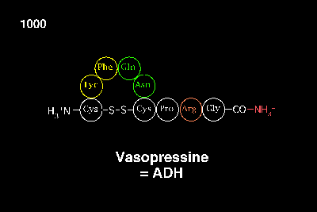
Biochemistry course A1 DV ; Prof A. MEKROUD , 2019/2020
EXAMPLE OF A PEPTIDE STRUCTURE

Slide 68
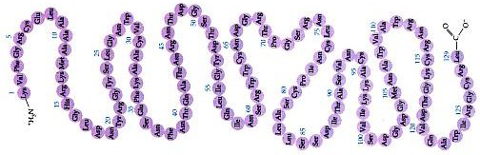
Biochemistry course A1 DV ; Prof A. MEKROUD , 2019/2020
EXAMPLE OF A PEPTIDE STRUCTURE
Lyzozyme

Slide 69
Biochemistry course A1 DV ; Prof A. MEKROUD , 2019/2020
PROTEINS
DEFINITION
A protein , also called a protein , is an assembly of amino acids .
linked by peptide bonds .
We speak of a protein when more than 50 amino acids are linked within a molecule.
chain of amino acids .
FUNCTIONS
Proteins have very diverse functions
Structure : protein fibers​
Movement : muscle contraction
Transportation : of substances in the blood
Transport: of substances across the cell membrane
Hormones : insulin, glucagon, vasopressin, …
Cell identification : receptors
Defense :​ antibodies
Catalysis: Enzymes

Slide 70
Biochemistry course A1 DV ; Prof A. MEKROUD , 2019/2020
PROTEINS
1. Protein classification methods
1.1. According to their shapes
1.1.1. Fibrous proteins
Polypeptide chains are elongated and coiled around an axis in a helical shape . They are structural proteins.
They can be extracellular , in which case they are insoluble in water and have a protective function.
α-keratin of the hair,
silk fibroin ,
skin elastin ,
tendon collagen .
They can also be intracellular, for example the
Myosin and tropomyosin of muscle cells.
Be careful not to confuse fibrous and filamentous (globular proteins attached to each other).

Slide 71
Biochemistry course A1 DV ; Prof A. MEKROUD , 2019/2020
PROTEINS
1.1.2. Globular proteins
Soluble in water, they are spherical in shape . They have a much more complex structure than fibrous proteins but exhibit a far greater variety of biological activities.
They can be membrane-bound and will then have roles such as:
carrier ,
receptors ,
ion channels ,
Cell adhesion proteins ...
They can be soluble and therefore be circulating plasma proteins such as albumin, protein hormones such as LH, cytosolic proteins such as calmodulin .

Slide 72
Biochemistry course A1 DV ; Prof A. MEKROUD , 2019/2020
PROTEINS
1.2. According to their functions
They can be involved in:
Structure and support , as is the case with collagen, elastin, membrane glycoproteins...
Contraction : actin, myosin ...
cell adhesion such as proteins like cadherin ,
signal reception such as membrane receptors for insulin or intracellular receptors for steroids,
signal transduction , the typical example being membrane G proteins

Slide 73
Biochemistry course A1 DV ; Prof A. MEKROUD , 2019/2020
PROTEINS
a signal : they can be the informational molecule such as growth factors (GF) or protein hormones (FSH),
Immunity is the role of immunoglobulins .
transport​ such as hemoglobin (O2 ₎ and transferrin (iron),
catalysis​ These proteins will therefore also play a role in metabolism, DNA replication and transcription, muscle contraction, cell signaling...
1.3. According to their composition
There are two main types of proteins. Those containing only amino acids are holoproteins .
Those containing a protein portion (the apolipoprotein ) and a non-protein portion are heteroproteins .
These two portions are linked in various ways: covalent , ionic , hydrogen , or hydrophobic bonds . This non-protein portion can be a prosthetic group ( inducing new biological properties by binding, as with the heme group in hemoglobin ).

Slide 74
Biochemistry course A1 DV ; Prof A. MEKROUD , 2019/2020
PROTEINS
The unique properties of each protein depend on the types of amino acids that
They are composed of them and their sequence. We can consider the 20 AAs as
an "alphabet" of 20 letters, used to construct "words" (the
proteins) Thus, one can change the meaning of a word by replacing a
letter by another.
Ex : Faire or Foire . It is clear that the meaning is different and therefore the
The protein is also different.
Sometimes the new word makes no sense (e.g., faire becomes faore ) , this
non-functional proteins . Ex: hemoglobins
human pathologies ( anemic sickle cell hemoglobin S). It does not
different from normal hemoglobin only at the level of the ^{6th} acyl residue of
β chain (glutamate replaced by valine and lysine)

Slide 75
Biochemistry course A1 DV ; Prof A. MEKROUD , 2019/2020
PROTEINS
I. Properties of proteins​​​​
1 . physico - chemical properties​
Solubility of globular proteins Influence of salt concentration (ionic strength µ )
:
Low concentration Increased protein solubility = dissolving effect
High concentration Protein precipitation = release effect​​
( reversible by dilution )
Influence of pH
Minimum solubility at pHi
Influence
of temperature High Temperature Denaturation​​​​​​​​
Influence of organic solvents
Ethanol and acetone insolubilize proteins​​​​
Electrical properties : Proteins , made up of amino acids ,
carry electrical charges .​
variables depending on pH. Each protein has an isoelectric point for which the
Mobility in an electric field is zero: overall electric

Slide 76
Biochemistry course A1 DV ; Prof A. MEKROUD , 2019/2020
PROTEINS
2. physical properties​​​
Sedimentation​​ : ultracentrifugation​
Viscosity : high​​​​
optical properties​​​
Function of the solution concentration
The size and shape of the molecule ; the
structure (absorption at 280 nm)
Molar mass
several thousand daltons
Light scattering , gel chromatography, filtration
,
polyacrylamide gel electrophoresis with SDS ( Sodium Dodecyl Sulfate )
Ultracentrifugation
3. chemical properties​​​
Properties of the peptide bond
; Hydrolysis of the peptide bond
Total or partial chemical hydrolysis
Enzymatic hydrolysis

Slide 77
Biochemistry course A1 DV ; Prof A. MEKROUD , 2019/2020
PROTEINS
3. chemical properties​​​
Hydrazynolysis
Biuret reaction​
Proteins + NaOH + CuSO4 with purple coloration
Protein interactions with other substances
: Specific interactions
With carbohydrate or polysaccharide macromolecules
Enzyme-substrate antigen - antibody ; hormone receptor ;
protein - ligand Non
- specific interactions
Fixation on non -
mineral substances Fixation to insoluble substrates bearing hydrophobic radicals
Adsorption of various dyes . Properties of side chains . Absorption at 280 nm
4. biological properties​​​
Proteins = Enzymes , antigens , antibodies, hormones, structural proteins ,
etc. …

Slide 78
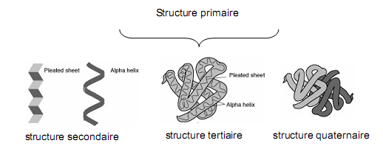
Biochemistry course A1 DV ; Prof A. MEKROUD , 2019/2020
PROTEINS
THREE-DIMENSIONAL ORGANIZATION
primary structure , which is the linear sequence of amino acids
in the protein .
the secondary structure , which accounts for the organization of groups
of amino acids in simple structural elements : alpha helices , leaflets
and beta towers, other structures.
the tertiary structure , which corresponds to the folding of the protein in
three-dimensional space (also referred to as three-dimensional structure)
( described by the coordinates of the atoms in space). This structure makes
taking into account the organization of secondary structural elements .
the quaternary structure , which defines the association ( multimerization ) between
proteins with identical ( homoassociation ) or distinct primary structures
( heteroassociation ) .​​​

Slide 79
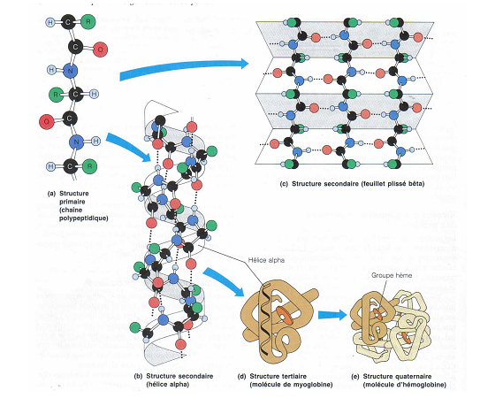
Biochemistry course A1 DV ; Prof A. MEKROUD , 2019/2020
THREE-DIMENSIONAL STRUCTURE OF PROTEINS

Slide 80
Biochemistry course A1 DV ; Prof A. MEKROUD , 2019/2020
PROTEINS
THREE-DIMENSIONAL ORGANIZATION
SECONDARY STRUCTURE
Four main types of interactions are involved in the folding of the
chain :​
The hydrophobic effect
Amino acids with hydrophobic radicals have a greater affinity
between themselves and with the water molecules surrounding the protein . The chain has
therefore a tendency to retreat in such a way as to regroup them together in the center of
the molecule , without direct contact with water. Conversely, amino acids
Hydrophilic molecules tend to position themselves at the periphery so as to be in
contact with water.
Ionic bonds
Positively ionized radicals form ionic bonds with those
which ionize negatively .
Hydrogen bonds​
Disulfide bridges
Two of the 20 amino acids have radicals containing a sulfur atom. This is the
In the case of cysteine , two cysteines can form a covalent bond with each other.
through the sulfur atom of their radical. This covalent bond can
connect two cysteines far apart on the chain .

Slide 81
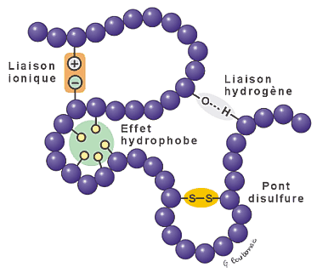
Biochemistry course A1 DV ; Prof A. MEKROUD , 2019/2020
PROTEINS

Slide 82
Biochemistry course A1 DV ; Prof A. MEKROUD , 2019/2020
PROTEINS
Pleated sheet structure β
The planes of successive bonds are arranged in a zigzag pattern and form angles close to 160°.
The side chains are alternately distributed on either side of the planes.
The bonds are formed by hydrogen bridges located in the planes of the pleated sheet between the –CO groups of one bond and the –NH groups of another peptide bond .
α helix structure​
The secondary structure is generated by the rotation of the atoms of the peptide chain relative to each other during the synthesis of the chain .
The most frequent secondary structure is the helix , which rotates the carbon chain about its own axis by one turn approximately every four amino acids . It is stabilized by hydrogen bonds between the carbonyl group of the peptide bond following amino acid number 1. 1 with the amine of the peptide bond that precedes amino acid no . 5, then similarly between amino acids 2 and 6, etc...
It also happens very often that several portions of chains join edge to edge and in opposite directions ( antiparallel ) to form a sheet where the carbonyls of each amino acid of one portion of the chain bond with the amines of the other portion.
In fibrillar proteins (collagen , keratin , fibroin , etc. ) we find other types of helices , which are often wound around each other in super- helices , etc.

Slide 83
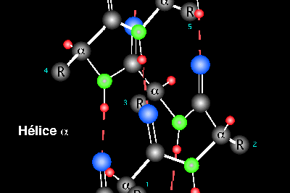
Biochemistry course A1 DV ; Prof A. MEKROUD , 2019/2020
PROTEINS
The alpha

Slide 84
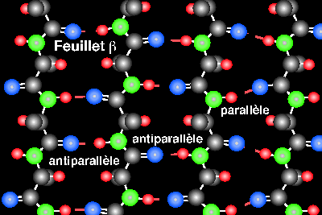
Biochemistry course A1 DV ; Prof A. MEKROUD , 2019/2020
PROTEINS
The beta sheet
In a beta sheet, hydrogen bonds form between certain segments of
The chain is arranged parallel to each other. The whole forms
pleated membrane . In a β - pleated sheet , two peptide chains
are folded and aligned side by side . The β - folding of the peptide chains
is favoured in the case of amino acids bearing small " R " side groups
uncharged . The peptide chains are held together by hydrogen bonds .
The lateral " R " groups are oriented outwards , pointing towards the
top and bottom of each sheet. Adjacent chains can be aligned ,
either in the same direction (parallel folds β ) or in opposite directions
(anti-parallel folds è le β) .

Slide 85
Biochemistry course A1 DV ; Prof A. MEKROUD , 2019/2020
PROTEINS
TERRITORIAL STRUCTURE
The final form of the amino acid chain , that is to say the structure
The final three-dimensional (3D) structure adopted by the amino acid chain
constitutes the tertiary structure of the protein . It includes the relationship
between the different domains ( α helix and β pleated sheets) formed by the
secondary structure of the protein and the interactions of lateral groupings
“ R ”​
The 3-D structure is thermodynamically stable within a restricted range
of temperature , pH, and ionic strength. Beyond this range, a protein can
unfold and lose their biological activity (denaturation ) .
Denaturing​​
Definition : It corresponds to a loss of configuration in space
( change of
Secondary, Third and Fourth grade structures) : the denatured protein is in a
state​ disordered . Conversely , the active protein is said to be native ( most
stable state ) .Therefore

Slide 86
Biochemistry course A1 DV ; Prof A. MEKROUD , 2019/2020
PROTEINS
Protein denaturation
Proteins are very sensitive to temperature changes and pH . These changes can lead to alterations in the tertiary structure , which greatly affects protein function, especially when the active site is affected. The active site is where the enzyme 's substrate binds.

Slide 87
Biochemistry course A1 DV ; Prof A. MEKROUD , 2019/2020
PROTEINS
Several conditions can cause protein denaturation :
Heat : Thermal agitation can cause the breaking of hydrogen bonds responsible for the structure of the protein.
pH : extreme acidity or alkalinity will disrupt the ionic interactions that stabilize proteins.

Slide 88
Biochemistry course A1 DV ; Prof A. MEKROUD , 2019/2020
PROTEINS
Solvent : Changing the solvent can alter the tertiary structure of proteins. For example, a polypeptide chain will change to present its hydrophobic parts on the outside if a protein is placed in a hydrophobic solvent.
Presence of detergents : the presence of detergents can interfere with protein-solvent interactions.
Fortunately, most denaturations are reversible . When a denaturation is irreversible , the protein can no longer reconstitute its tertiary structure ( for example, when cooking an egg white ) .

Slide 89
Biochemistry course A1 DV ; Prof A. MEKROUD , 2019/2020
PROTEINS
Denaturing agents,
physical agents,
temperature
, ultrasound,
ultraviolet,
pH,
chemical agents
Highly denaturing agents cause precipitation and denaturation: complex proteins coagulate as during hydration, with the opening of certain bonds and structural modifications.
Organic acids:
Nitric acid,
Perchloric acid.
Bases:
Heavy metal salts

Slide 90
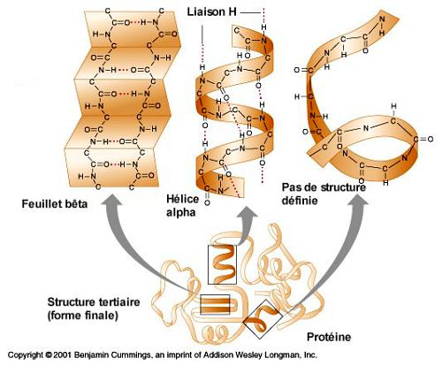
Biochemistry course A1 DV ; Prof A. MEKROUD , 2019/2020
PROTEINS

Slide 91
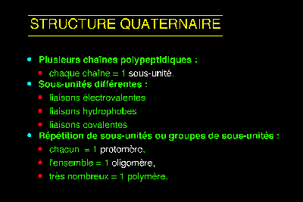
Biochemistry course A1 DV ; Prof A. MEKROUD , 2019/2020
PROTEINS
QUATERNARY STRUCTURE:
Each monomer is capable of ensuring biological function
Examples
Hemoglobin​​ : 4 monomers HbA a2b2
Glutaminosynth etase : 4 monomers N and H

Slide 92
Biochemistry course A1 DV ; Prof A. MEKROUD , 2019/2020
PROTEINS
PROTEIN CLASSIFICATION:
Holoproteins = true
proteins , fibrillar proteins​​
Keratins , Collagens , Globular Proteins
​​
Protamines, Histones, Prolamins, Albumins, Globulins,
Heteroproteins​​​​​​
Phosphoproteins​​
Case é ine
Lipoproté ines​
Glycoproteins​​
Chromoprotein Antibodies
​​
Myoglobin
Hemoglobin Nucleoproteins​
​​​​​

