Slide 1
LIPIDS
Biochemistry course A1 DV ; Prof A. MEKROUD , 2019/2020
2.1 Definition
These are organic molecules insoluble in water ( lipos ) and soluble in nonpolar organic solvents such as benzene, chloroform, ether, etc.
They are characterized by the presence in the molecule of at least one fatty acid or fatty chain.
Cholesterol, steroids, and vitamin D are linked to lipids due to their insolubility in water.
2.2 Biological role
Lipids make up about 20% of body weight.
They are a mobilizable energy reserve: 1g of lipids = 9 kcal
They have a precursor role: steroids, vitamins, prostaglandins.
Two polyunsaturated fatty acids are essential nutritional factors because they are not synthesized by the body and must be obtained through diet. These are indispensable fatty acids: linoleic acid and linolenic acid .
Membranes have a lipid structure.

Slide 2
LIPIDS
Biochemistry course A1 DV ; Prof A. MEKROUD , 2019/2020
2.3 Fatty acids
They are monoacids, linear, with an even number of carbons, either saturated or unsaturated.
2.3.1 Saturated fatty acids
[CH3 -(CH2)n - COOH]
4C Butyric acid
16C Palmitic acid
18C Stearic acid
24C Lignoceric acid

Slide 3
FATTY ACIDS
Biochemistry course A1 DV ; Prof A. MEKROUD , 2019/2020
NOMENCLATURE
The general nomenclature uses the representation : C n : X *
n: Number of carbon atoms
X: Number of double bonds, sometimes replaced by ∆
*: Position of double bonds, represented by the number
of the carbon closest to the carboxyl group.
saturated fatty acids , X = 0
Linoleic acid​
C ₁₈ :2 ^{9,12}
CH ₃ — (CH ₂ ) ₄ — CH=CH — CH ₂ — CH=CH — (CH ₂ ) ₇ -COOH
Myristic acid
C ₁₄ : 0
CH3 — ( _{CH2} ) ₁₂ --COOH​

Slide 4
FATTY ACIDS
Biochemistry course A1 DV ; Prof A. MEKROUD , 2019/2020
According to the most frequently used nomenclature ( Geneva system ) , the
Fatty acids are named according to the hydrocarbon having the same number
of atomsof carbon. The suffix OIQUE is then added :
- AG saturated : suffix ANOIC (alkane)
Unsaturated AG : suffix ENOIQUE ( alkene )

Slide 5
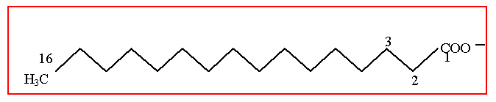
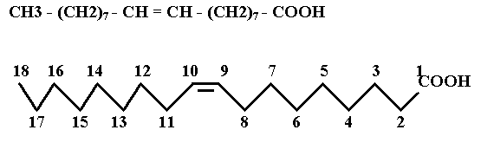
FATTY ACIDS
Biochemistry course A1 DV ; Prof A. MEKROUD , 2019/2020
The first carbon is the carboxyl group. Example: Palmitic acid CH3-(CH2)14-COOH
It 's a general assembly
saturated​
Oleic acid​
It 's a general assembly
Unsaturated​
Monounsaturated or​
ethylenic​​​

Slide 6
FATTY ACIDS
Biochemistry course A1 DV ; Prof A. MEKROUD , 2019/2020
LIST OF MAIN NATURAL SATURATED FATTY ACIDS
Distribution in nature | Melting point | Common noun | Systematic name​ | Raw formula
Cow or goat butter | - 7°9 | Butyric acid | Butanoic | C4H8O2​​​​​
 | - 3°9 | A.C. Caproic | Hexanoic | C6H12O2​​​​​
 | + 16°3 | Caprylic acid | Octanoic | C8H16O2​​​​​
 | +31°3 | Capricorn | Deanic​​ | C ₁₀ H ₂₀ O ₂
Oils or fats animal or vegetable​​ | +44°1 | Ac laurique | Dod é canoique | C ₁₂ H ₂₄ O ₂
 | +54° | Ac myristique | Tetradonic​​​​ | C ₁₄ H ₂₈ O ₂
 | +63° | Palmitic acid | Hexad é canoique | C ₁₆ H ₃₂ O ₂
 | 69°5 | Stearic acid​ | Octade canonical​ | C ₁₈ H ₃₆ O ₂
 | +75°3 | Peanut oil | Eicosanoic | C ₂₀ H ₄₀ O ₂
 | +80° | Ac beh e nic​ | Docosanoique | C ₂₂ H ₄₄ W ₂
 | +84° | Ac lignocéric​ | Tetracosanoic​​ | C ₂₄ H ₄₈ O ₂
Waxes | +87°7 | Acetate​​ | Hexacosanoic | C ₂₆ H ₅₂ O ₂
 | +91° | Montanique Academy | Octacosanoic | C ₂₈ H ₅₆ O ₂
 | +93° | A. melisica​ | triacontanic | C ₃₀ H ₆₀ O ₂

Slide 7
FATTY ACIDS
Biochemistry course A1 DV ; Prof A. MEKROUD , 2019/2020
MONOSNASTATED OR MONOETHYLENENIC FATTY ACIDS
Oleic acid : C ₁₈ :1 ⁹
POLYUNSATURATED OR POLYETHYLENENIC FATTY ACIDS
Linolenic acid : C18 : 3 ^{9,12,15}
Arachidonic Acid: C ₂₀ :4 ^{5,8,11,14}

Slide 8
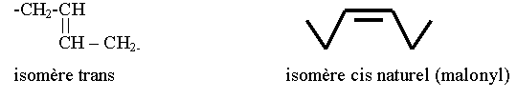
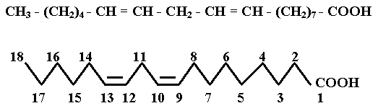
FATTY ACIDS
Biochemistry course A1 DV ; Prof A. MEKROUD , 2019/2020
The presence of a double bond in a fatty acid results in isomerism.
cis-trans. Natural fatty acids are cis:
2.3.3 Polyunsaturated fatty acids
Linoleic acid C ₁₈ :2 ^{9.12} Linoleic acid is an essential fatty acid
(Daily requirement: 3-4 g). It is a C18 fatty acid with 2 double bonds (9, 12).

Slide 9
FATTY ACIDS
Biochemistry course A1 DV ; Prof A. MEKROUD , 2019/2020
UNSATURATED OR ETHYLENENIC FATTY ACIDS
C
C
CIS configuration
C
C
C
C
C
C
Trans Configuration
C
C
C
C
C
C
C
C

Slide 10
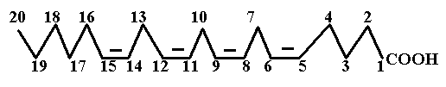
FATTY ACIDS
Biochemistry course A1 DV ; Prof A. MEKROUD , 2019/2020
Arachidonic acid C ₂₀ : 4 ^{5,8,11,14} It has 4 double bonds at positions 5, 8, 11, and 14. Linoleic acid is converted into arachidonic acid in the body at 20°C.
and 4 double bonds. In the absence of linoleic acid in the diet, the acid
arachidonic acid becomes indispensable.

Slide 11
FATTY ACIDS
Biochemistry course A1 DV ; Prof A. MEKROUD , 2019/2020
Properties of fatty acids
Physical properties:
Solubility
Butyric acid at 4C is soluble in water, then the solubility of fatty acids
decreases gradually and they are insoluble from 10C.
They are soluble in nonpolar organic solvents: benzene, chloroform, …
Melting point (MP); Boiling point ( BP):
increases with the number of C ( the longer the carbon chain, the higher the PF ).
Ex: palmitate (C16), mp = 70°C; Oleate (C18), mp = 80°C
The PF decreases as the number of double bonds increases.
Ex: Stearate (C18:0), mp = 70°C; Oleate (C18:1), mp = 13°C
Increases with chain length ( e.g., C16, PE=70°C; C18, PE=80°C)
However, the number of double bonds has no influence on the boiling point .
spectral properties​​​
Fatty acids absorb in the ultraviolet (UV) light. The maximum absorption depends on the number of double bonds:
does it mean, spectral properties , absorb in the UV , absorption maximum ?

Slide 12
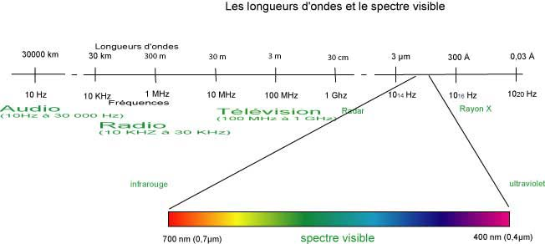
FATTY ACIDS
Biochemistry course A1 DV ; Prof A. MEKROUD , 2019/2020
Principle of Molecular Absorption Spectrophotometry​​​​​​​
A colored compound absorbs its own color or complementary colors .

Slide 13
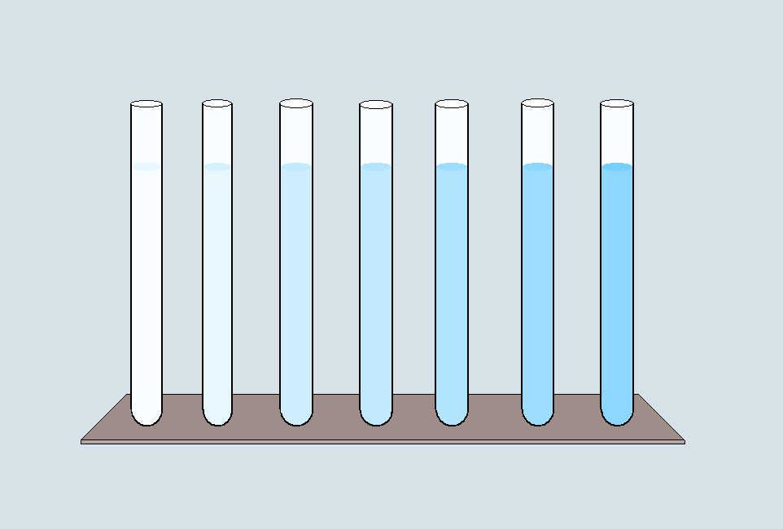
FATTY ACIDS
Biochemistry course A1 DV ; Prof A. MEKROUD , 2019/2020
Standard range , with increasing concentrations of copper sulfate (blue) = _{CuSO4}
It is noted that the more CuSO4 is put into the tube, the darker it becomes .
In reality , this observation should be interpreted differently :
The greater the number of CuSO4 molecules in the medium, the greater the amount of energy
The greater the absorbed light : In other words, the darker (or more opaque) the tube , the more
The light coming out of the tube is weak = MOLECULAR ABSORPTION HAS OCCURRED

Slide 14
1. Definition and principle
Biochemistry course A1 DV ; Prof A. MEKROUD , 2019/2020
Monochromatic light beam passing through a tank containing dissolved substance
I 0
I
Dissolved substance
I < I 0

Slide 15
Biochemistry course A1 DV ; Prof A. MEKROUD , 2019/2020
DIAGRAM OF A SINGLE-BEAM SPECTROPHOTOMETER
Cell
Photo
electric
Source
bright
Monochromator
Tank
Slot
entry
Slot
exit
Amplifier
Galvanometer
Or computer

Slide 16
Concept of absorption spectrum
Biochemistry course A1 DV ; Prof A. MEKROUD , 2019/2020
This is established in order to determine the maximum absorption of light by a given substance by varying the wavelength
For example, chlorophylls a and b absorb in the blue and red parts of the spectrum. But at what wavelength should the instrument be set to read the absorption of each chlorophyll under optimal conditions?

Slide 17
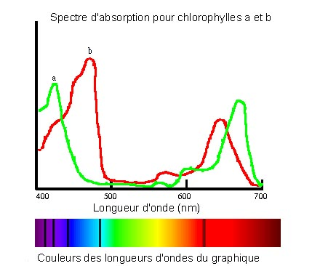
Biochemistry course A1 DV ; Prof A. MEKROUD , 2019/2020
480 nm
430 nm

Slide 18
FATTY ACIDS
Biochemistry course A1 DV ; Prof A. MEKROUD , 2019/2020
spectral properties​​​
Fatty acids absorb in the ultraviolet ( UV) light. The maximum absorption depends
the number of double bonds:
Example: 2 double bonds: 232 nm
3 double bonds: 268 nm
4 double bonds: 300 nm
chemical properties​​​ :
These will depend on two fundamental parameters
- The presence of the carboxyl function
- The presence of double bonds
( the carbon chain does not give the molecule any particular chemical properties )
Properties due to the carboxyl group ( COOH)
- Formation of salts: (saponification)
The action of metallic hydroxide ( NaOH or KOH) on a fatty acid gives rise to an alkali
salt or soap . Alkaline salts are soluble in water and possess foaming and
emulsifiers​

Slide 19
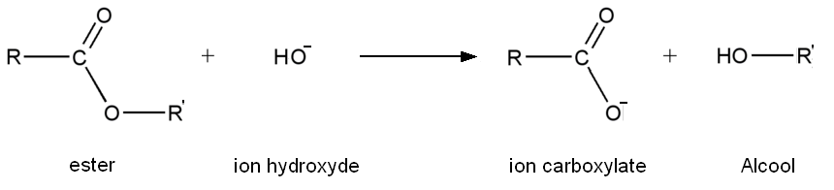
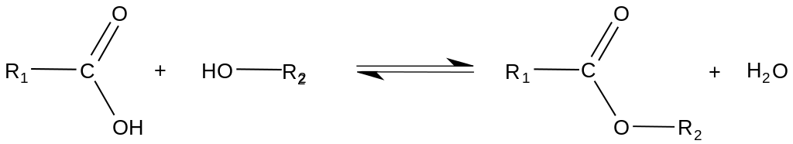
FATTY ACIDS
Biochemistry course A1 DV ; Prof A. MEKROUD , 2019/2020
Saponification reaction with NaOH or KOH
NaOH
H2O​​
H
N / A
Ester formation​
The esterification reaction requires , from a chemical point of view, the presence of a mineral acid such as
Catalyst. In living organisms, this reaction is catalyzed by specific enzymes : Esters
Properties due to the presence of double bonds​
Reduction ( or addition reaction )​
The addition of hydrogen to the double bond(s) transforms the unsaturated
Example: Ol é ate (C18:1) + 2H
Stearate ( C18 :0)
vitro , the catalyst is platinum black. It is thanks to this process that in the food industry,
Vegetable oils are transformed into margarines .

Slide 20
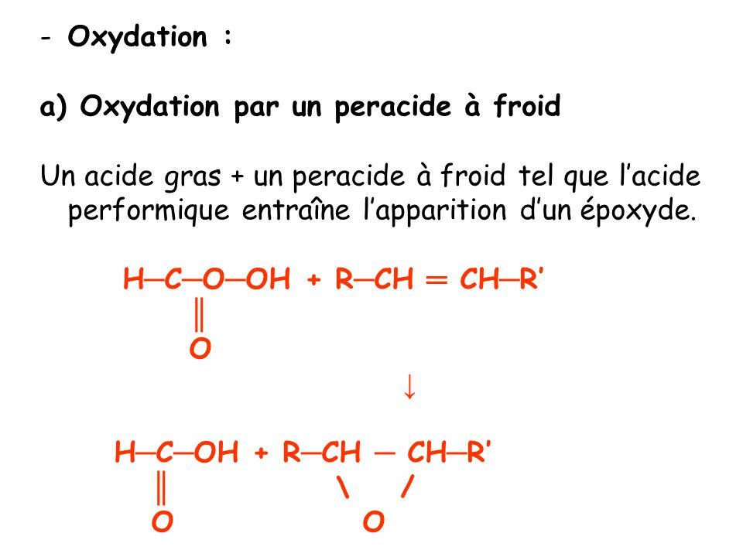
FATTY ACIDS
Biochemistry course A1 DV ; Prof A. MEKROUD , 2019/2020
Oxidation
This is done by a peracid: a molecule possessing an oxygen atom between the carbon
and the OH group oxidizing power e.g., performic acid
low temperatures : the oxidation of an ethylene glycol by a peracid leads to an epoxide
(compounds that are very toxic to the skin)

Slide 21
FATTY ACIDS
Biochemistry course A1 DV ; Prof A. MEKROUD , 2019/2020
When heated: at 50°C , under the action of a mineral salt , a fatty acid gives a glycol.
R-CH=CH-(CH2)n-COOH R-CH ₂ -CHOH-(CH₂)n- COOH

Slide 22
FATTY ACIDS
Biochemistry course A1 DV ; Prof A. MEKROUD , 2019/2020
Autooxidation of unsaturated fats
This process normally develops in open air and gives fats an odor
Characteristic (it 's rancidity). This auto -oxidation can be activated by
Organic ( epoxides ) or biological ( lipoxidases ) catalysts. Rancidity leads to
to the formation of toxic byproducts . In the food industry, this auto - oxidation is
partially avoidable thanks to the use of antioxidants .​
Fixation of halogens ( Br , I)
Iodine binds to the carbons of double bonds :
R---CH==CH---R ' + I ₂ R---CH I ---CH I- --R
Interest :​ This property is used for determining the number of double bonds .
The iodine index is defined as follows : it is the number of iodine ( I2) molecules needed
For saturate all the double bonds of an unsaturated fatty acid .
Isomerization :​
The cis - trans isomerization of natural unsaturated fatty acids is possible by chemical
means. It is very slow to room temperature and faster when warm. (This is one of the
factors of rancidity of fats ) .
C ₁₈ :1 ⁹
(Cis)
Ac . oleic​
Elaidic Acid
C ₁₈ :1 ⁹
(Trans)

Slide 23
FATTY ACIDS
Biochemistry course A1 DV ; Prof A. MEKROUD , 2019/2020
SEPARATION OF FATTY ACIDS :
The analysis of fatty acid mixtures obtained by hydrolysis of natural lipids poses no
problem since the use of gas chromatography (GC ) , a process
very precise and very sensitive analysis .​​
Principle: This is partition chromatography, which is only used for molecules
molecular weight and are volatile
Principle of GPC:
Separation, identification and quantification of volatile constituents of a mixture according to the partition coefficient between a stationary phase (solid or liquid) and a mobile phase (gaseous).
Separation based on retention time through the stationary phase (usually a column)

Slide 24
Equipment
Biochemistry course A1 DV ; Prof A. MEKROUD , 2019/2020
Microsyringe
Column of
Separation
Injection chamber
Gas
vector
Thermostatically controlled chamber
Detector
Recorder

Slide 25
Experimental technique and protocol:
Biochemistry course A1 DV ; Prof A. MEKROUD , 2019/2020
1. Solubilization of substances (appropriate organic solvents with no affinity for the stationary phase )
2. Injection of the sample using a microsyringe (injection chamber preheated to 350°C)
3. Volatilization of the solvent and the substances to be separated
4. Injection of a carrier gas flow (no affinity of the gas for the column)
5. Migration of substances through the column
6. Release of substances from the column (release order inversely proportional to retention time in the column = The greater the affinity for the column, the later the release of the substance will be)
7. Detection (by ultrasensitive measurement systems)
8. Recording (either on paper or directly on a control screen)

Slide 26
Examples of recording traces:
Biochemistry course A1 DV ; Prof A. MEKROUD , 2019/2020

Slide 27
Examples of recording traces:
Biochemistry course A1 DV ; Prof A. MEKROUD , 2019/2020

Slide 28
Biochemistry course A1 DV ; Prof A. MEKROUD , 2019/2020

Slide 29
Graph interpretation:
Gas chromatography (GC) allows for the identification of separate elements (retention times specific to each substance) = Qualitative Method
The separated elements can be quantified in relation to the height of the peak obtained and the area under the curve = Quantitative Method
Biochemistry course A1 DV ; Prof A. MEKROUD , 2019/2020
Areas of application :
very broad field , (e.g., AGL in serum ) but also the search for drug residues ( antibiotics ) or toxic substances ( organochlorines )

Slide 30
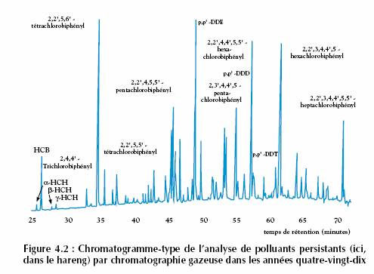
Biochemistry course A1 DV ; Prof A. MEKROUD , 2019/2020
Examples of actual gas chromatography traces

Slide 31
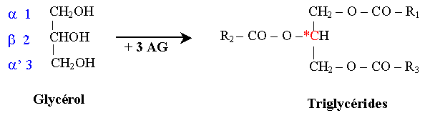
SIMPLE LIPIDS
Biochemistry course A1 DV ; Prof A. MEKROUD , 2019/2020
GLYCERIDES
These are simple lipids, ternary compounds made up of C, H, O
These are fatty acid esters + glycerol
If the 3 fatty acids are identical, the triglyceride is homogeneous; if they are different,
it is heterogeneous. These are the most numerous natural lipids present in the tissue
adipose (reserve fats) and in many vegetable oils.
They represent a significant energy reserve in humans.

Slide 32
Biochemistry course A1 DV ; Prof A. MEKROUD , 2019/2020
GLYCERIDES
NOMENCLATURE
This results from the combination of two criteria :
The nature of fatty acids is erifying glycerol
number and position of these fatty acids
Thus, mono-, di-, or triglyceride wrinkles can occur depending on the number
of acids bold present :
- Is distinguished by AGs of the same nature = Homogeneous
- Is erified by AGs of different nature = Heterogeneous​​​​

Slide 33
Biochemistry course A1 DV ; Prof A. MEKROUD , 2019/2020
GLYCERIDES
NOMENCLATURE
structure | General name​​​
 | α monoglyceride
CH2---O — CO — R CHOH CH2 — O — CO--R
 | αβ heterogeneous diglyceride
CH2---O — CO — R1 CH----O — CO — R2 CH2---O---CO---R3

Slide 34
Biochemistry course A1 DV ; Prof A. MEKROUD , 2019/2020
GLYCERIDES
Another nomenclature system takes into account the root of the acyl esterifying
glycerol by clearly defining its position, followed by the word glycerol .
Example: 1 ac . Palmitic in C1 = 1 palmitiyl glycerol or α palmityl glycerol
To be completed
1 palmitic acid in C1 and 2 stearic acids in C2 and C3 (name and structure)
=
3 oleic acids in C1, C2 and C3 (name and structure)
=
1 lauric acid at C1, 1 linolenic acid at C2, 1 stearic acid at C3 (name and structure)
=

Slide 35
Biochemistry course A1 DV ; Prof A. MEKROUD , 2019/2020
GLYCERIDES
HYDROLYSIS:
dilute acidic medium (H2SO4, at 5%), ester bonds are destroyed and we
This results in the release of fatty acids on the one hand and glycerol on the other .
SAPONIFICATION
A triglyceride treated with potassium hydroxide (KOH) gives rise to glycerol .
and fatty acids, but in the form of salts (or soaps)
This allows us to determine a saponification value, which will be higher the greater the amount of triglycerides to be saponified in the fats . The saponification value represents the amount of KOH (in mg) required to saponify 1 gram of fat.
Saponification index | Type of fat
196 | Animal fat
225 | Butter
185 | Olive oil​

Slide 36
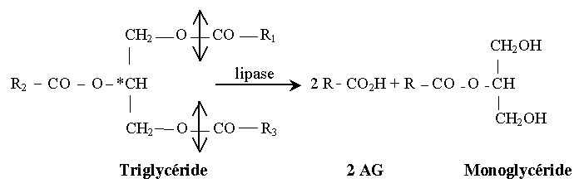
Biochemistry course A1 DV ; Prof A. MEKROUD , 2019/2020
GLYCERIDES
physico - chemical properties​
They are soluble in acetone, which differentiates them from phospholipids.
(they are very nonpolar).
Hydrolysis of triglycerides
Lipase, an enzyme in pancreatic juice, hydrolyzes triglycerides
monoglyceride-based foods + 2 fatty acids:
In adipose tissue, hydrolysis is complete because it involves
hormone-sensitive lipase, then monoglyceride lipase to give:
Glycerol + 3 AG

Slide 37
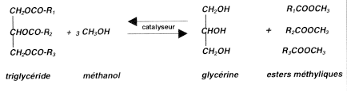
GLYCERIDES
Biochemistry course A1 DV ; Prof A. MEKROUD , 2019/2020
ALCOHOL LYSIS
This is done using alcohols (methanol or ethanol ) and we obtain on the one hand
methyl or ethyl esters of fatty acids and, on the other hand , glycerol
RANCING:
a chemical standpoint, it is an oxidation of the ethylene bonds
within unsaturated fatty acids . At times, oxidation can lead to the cleavage of
the chain at the level of the double bonds thus releasing aldehydes and fatty acids
volatile compounds that are the source of the unpleasant odor .​​
methanol

Slide 38
GLYCERIDES
Biochemistry course A1 DV ; Prof A. MEKROUD , 2019/2020
BIOLOGICAL PROPERTIES
Glycerides serve as energy reserves and are stored in the cytoplasm of adipocytes .
They act as thermal insulators. They provide mechanical protection against impacts and support for the components .
They are also metabolic intermediates in the synthesis and degradation of lipids .

Slide 39
Biochemistry course A1 DV ; Prof A. MEKROUD , 2019/2020
THE CERIDES
Definition:
These are esters of fatty acids and long-chain carbon alcohols and
High molecular weights. They are commonly called CIRES; they are part
lipids from animal waxes (insects or sperm)
The constituent alcohols are
Cerylic alcohol = ( _{CH3-} ( _{CH2} ) ₂₈ - _{CH2OH} )
Myricyl alcohol = ( _{CH3-} ( _{CH2} ) ₂₄ - _{CH2OH} )
Physicochemical properties:
Overall, cerides possess the same physicochemical properties.
than fatty acids and triglycerides
Biological properties:
This class of lipids has the particularity of primarily entering the structure
coating lipids

Slide 40
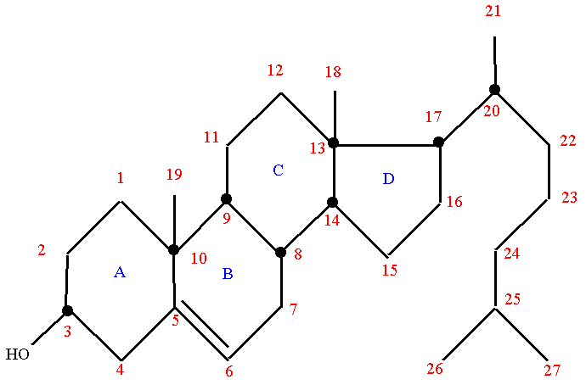
Biochemistry course A1 DV ; Prof A. MEKROUD , 2019/2020
STERIDES
These are cholesterol esters. Cholesterol is a compound structure
of 3 hexagonal cycles + one pentagonal cycle corresponding to the
cyclopentanoperhydrophenanthrene . It possesses a secondary alcohol function.
at C3 and a double bond at 5.

Slide 41
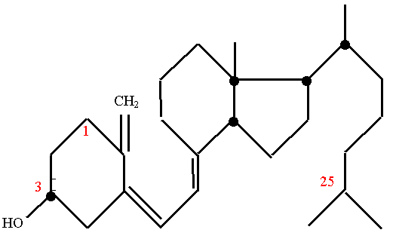
Biochemistry course A1 DV ; Prof A. MEKROUD , 2019/2020
STERIDES
Steride is formed by esterification of a fatty acid on the alcohol function at position 3 of cholesterol.
Cholesterol is obtained from food and synthesized by the liver; it is transported in the blood in lipoproteins.
It is a constituent of membranes (role in fluidity).
Cholesterol is used in the body for the synthesis of 3 groups of molecules: Steroid hormones (cortisol, testosterone, etc.), vitamin D3, and bile acids.
It is synthesized from a
precursor 7-dehydrocholesterol,
present in the skin, which transforms
vitamin D3 is produced under the effect of UV rays.
is metabolized in the liver where a
25-hydroxylase transforms it into 25-OH-
vitamin D3, and then the latter is
hydroxylated in the kidney by a 1-hydroxylase
to provide 1,25-dihydroxyvitamin D3
or calcitriol, which is a hormone. Calcitriol
Is responsible for all properties
Vitamin D3. Vitamin D3 is a
fat-soluble vitamin that prevents rickets
by promoting the fixation of calcium to the bone.
Vitamin D3 _{Formula} _{Or Cholecalciferol}

Slide 42
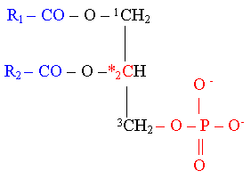
COMPLEX LIPIDS
Biochemistry course A1 DV ; Prof A. MEKROUD , 2019/2020
GLYCEROPHOSPHOLIPIDS
Phosphatidic acid
It is the basic element of glycerophospholipids.
Phosphatidic acid = Phosphoric ester of diglyceride
The two fatty acids
have a long chain
(14C), the fatty acid in
Position 2 is often
unsaturated.
The acidity of the molecule
comes from the 2 mobile H
free of phosphoric acid.

Slide 43
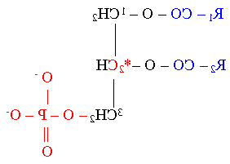
Biochemistry course A1 DV ; Prof A. MEKROUD , 2019/2020
GLYCEROPHOSPHOLIPIDS
Cardiolipin (or diphosphatidylglycerol)
Structure
H
HO-CH ₂
CHOH
CH2 ₋ OH
H
2 H ₂ O

Slide 44
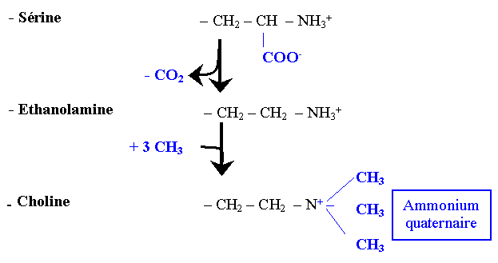
COMPLEX LIPIDS
Biochemistry course A1 DV ; Prof A. MEKROUD , 2019/2020
GLYCEROPHOSPHOLIPIDS
Glycerophospholipids
They are made up of phosphatidic acid + alcohol
Type of alcohol
The different classes of
glycerophospholipids Lipid is formed by attachment
of an alcohol on the acid
Phosphatidic. Depending on the alcohol, we obtain...
different classes of lipids.
Phosphatidylserines =
Phosphatidic Acids + Serine
Phosphatidylethanolamine s= CEPHALINES
Phosphatidic Acids + Ethanolamine
Phosphatidylcholines = LECITHINS
Phosphatidic Acids + Choline
Phosphatidylinositols =
Phosphatidic Acids + Inositol

Slide 45
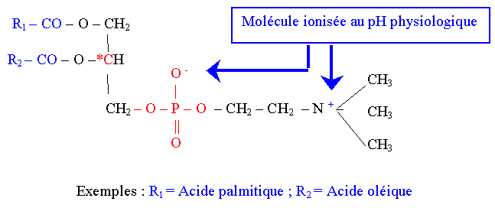
COMPLEX LIPIDS
Biochemistry course A1 DV ; Prof A. MEKROUD , 2019/2020
GLYCEROPHOSPHOLIPIDS
PHOSPHATIDYL-CHOLINES OR LECITHINS
They are found in the brain, liver, and egg yolk.

Slide 46
Biochemistry course A1 DV ; Prof A. MEKROUD , 2019/2020
PHOSPHATIDYL-CHOLINES OR LECITHINS
Actions of lecithinases
has
b
c
d
Lecithinase a = 1 AG + Lysolecithin
Lecithinase b = 1 AG + Glycerophosphocholine
Lecithinase c = Diglyceride + phosphocholine
Lecithinase d = Phosphatidic acid + choline

Slide 47
Biochemistry course A1 DV ; Prof A. MEKROUD , 2019/2020
Lecithins are waxy yellow substances found in the liver, the
egg yolk . This molecule can be acted upon by enzymes
specific : lecithinases or phospholipases​​​​
Lecithinases​
There are 4 enzymatic forms of lecithinases (each with a specific site of action)
for each of them
Form A: present in venoms (snakes, scorpions , bees, etc.), leads to
1 AG + a lysolecithin .
Form B: present in the pancreas. Only acts after the action of form A.
(therefore, on lysolecithin ). Causes intravascular hemolysis and
leads to 1 AG + glycerophosphocholine
Form C: Present in bacteria. Action independent of the two forms A
and B. Leads to 1 glyceride + phosphocholine
D : Extracted from vegetables. Leads to 1 phosphate + choline

Slide 48
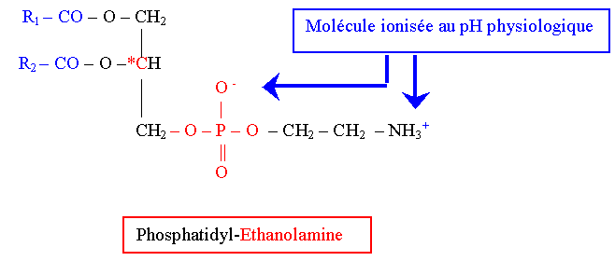
COMPLEX LIPIDS
Biochemistry course A1 DV ; Prof A. MEKROUD , 2019/2020
GLYCEROPHOSPHOLIPIDS
PHODPHATIDYL-ETHANOLAMINE OR CEPHALINS
At the pH of blood (7.35 - 7.45) the molecules are ionized.

Slide 49
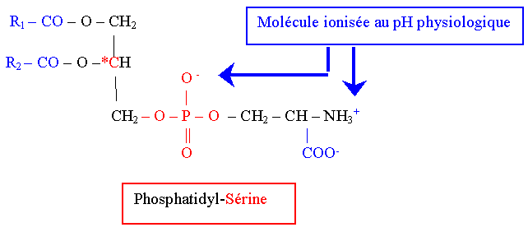
COMPLEX LIPIDS
Biochemistry course A1 DV ; Prof A. MEKROUD , 2019/2020
GLYCEROPHOSPHOLIPIDS
PHOSPHATIDYL-SERINE

Slide 50

COMPLEX LIPIDS
Biochemistry course A1 DV ; Prof A. MEKROUD , 2019/2020
SPHINGOLIPIDS
The name sphingolipids refers to complex lipids that contain in
their structure a molecule of 4 - sphingosine ( formerly called sphingosine )
SPHINGOSIN STRUCTURE
(Or 2- Amino - octadecene -4- ene- 1,3-diol or 2- amino -4- octadecene -1,3-diol )
Note: It is important to remember that sphingolipids differ from other lipids in that
The fatty acids are not bound to sphingosine by an ester bond but by a bond
amide (that is , at the level of the primary amine function of sphingosine ). The
The remaining alcohol functions can in turn form ester bonds with:
- Either carbohydrates = GLYCOSPHINGOLIPIDS
- Either phosphates = PHOSPHOSPHINGOLIPIDS

