Slide 1
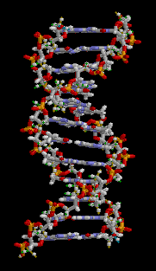
Nucleic acids
Biochemistry course A1 DV ; Prof A. MEKROUD , 2025/2026
What does "DNA" mean?
What is its chemical composition?
What are its roles?

Slide 2
Nucleic acids
Biochemistry course A1 DV ; Prof A. MEKROUD , 2019/2020
  There are 2 types of nucleic acids:
  DNA and RNA
DNA is a molecule of great importance
biological because it is the carrier of genetic information. The genetic information it contains is transmitted to offspring, therefore it is the main vehicle of the phenomenon of heredity.

Slide 3
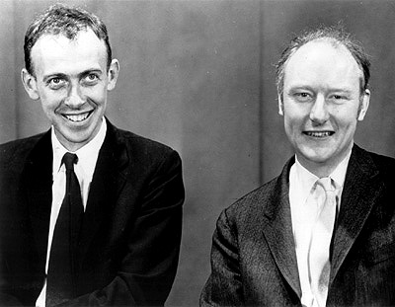
Nucleic acids
Biochemistry course A1 DV ; Prof A. MEKROUD , 2019/2020
Historical
Crick and Watson 1953
(Discovering the structure)
(From the DNA molecule)
Deoxyribo acid​​ Nuclear​
(Nucleotide Polymer)

Slide 4
Structure of nucleic acids
Biochemistry course A1 DV ; Prof A. MEKROUD , 2019/2020
RNA is located​ basically in the cytoplasm , but he exists Also in the core .
DNA and RNA are formed by the repetition of subunits called​​​​​​​​ nucleotides .​​
Each nucleotide​​ East constituted​ in turn, consisting of 3 parts:
- A nitrogenous base​
-One sugar Or dare has five ribose carbons or
deoxyribose​​
-A phosphate

Slide 5
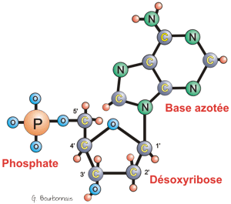
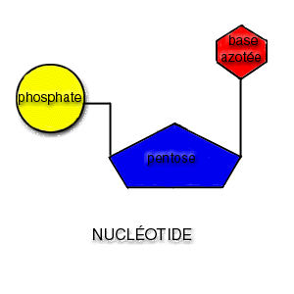
Nucleic acids
Biochemistry course A1 DV ; Prof A. MEKROUD , 2019/2020
Chemical structure

Slide 6
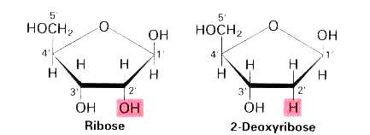
Nucleic acids
Biochemistry course A1 DV ; Prof A. MEKROUD , 2019/2020
Sugar: Ribose or Deoxyribose ?
Ribose is here In RNA and deoxyribose East here In DNA . In ribose, the C2' carbon is linked to a group hydroxyl . In deoxyribose , this​ carbon East linked to a single atom hydrogen instead than at group hydroxyl .

Slide 7
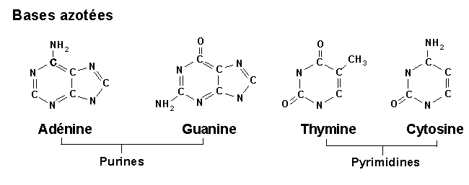
The 4 types of nitrogenous bases
Biochemistry course A1 DV ; Prof A. MEKROUD , 2019/2020
Pyrimidines:
whose structure comprises a single cycle.
Purines:
whose structure comprises two cycles.

Slide 8
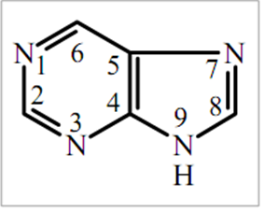
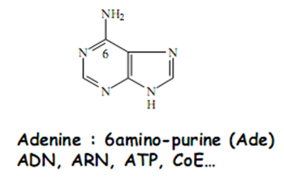
a-Purine bases
Biochemistry course A1 DV ; Prof A. MEKROUD , 2019/2020
Adenine

Slide 9
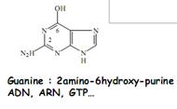
a-Purine bases
Biochemistry course A1 DV ; Prof A. MEKROUD , 2019/2020
Guanine

Slide 10
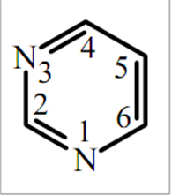
b-Pyrimide bases
Biochemistry course A1 DV ; Prof A. MEKROUD , 2019/2020
Derived from the pyrimidine nucleus which is
an aromatic nucleus with 6 atoms: 4C and 2N and
result from the substitution of atoms
hydrogen from the heterocycle by
Hydroxyl amine or methyl substituents.

Slide 11
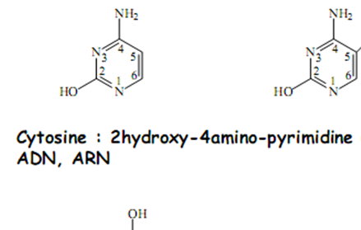
b-Pyrimide bases
Biochemistry course A1 DV ; Prof A. MEKROUD , 2019/2020
Cytosine

Slide 12
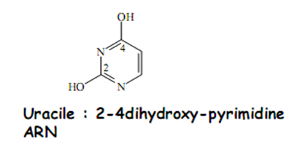
b-Pyrimide bases
Biochemistry course A1 DV ; Prof A. MEKROUD , 2019/2020
Uracil

Slide 13
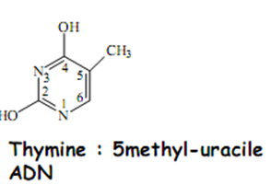
b-Pyrimide bases
Biochemistry course A1 DV ; Prof A. MEKROUD , 2019/2020
Thymine

Slide 14
properties of purine and pyrimidine bases
Biochemistry course A1 DV ; Prof A. MEKROUD , 2019/2020
The aromatic character of purine and pyrimidine bases gives them:
- Resistance to oxidation.
- A characteristic absorption in
UV (identification and dosage).
The presence of hydroxyl and amine substituents allows purine and pyrimidine bases to exist in several tautomeric forms , the keto or lactam form and the enol or lactime form .
Notes:
Tautomerism is the transformation of a functional grouping by the simultaneous displacement of a
hydrogen atom and an electron pair from an adjacent double bond.

Slide 15
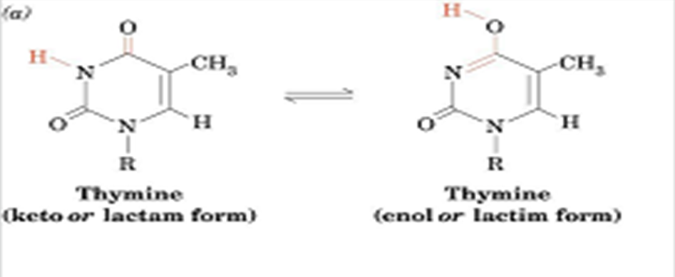
Biochemistry course A1 DV ; Prof A. MEKROUD , 2019/2020
Keto or lactam form of thymine
Enol or lac time form of thymine
L
Tautomerism is the transformation of one functional group into another group by:
simultaneous movement of a hydrogen atom And
of an electron pair resulting from a double bond
adjacent.

Slide 16
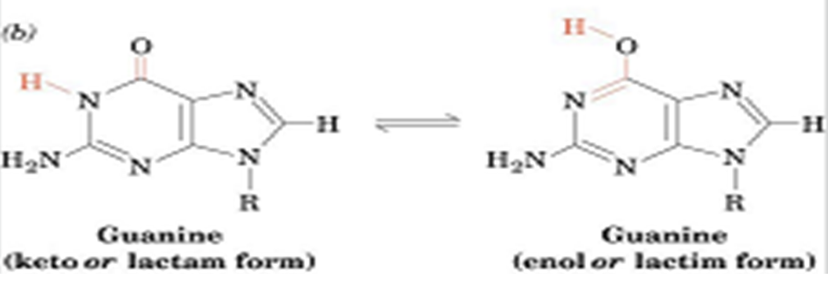
- The presence of hydroxyl and amine substituents allows purine and pyrimidine bases to exist in several tautomeric forms , the keto or lactam form and the enol or lactime form .
At physiological pH, the keto form predominates.
At high pH, the molecule reverts to the enol form , which affects the bonding between DNA base pairs = DNA denaturation.
Biochemistry course A1 DV ; Prof A. MEKROUD , 2019/2020
lactime form of guanine
Keto or lactam form of guanine

Slide 17
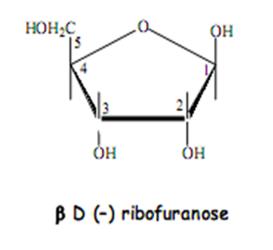
Biochemistry course A1 DV ; Prof A. MEKROUD , 2019/2020
Sugar (ribose)
`
`
`
`
`

Slide 18
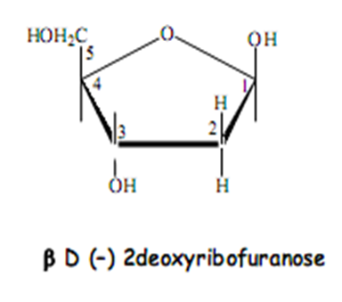
Deoxyribose
Biochemistry course A1 DV ; Prof A. MEKROUD , 2019/2020
`
`
`
`
`

Slide 19

Biochemistry course A1 DV ; Prof A. MEKROUD , 2019/2020
Phosphoric acid

Slide 20
Nucleosides​​​
Biochemistry course A1 DV ; Prof A. MEKROUD , 2019/2020
Covalent combination of a sugar and a nitrogenous base by a beta-N glycosidic bond
base
dare

Slide 21
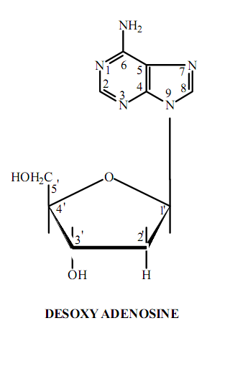
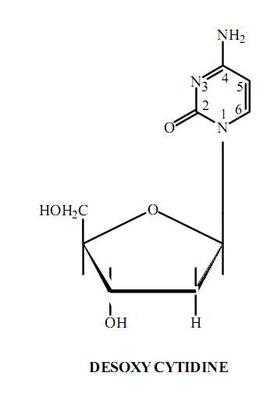
Nucleosides​​​
Biochemistry course A1 DV ; Prof A. MEKROUD , 2019/2020

Slide 22
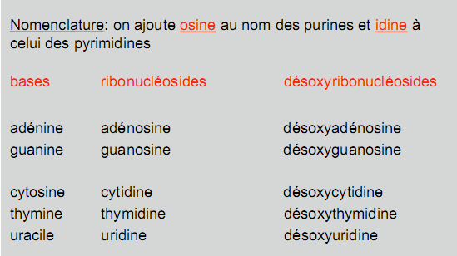
Biochemistry course A1 DV; Prof A. MEKROUD, 2019/2020

Slide 23
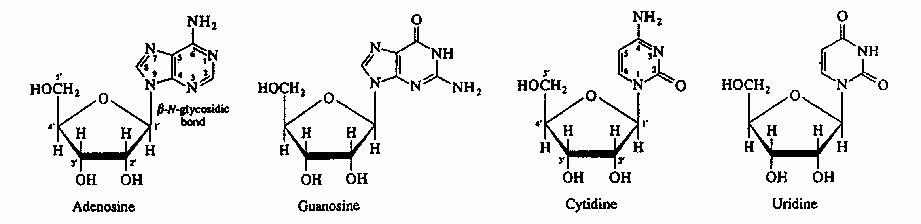
Ribonucleosides​​​
Biochemistry course A1 DV ; Prof A. MEKROUD , 2019/2020

Slide 24
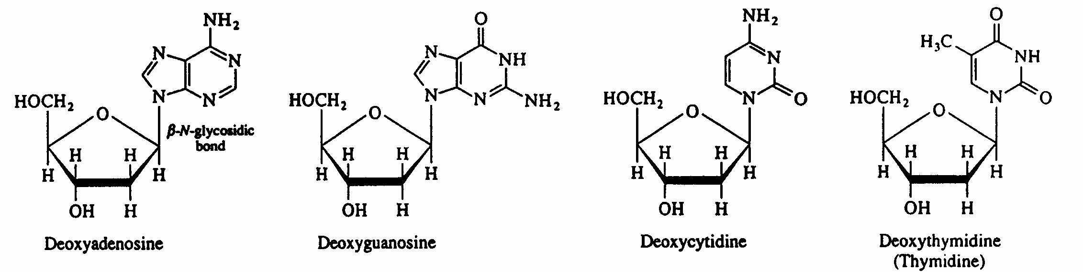
Deoxyribonucleosides​
Biochemistry course A1 DV ; Prof A. MEKROUD , 2019/2020

Slide 25
Nucleotides​​
Biochemistry course A1 DV ; Prof A. MEKROUD , 2019/2020
Phosphoric esters of nucleosides
Base
dare
phosphate
nucleoside
Phosphoric acid
Base
dare
phosphate
nucleotide

Slide 26
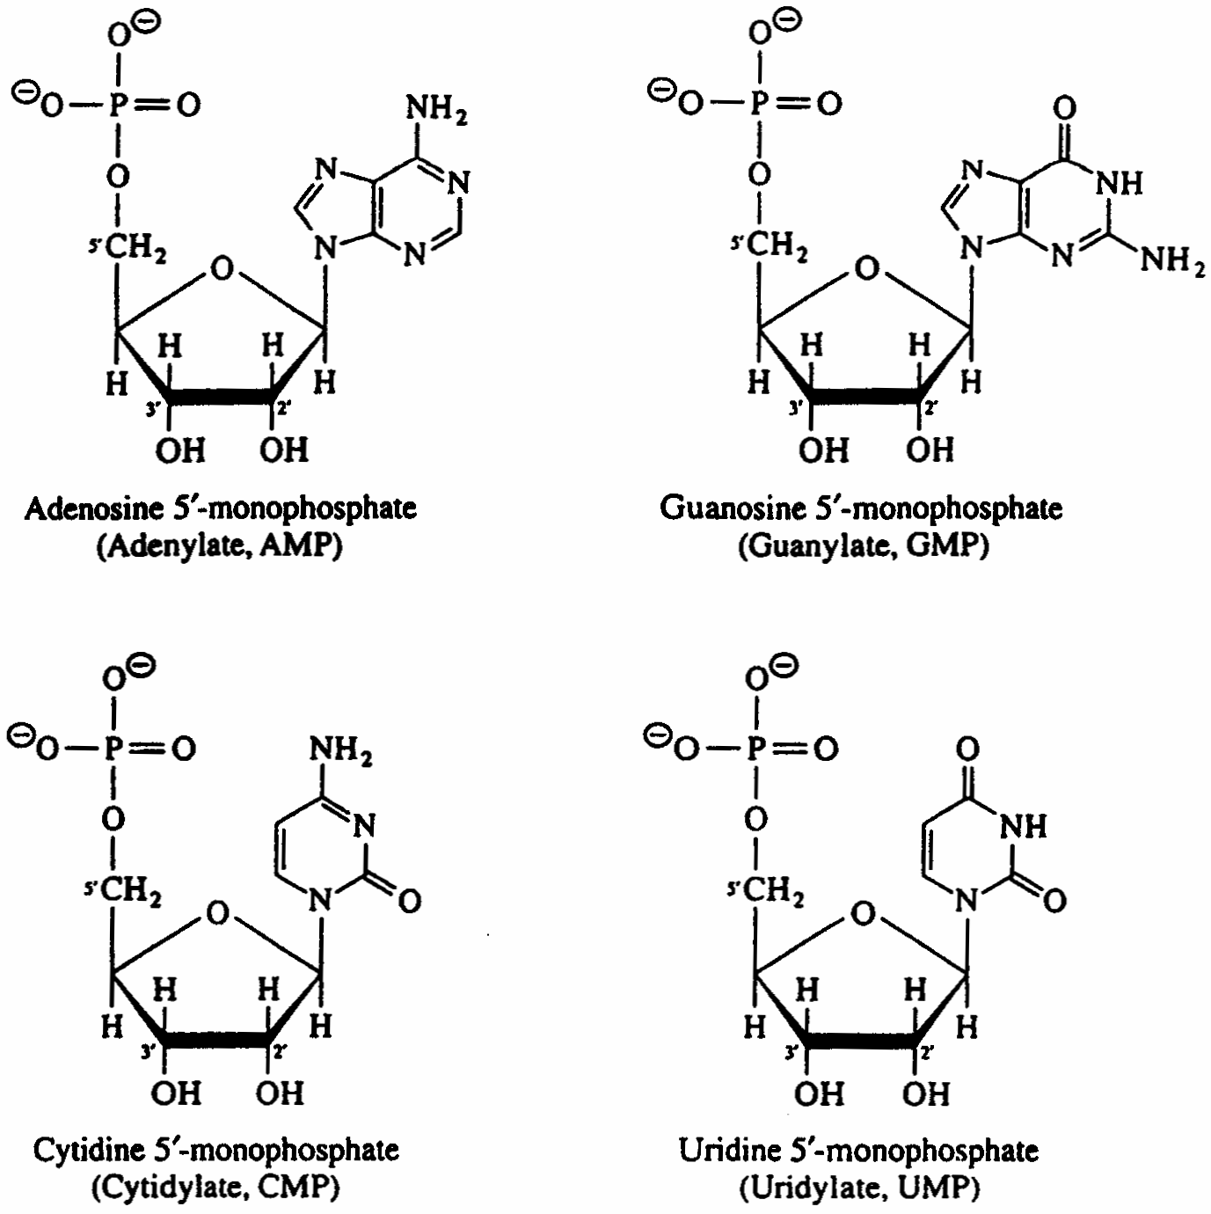
Nucleotide
Biochemistry course A1 DV ; Prof A. MEKROUD , 2019/2020

Slide 27
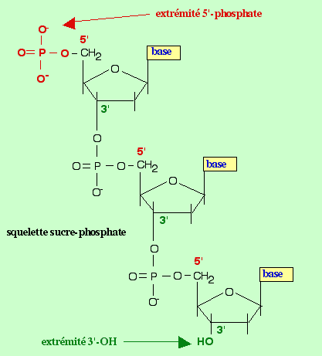
Biochemistry course A1 DV ; Prof A. MEKROUD , 2019/2020
Structure of a polynucleotide
Nucleic acid reading convention : 5' to 3' free OH

Slide 28
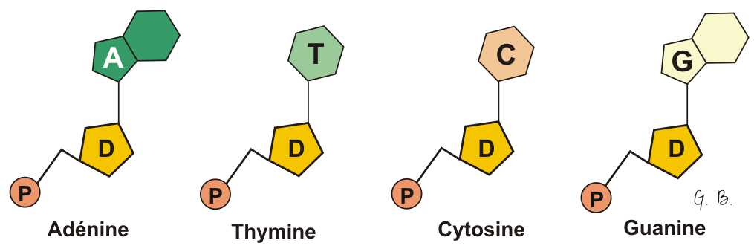
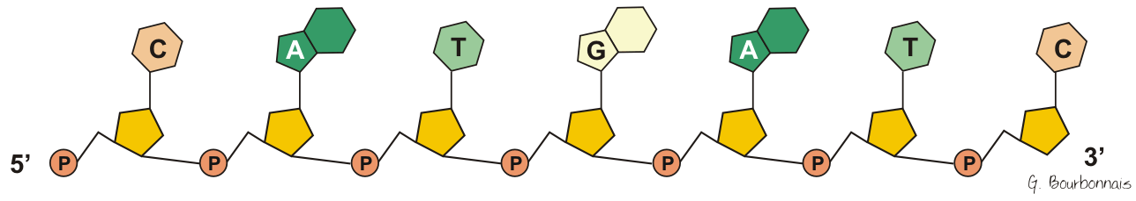
Biochemistry course A1 DV ; Prof A. MEKROUD , 2019/2020
There are therefore 4 types of nucleotides: A, T, C, G
Nucleotides can link together through their sugar (deoxyribose) and their phosphate group.

Slide 29
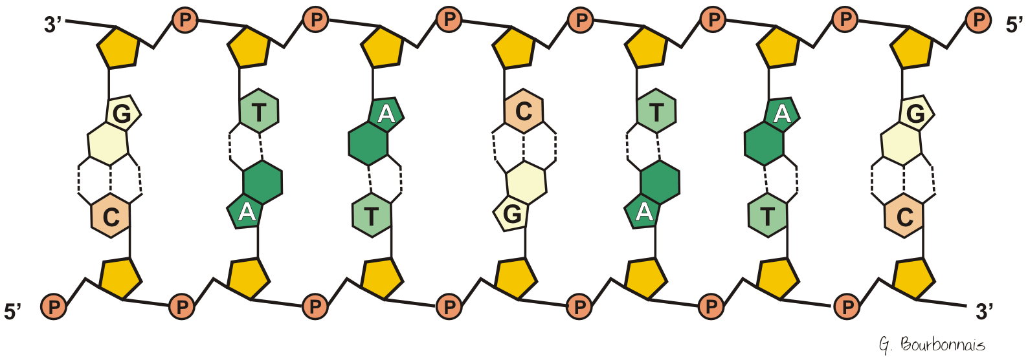
Biochemistry course A1 DV ; Prof A. MEKROUD , 2019/2020
So…
Two nucleotide chains can join together if their bases are complementary (A opposite T and C opposite G).

Slide 30
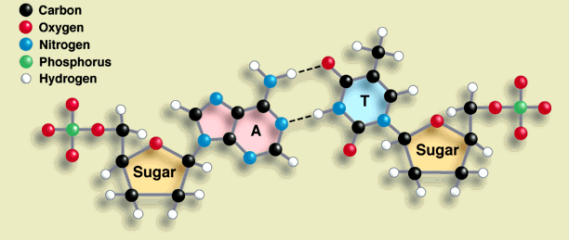
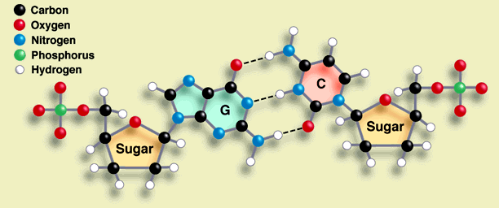
Hydrogen bonds
Biochemistry course A1 DV ; Prof A. MEKROUD , 2019/2020
A can be paired with T and C with G :
A with T : two hydrogen bonds (weak bonds)
C with G : three hydrogen bonds

Slide 31
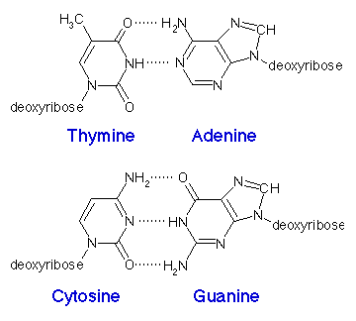
Nitrogenous bases
Biochemistry course A1 DV ; Prof A. MEKROUD , 2019/2020
A purine always bonds with a pyrimidine. Thus, the paired bases always have a constant total width of three rings.

Slide 32
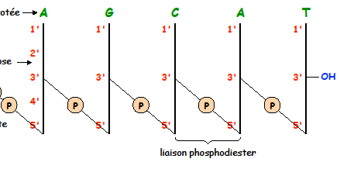
Biochemistry course A1 DV ; Prof A. MEKROUD , 2019/2020
pApGpCpApT =AGCAT

Slide 33
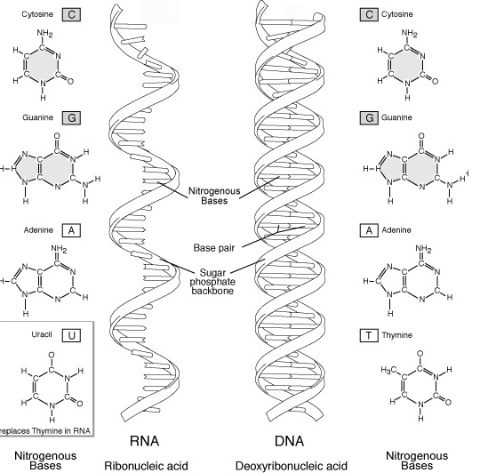
Biochemistry course A1 DV ; Prof A. MEKROUD , 2019/2020

Slide 34
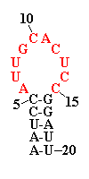
Biochemistry course A1 DV ; Prof A. MEKROUD , 2019/2020
There are several types of RNA:
Non-coding RNA:
rRNA, tRNA ,
Coding RNAs:
mRNA
Native RNA exists as a single-stranded molecule; the single strand of RNA is capable of folding back on itself into a hairpin shape.

Slide 35
tRNA :
It allows the transport of amino acids to the ribosome (the site of protein biosynthesis ): a alone chain of 73 to 93 ribonucleotides, its end 3 ends with a CCA where the AA and its end are attached initial East always a 5 pG.
mRNA :
Its sequence is complementary to one of the two strands of the DNA molecule.
It contains the genetic information for biosynthesis. A protein possesses translation initiation sequences (AUG or GUG) and sequences signaling the end of translation (UAA, UAG, UGA).
Biochemistry course A1 DV ; Prof A. MEKROUD , 2019/2020

