Slide 1
Biochemistry course A1 DV ; Prof A. MEKROUD , 2025/2026
INTRODUCTION TO THE STUDY OF ENZYMOLOGY
1. History.
Living organisms are the site of a large number of very diverse biochemical reactions.
These reactions take place under conditions where, normally, they could not occur. If they happen, it is because they are catalyzed by biological macromolecules: enzymes.
The catalytic power of enzymes is linked, among other things, to the very high specificity of recognition of the molecules on which they act.
Enzymology is the branch of biochemistry that studies the structural and functional properties of enzymes (the structure-function relationship) .
In particular, it is used to describe the rate of reactions catalyzed by enzymes.

Slide 2
Biochemistry course A1 DV ; Prof A. MEKROUD , 2025/2026
INTRODUCTION TO THE STUDY OF ENZYMOLOGY
It is difficult to pinpoint exactly when the concept of enzyme was discovered, and especially the enzyme as the sole catalyst for chemical reactions that take place in living organisms.
1783: Spallanzani reported that the meat is liquefied by a gastric extract. He also noted that temperature has a significant effect.
1814: Mr. Kirchhoff observed that a "glutinous" component (as he called it at the time) of wheat converts starch into sugar.
1833: The first discovery of an enzyme is usually attributed to Payen and Persoz who treated an aqueous extract of malt with ethanol and then precipitated a heat-labile substance that hydrolyzes starch .
They called this fraction "diastase" ("separation" in Greek) since this fraction separates the soluble sugar from the insoluble starch. We now know that this preparation was an unpurified solution of amylase .
1834: Schwann was the first to obtain an active agent of animal origin (pepsin) which he partially purified by treating the stomach wall with acid.

Slide 3
Biochemistry course A1 DV ; Prof A. MEKROUD , 2025/2026
INTRODUCTION TO THE STUDY OF ENZYMOLOGY
1838 : Cagniard de Latour showed that the fermentation process is due to living organisms.
1858 to 1871: The work of Louis Pasteur confirmed this idea. Pasteur put forward the revolutionary hypothesis that the chemical changes during fermentation resulted from the life processes of the microorganisms involved in fermentation.
In contrast, von Liebig favored a purely chemical theory: a "ferment" was a chemical substance produced by a decomposing organism.
1860 : Berthelot macerated yeast and obtained a fraction that could be precipitated with alcohol and converted sucrose into glucose plus fructose. He concluded that invertase (the name he gave to the active agent in this extract) was one of the many ferments present in yeast.
1878: Kühne proposed the name enzyme (" En- " and " zumê ", meaning "in the leaven") to describe these ferments. The addition of the suffix "ase" to the name of an enzyme's substrate to name the enzyme was proposed by Duclaux in 1898.

Slide 4
Biochemistry course A1 DV ; Prof A. MEKROUD , 2025/2026
INTRODUCTION TO THE STUDY OF ENZYMOLOGY
1897: A German chemist, Hahn , attempted to isolate proteins from yeast ( Saccharomyces cerevisiae ) by grinding the yeast in a mortar with fine sand and diatomaceous earth. However, this yeast extract preparation did not keep well.
Hans and Eduard Buchner were also interested in yeast extracts for therapeutic purposes. Since these extracts were intended for human use, they could not contain bactericides. Remembering that sugar preserves fruit, Hans Buchner suggested adding sucrose to the yeast extract to preserve it. Eduard Buchner observed that adding sugar caused bubbles to form in the mixture. He concluded that this was fermentation , a process described by Louis Pasteur as "life in the absence of air."
In publishing his observations, Eduard Buchner concluded: " The complexity of the yeast is not essential to the occurrence of this process. The active ferment in the juice is probably only a dissolved substance, undoubtedly a protein : we will call it zymase." For this discovery, Eduard Buchner received the Nobel Prize in 1907 .

Slide 5
Biochemistry course A1 DV ; Prof A. MEKROUD , 2025/2026
INTRODUCTION TO THE STUDY OF ENZYMOLOGY
We now know that the "zymase" in yeast extracts is actually a mixture of enzymes which together catalyze the reactions of glycolysis .
1897 : In the same year, Bertrand observed that certain enzymes require dialyzable factors for their activity. He named them coenzymes.
At the beginning of the 20th century, major work was undertaken to purify enzymes and, above all, to describe their catalytic activity in mathematical terms.
1902: V. Henri and Adrian Brown independently suggested that the formation of an enzyme-substrate complex is an obligatory intermediate of the enzymatic reaction.

Slide 6
Biochemistry course A1 DV ; Prof A. MEKROUD , 2025/2026
INTRODUCTION TO THE STUDY OF ENZYMOLOGY
Henri was therefore the first to describe the mathematical equation linking the effect of substrate concentration to the rate of catalysis.
1913: Leonor Michaelis and Maud Menten rediscovered V. Henri's equation and established the relationship known as the Henri- Michaelis - Menten equation .
The important point is that obtaining this equation is based on the assumption that a rapid equilibrium is established between the concentrations of the enzyme, the substrate and the enzyme-substrate complex (E + S <==> ES).
1925 : George Briggs and James Haldane generalized the previous equation by introducing the concept of steady state for the concentration of the enzyme-substrate complex.
The fact that enzymes are proteins was only accepted from the late 1920s onwards.

Slide 7
Biochemistry course A1 DV ; Prof A. MEKROUD , 2025/2026
INTRODUCTION TO THE STUDY OF ENZYMOLOGY
New chemical and physical techniques were used to analyze the structure of proteins.
1926: James Sumner (Nobel Prize in 1946) crystallized urease .
1930s : John Northrop (Nobel Prize in 1946) and his collaborators crystallized pepsinogen , pepsin and several isoforms of trypsin and chymotrypsin and demonstrated the purity of the crystals obtained.
1940s and 1950s: Hundreds of enzymes were purified and crystallized, thus enabling the elucidation of dozens of metabolic pathways .
1955: Frédéric Sanger (1st Nobel Prize in 1958) published the complete amino acid sequence of a small protein: insulin ( molar mass 6000 Da).
1960s: The first sequence of an enzyme (ribonuclease, molar mass 13700 Da) was published in 1960 and the first chemical synthesis (also of ribonuclease) was obtained in 1969.

Slide 8
Biochemistry course A1 DV ; Prof A. MEKROUD , 2025/2026
INTRODUCTION TO THE STUDY OF ENZYMOLOGY
Enzymes (formerly called ferments or diastases) are biological compounds of
protein nature , endowed with catalytic activity and produced by a living cell .
It is therefore a catalyst , that is to say , an accelerator of a biochemical reaction. That is
Why in order to facilitate understanding of the enzyme 's mechanism of action and the laws
that govern it govern , it is necessary to first study some simple data concerning the
Chemical reaction in general and the parameters on which it depends .
Parameters of the chemical reaction
1. Rate of reaction : A chemical reaction is a dynamic process that starts from a state
Initially , the molecules are transformed to reach a final state . This process takes place
at a Speed. This is the speed of the reaction . dx
V = -----
dt
dx being the quantity of initial substance transformed during the unit of time dt.
Develop the reaction rate curve

Slide 9
Biochemistry course A1 DV ; Prof A. MEKROUD , 2025/2026
INTRODUCTION TO THE STUDY OF ENZYMOLOGY
GULDBERG AND WAAGE'S LAW
The concentration of a substance A in a homogeneous medium is the mass of substance
Contained in a unit of volume (e.g. mole/litre).
If this substance A decomposes into 2 substances X and Y, the rate of the reaction is
Proportional to the concentration of A. V = k [A]
K is a constant rate that depends only on temperature.
Law of mass action applied to equilibria chemicals
Either the reaction following which leads to a state equilibrium A + BC + D
V1
V2
V1 = k1 [A]. [B]
V2 = k2 [C]. [D]
In equilibrium : V1 = V2 therefore k1 [A]. [B] = k2 [C]. [D] = K, this is

Slide 10
Biochemistry course A1 DV ; Prof A. MEKROUD , 2025/2026
INTRODUCTION TO THE STUDY OF ENZYMOLOGY
2nd ^{law} of GULDBERG and WAAGE , applied to chemical equilibria
If we increase the concentration of bodies A and B, the equilibrium will shift in the direction of
the increase in C and D, which will result in a high consumption of A and B
A new balance will be established .
A
Let A B C D E ……… ..
If, for any reason, the concentration of C increases, the stability wiill be disrupted : The
C production will then be slowed, which will lead to a slowing of the degradation of
B, which will have repercussions on the degradation of A. In parallel, there will be an increase
in the degradation of C, which will in turn increase the degradation of D and so on.

Slide 11
Biochemistry course A1 DV ; Prof A. MEKROUD , 2025/2026
INTRODUCTION TO THE STUDY OF ENZYMOLOGY
CATALYST ENGINES:
It is a compound which , without undergoing any visible transformation and at low doses,
modifies the kinetics of a chemical reaction .
The action of a catalyst is not to cause or make possible a chemical reaction
From a thermodynamic point of view, but only to activate it if it is chemically in
compliance .​
Therefore, the catalyst, after its action, remains intact at the end of the chemical reaction .
TYPE OF CATALYSIS:
Homogeneous catalysis :
Homogeneous catalysis occurs when the reaction compounds and the catalyst are identical .
together constitute a single homogeneous phase , liquid or gaseous
Ew : dilute acid + sucrose glucose + fructose

Slide 12
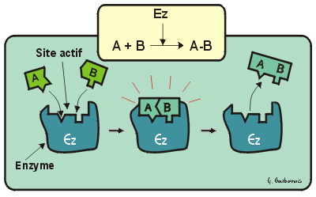
Biochemistry course A1 DV ; Prof A. MEKROUD , 2025/2026
INTRODUCTION TO THE STUDY OF ENZYMOLOGY
Heterogeneous catalysis​​​​​
To be represented in diagram form

Slide 13
Biochemistry course A1 DV ; Prof A. MEKROUD , 2025/2026
ENZYMOLOGY SECTION
1 - Definitions​
1.1 - Enzyme
It is an organic substance , of a protein nature , endowed with properties
catalytic , and activating or inhibiting one or more chemical reactions ; inside
of a living organism.
Enzymology is the study of enzymes.
The noun " enzyme " can be either feminine or masculine, but most commonly
Utilis é remains the feminine form .
proteins are catalysts, meaning that by acting on
At very small concentrations , they increase the speed of chemical reactions , without
modifying the result . At the end of the reaction, the structure of the enzyme is found
unchanged​​
Enzymatic proteins are synthesized by living organisms. This synthesis is
genetically determined: its preservation in the genome is favored by the need
what does this living being experience when it has this reaction?

Slide 14
Biochemistry course A1 DV ; Prof A. MEKROUD , 2025/2026
1.2 - Example of an enzyme: carbonic anhydrase
H₂O H ⁺​​
Zn ⁺⁺
CO₂ HCO₃​​

Slide 15
Biochemistry course A1 DV ; Prof A. MEKROUD , 2025/2026
ENZYMOLOGY SECTION
Carbonic anhydrase is an enzyme present in all our cells.
It is a protein with a mass of 29,000 daltons, consisting of a chain
of 264 amino acids . The presence of a zinc atom is necessary for its
activity . It catalyzes the reaction of adding a water molecule to a
a molecule of carbon dioxide to give carbonic acid which dissociates
at physiological pH in a bicarbonate ion and a proton. (HCO3- + H+).
This reaction is reversible and leads to an equilibrium state that catalysis
The enzymatic content does not change.

Slide 16
Biochemistry course A1 DV ; Prof A. MEKROUD , 2025/2026
ENZYMOLOGY SECTION
NOMENCLATURE
The nomenclature of enzymatic reactions is expressed
by a set of four numbers separated by points :
The first of these numbers designates the type of reaction
catalyzed , among the six major classes of enzymatic reactions .
The second and third express the nature of the chemical substances
on which this reaction occurs .
The fourth number is an order number .
In chemistry
A B
C = catalyst
In Biochemistry
S P
E = Enzyme

Slide 17
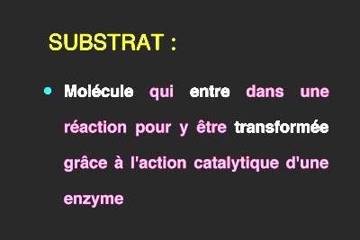
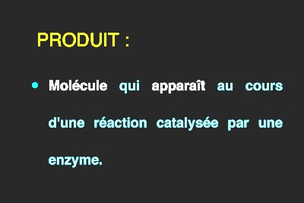
Biochemistry course A1 DV ; Prof A. MEKROUD , 2025/2026
ENZYMOLOGY SECTION

Slide 18
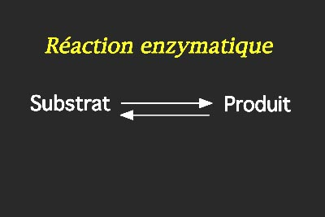
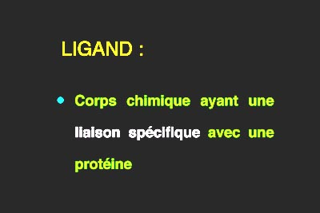
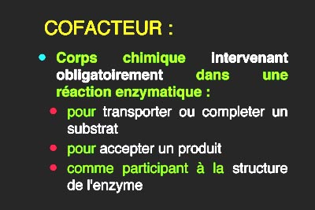
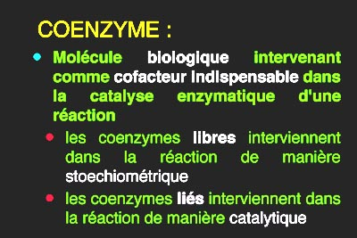
Biochemistry course A1 DV ; Prof A. MEKROUD , 2025/2026
ENZYMOLOGY SECTION

Slide 19
Biochemistry course A1 DV ; Prof A. MEKROUD , 2025/2026
LIGAND
All molecules that bind specifically to a protein are called ligands. For each ligand, there is at least one binding site on the protein that receives it.
CO-FACTOR
Cofactors can be ions such as the zinc atom of carbonic anhydrase or small mineral molecules usually present in biological environments, starting of course with the water Molecule.Some cofactors are more complex molecules synthesized by cells: we will call them coenzymes.
CO-ENZYME
Coenzymes are biological molecules, meaning that their natural synthesis
can only be done by living cells. When this synthesis is not carried out
in the genetic heritage of a species, then all or part of the molecule of
The coenzyme must be supplied to this species through its diet: this food
An essential element is called a vitamin. Coenzymes are cofactors, therefore...
molecules essential for enzymatic catalysis.

Slide 20
Biochemistry course A1 DV ; Prof A. MEKROUD , 2025/2026
ENZYMOLOGY SECTION
Enzyme
Enzyme concentration
Let 's examine how the reaction changes when we change the concentration of the
enzyme.The measurements of product concentration over time are different .
for each of the enzyme concentrations tested . When the concentration of the enzyme
is large (for example E3) the initial velocity is greater than when the concentration of
the enzyme is small (for example E1).
substrate concentration
Let's examine again the evolution of the reaction when we change the
Substrate concentration. Measurements of product concentration as a function of
The times are different for each of the substrate concentrations tested .
When the substrate concentration is high (e.g., S10) the initial velocity
is greater than when the substrate concentration is small (e.g. S1).
These initial velocities can be measured by calculating the concentration difference of
produced over a given time , for each concentration of the substrate.

Slide 21
Biochemistry course A1 DV ; Prof A. MEKROUD , 2025/2026
ENZYMOLOGY SECTION
Enzyme
Reaction speed​
To measure the activity of an enzymatic reaction having only one substrate
and a product, in a defined medium , we observe the concentrations of
substrate or product, which are functions of elapsed time :
the concentration of the substrate decreases over time , that of the product
increases over time. When these measurements are taken at times t1 and t2
separated by a delay dt , we call S1 and P1 the substrate concentrations
and the product at time t1, and S2 and P2 the concentrations of the substrate
and the produced at time t2. The difference between the substrate
concentrations dS is the opposite of the difference between the concentrations
of the product (-dP).
Let the rate of reaction be the ratio minus dS/dt, which is equal to dt. The
reaction rate represents the number of moles of substrate transformed into
moles of product, in a given volume and in a given time .

Slide 22
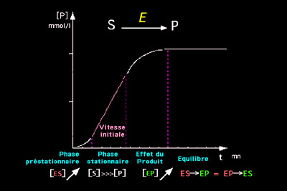
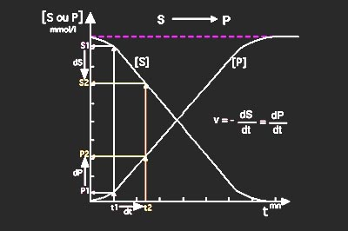
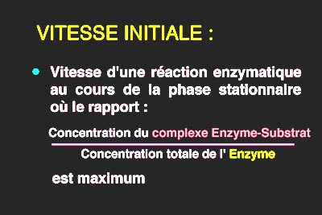
Biochemistry course A1 DV ; Prof A. MEKROUD , 2025/2026
ENZYMOLOGY SECTION
Enzyme
Reaction speed​

Slide 23
Biochemistry course A1 DV ; Prof A. MEKROUD , 2025/2026
ENZYMOLOGY SECTION
Enzyme
Initial speed
During the stationary phase, the rate is constant: this is called the initial rate. This is a phase of the reaction where a maximum number of enzyme molecules are bound to substrate molecules. The ratio of bound enzyme to total enzyme is at its maximum. Under these conditions,
The enzyme's catalytic efficiency is highest, therefore the initial velocity is the highest of all the velocities that can be measured as a function of the reaction phases. In the remainder of this course, the velocity studied will always be the initial velocity.

Slide 24
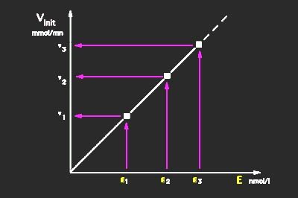
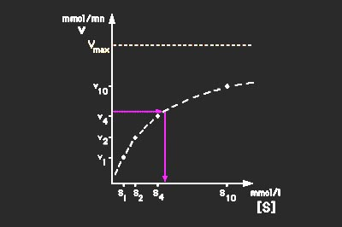
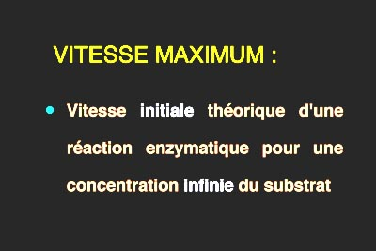
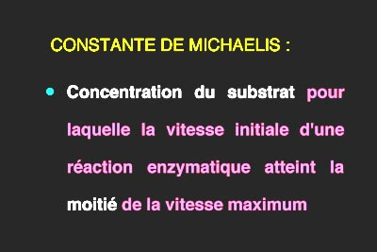
Biochemistry course A1 DV ; Prof A. MEKROUD , 2025/2026
ENZYMOLOGY SECTION

Slide 25
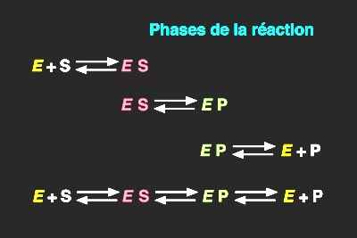
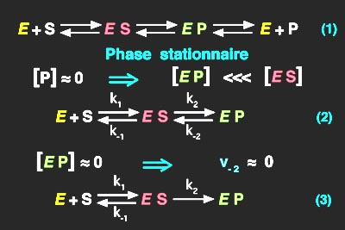
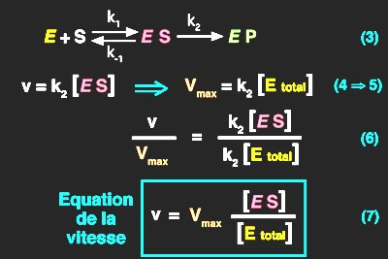
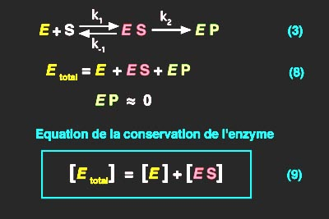
Biochemistry course A1 DV ; Prof A. MEKROUD , 2025/2026
ENZYMOLOGY SECTION

Slide 26
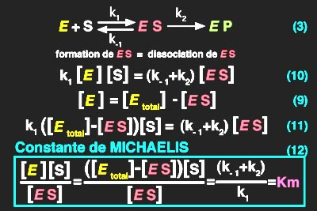
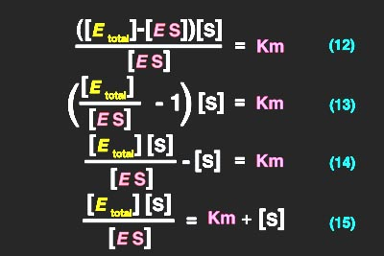
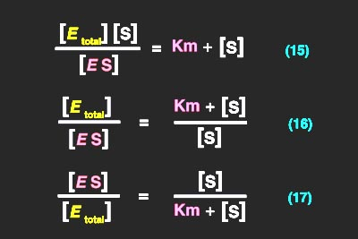
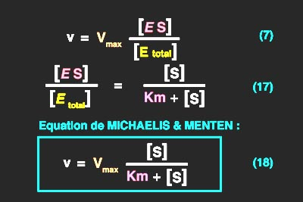
Biochemistry course A1 DV ; Prof A. MEKROUD , 2025/2026
ENZYMOLOGY SECTION

Slide 27
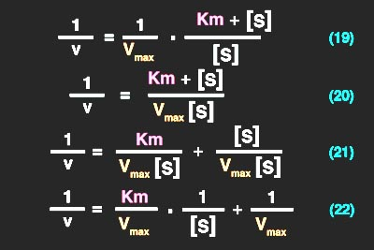
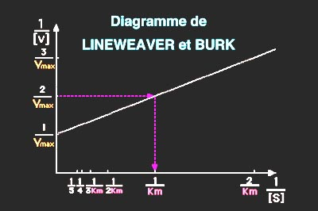
Biochemistry course A1 DV ; Prof A. MEKROUD , 2025/2026
ENZYMOLOGY SECTION
Calculations

Slide 28
General structure of enzymes
Biochemistry course A1 DV ; Prof A. MEKROUD , 2025/2026
PRIMARY, SECONDARY AND TERTAR STRUCTURES:
Enzymes are globular proteins, which include
several degrees of organization, as with proteins.
QUATERNARY STRUCTURE:
It corresponds to the combination of several elementary structures.

Slide 29
Isoenzymes
Biochemistry course A1 DV ; Prof A. MEKROUD , 2025/2026
DEFINITION:
Identical catalytic activity with structures
slightly different (example LDH : Lactate dehydrogenase )
Pyruvate
LDH
Lactate
NADH + H ⁺
NAD ⁺
Ubiquitous reaction = anaerobic glycolysis
NOT VERY SPECIFIC

Slide 30
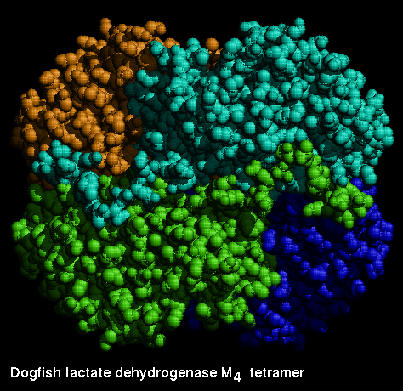
Quaternary structure of the LDH
Biochemistry course A1 DV ; Prof A. MEKROUD , 2025/2026
Monomer
LDH tetramer

Slide 31
Isoenzymes
Biochemistry course A1 DV ; Prof A. MEKROUD , 2025/2026
Structural differences at the protomer level can involve an amino acid in the chain or even a radical
Example: Ala - Ileu - Val - Val- thr
Ala --- Ileu --- Arg -- -Val--- Thr
150
154
Note: This does not affect the catalytic activity of the enzyme.

Slide 32
Quaternary structure of the LDH
Biochemistry course A1 DV ; Prof A. MEKROUD , 2025/2026
Heteropolymeric organization :
4 Monomers = 1 Tetramer
M -type monomer
H -type monomer

Slide 33
The different isoenzymes of LDH
Biochemistry course A1 DV ; Prof A. MEKROUD , 2025/2026
LDH1 = H4
LDH3 = M2 H2
LDH5 = M4
LDH2 = M1 H3
LDH4 = M3 H1

Slide 34
The active site of enzymes: Topology
Biochemistry course A1 DV ; Prof A. MEKROUD , 2025/2026
Definition:
The active site is the preferred contact area, located in the zone
hydrophobic of the enzymatic protein, at the level of which is exerted
selectively the catalytic power of the enzyme.

Slide 35
The active site of enzymes: Behavior
Biochemistry course A1 DV ; Prof A. MEKROUD , 2025/2026
The three parameters​ fundamentals involved in the mechanism of
The functioning of the active site of an enzyme includes:
-The presence of this site in a very particular environment : The area
internal hydrophobic , that is to say a cavity lined with amino acid residues
hydrophobic, which allows the substrates to be fixed in a micro-environment
non-aqueous essential for the proper functioning of Catalysis.
-the organization of this site in a defined geometric form , necessary and
sufficient for access to the substrate , which brings the enzyme and the substrate to short-distance contacts
-The fact that a few polar amino acids stand out in the whole of the internal hydrophobic zone by their highly reactive groups, which allows for the catalysis itself.

Slide 36
Molecular mechanism of the catalytic act
Biochemistry course A1 DV ; Prof A. MEKROUD , 2025/2026
The enzymatic efficiency is astonishing : this type of catalysis multiplies by a factor of between 105 and 1010, the rate of a reaction . At the molecular level, this enormous acceleration of the rate is explained by 4 fundamental phenomena :
1- Positioning and proximity effect : the active site is an area where the proximity of molecules called upon to react and the appropriate positioning .
2- Covalent catalysis : This step is crucial and corresponds to the intermediate state . The substrate gains an energy level that makes it very reactive .
3- Acid - base catalysis : this includes 2 aspects, one specific and the other general .
4- Conformational constraints : This refers to the three-dimensional structure of the substrate and its perfect conformity with that of the substrate

Slide 37
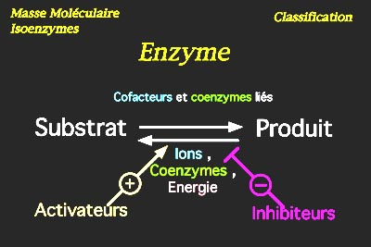
Biochemistry course A1 DV ; Prof A. MEKROUD , 2025/2026
ENZYMOLOGY SECTION
Effect of effector concentration
Factors : the effectors
the coenzymes and the energy
are the essential factors for the enzymatic reaction . The others
molecules that bind to the enzyme, the ligands, can
can have a positive or negative effect . They can promote or, conversely
to disrupt the course of the reaction .

Slide 38
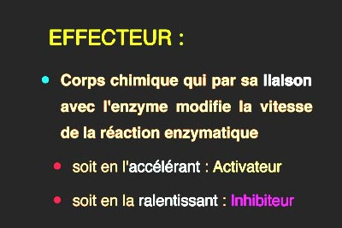
Biochemistry course A1 DV ; Prof A. MEKROUD , 2025/2026
ENZYMOLOGY SECTION

Slide 39
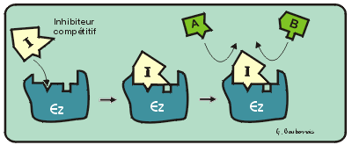
Biochemistry course A1 DV ; Prof A. MEKROUD , 2025/2026
ENZYMOLOGY SECTION
Competitive inhibition​
When the binding of an inhibitor to an enzyme prevents enzyme-substrate binding, this is called competitive inhibition of that substrate. In addition to enzyme-substrate binding, there is enzyme-inhibitor binding, resulting in an E complex. I inactive. The dissociation constant of this complex E I, or K i, is defined with respect to the concentrations of the free enzyme, the inhibitor, and the
complex E I.
In the equation for the conservation of the enzyme (line 9*) another form of the enzyme appears : the E complex I. The velocity equation (line 7*), which depends only on the complex E S since the complex E I is inactive, remains unchanged .

Slide 40
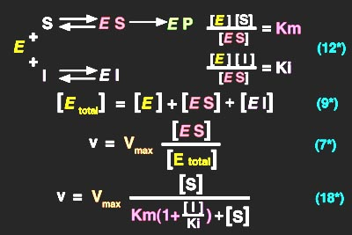
Biochemistry course A1 DV ; Prof A. MEKROUD , 2025/2026
ENZYMOLOGY SECTION

Slide 41
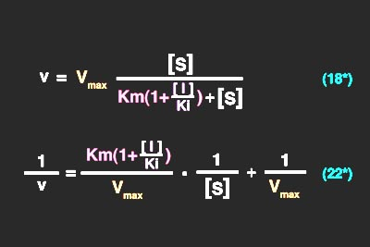
Biochemistry course A1 DV ; Prof A. MEKROUD , 2025/2026
ENZYMOLOGY SECTION

Slide 42
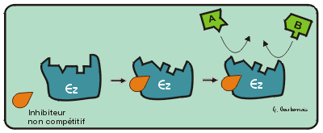
Biochemistry course A1 DV ; Prof A. MEKROUD , 2025/2026
ENZYMOLOGY SECTION
- competitive inhibition
When an inhibitor binds to the enzyme at a completely independent site
at the active site, there is no competition between the substrate and the inhibitor.
, by binding, renders the enzyme molecule unable to catalyze the reaction :
This is referred to as non -competitive inhibition .
All enzyme molecules can bind to the inhibitor. The complex
inactive enzyme-substrate-inhibitor complex . The free enzyme
By combining with the inhibitor, it forms an enzyme-inhibitor complex which can
itself binds to a substrate molecule, giving a complex E S I, identical to
that obtained from complex E S and of course r inactive . The constant Ki of the enzyme
vis -à -vis the inhibitor always represents the dissociation constant of the complex
E I, but also that of complex E S I.

Slide 43
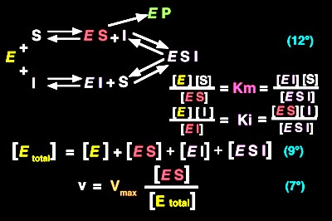
Biochemistry course A1 DV ; Prof A. MEKROUD , 2025/2026
ENZYMOLOGY SECTION

Slide 44
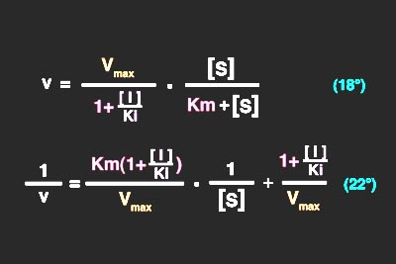
Biochemistry course A1 DV ; Prof A. MEKROUD , 2025/2026
ENZYMOLOGY SECTION

Slide 45
Biochemistry course A1 DV ; Prof A. MEKROUD , 2025/2026
ENZYMOLOGY SECTION
Incompetent inhibition​​
uncompetitive inhibitor It never binds to the free enzyme but only to the enzyme complexed with the ES substrate , thus preventing product formation. Generally, substrate binding to the enzyme causes a conformational change in the enzyme, revealing a binding site for the inhibitor. The inhibitor, in turn, alters the conformation of the enzyme's active site, preventing the reaction.
As its name suggests, an uncompetitive inhibitor does not compete with a substrate at its binding site.

Slide 46
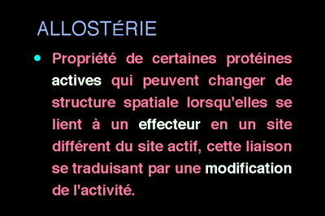
Biochemistry course A1 DV ; Prof A. MEKROUD , 2025/2026
ENZYMOLOGY SECTION
Allosteric effects​
EE 42

Slide 47
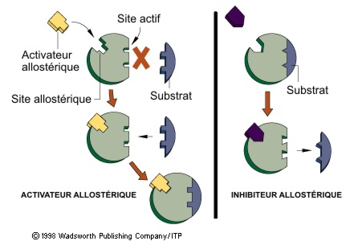
Biochemistry course A1 DV ; Prof A. MEKROUD , 2025/2026
Allosteric effects​

Slide 48
Biochemistry course A1 DV ; Prof A. MEKROUD , 2025/2026
ENZYMOLOGY SECTION
Allosterism involves proteins with activity :​​​
enzymes, transporters, channels, pumps, receptors , contractile proteins, etc ...
Allosteric effectors are ligands with a different binding site .
of the substrate binding site (active site, catalytic site). This could be another
substrate or product molecule , different from the one that participates in the reaction
enzymatic or transport This is referred to as a homotropic allosteric effect . If at
if the effector is a different molecule , this is called an allosteric effect .
heterotropic .​​​
When an allosteric protein has several subunits , substrate binding
or its effect on one subunit results in an effect on the other subunits of
the protein .
The change in activity is always quantitative :
increase = allosteric activation
allosteric inhibition .

Slide 49
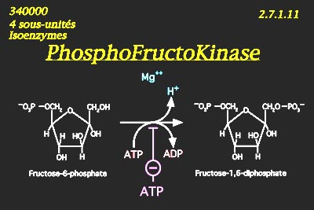
Biochemistry course A1 DV ; Prof A. MEKROUD , 2025/2026
ENZYMOLOGY SECTION
Allosteric effects​
Example of allostery phosphofructokinase

Slide 50
Biochemistry course A1 DV ; Prof A. MEKROUD , 2025/2026
ENZYMOLOGY SECTION
Allosteric effects​
Phosphofructokinase (abbreviated PFK ) is an enzyme present in all
our cells. It comprises 4 almost identical subunits , with 4 active sites
It catalyzes a phosphate and energy transfer reaction of the coenzyme
ATP is transferred to fructose 6-phosphate, which it activates into fructose 1,6-
Bisphosphate proton is released .​
PFK is the slowest enzyme in cytoplasmic glycolysis, a metabolic pathway .
of energy metabolism . It catalyzes the carbohydrate commitment stage in
energy production . It is therefore the key enzyme in this metabolic pathway .
The kinetics of PFK are allosteric ; they are re - inhibited by the end product of the
Glycolysis, ATP. An ATP molecule (allosteric effector ) , different from the one that
It provides phosphate and energy ( coenzyme), and binds to a binding site on each
protomer and this fixation decreases the affinity of the active site for fructose 6-
phosphate . This results in a slowing of the reaction speed .
Produce a diagram

Slide 51
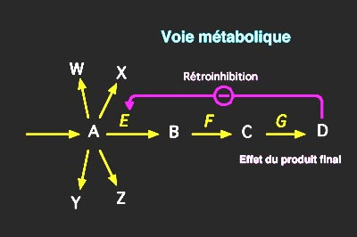
Biochemistry course A1 DV ; Prof A. MEKROUD , 2025/2026
ENZYMOLOGY SECTION
Allosteric effects​
Enzymatic reactions allow our body to synthesize
biological molecules that it needs. This synthesis is carried out from compounds
simple, often food-based. A compound A , for example, can be the substrate
of enzymatic reactions leading to various syntheses . It is a crossroads
Metabolic . Each of these syntheses will be done in several stages (A, B, C, D,... )
each catalyzed by a specific enzyme (E, F, G,...). The rate of synthesis of
The final product depends on the speed of the slowest of these enzymes. If this final
Product is present in insufficient quantity, this enzyme must be activated . If, on the
Contrary there is a high concentration of product D; this enzyme must be inhibited . It is
desirable that the intermediate compounds do not accumulate, therefore that the enzyme
the slowest, which will be regulated , is the one that catalyzes the first reaction
leading to the final product. In this set of enzymatic reactions , enzyme E catalyzing the
Transformation of A into B, the first step of the synthesis , is the one that must be
regulated by effectors that will allow control of the speed of the assembly .
For example, an excess of final product can lead to the inhibition of this first step :
This is called re - inhibition .

Slide 52
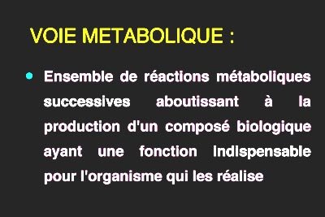
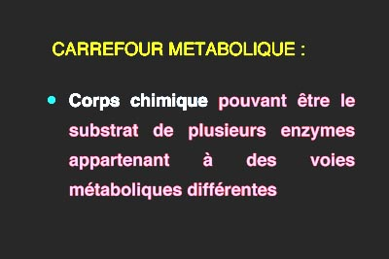
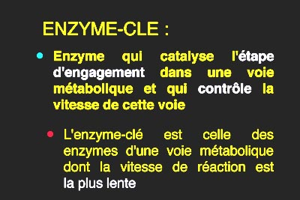
Biochemistry course A1 DV ; Prof A. MEKROUD , 2014/2015
ENZYMOLOGY SECTION

Slide 53
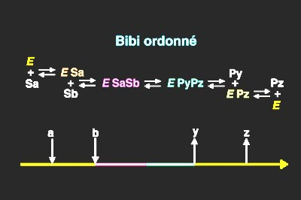
Biochemistry course A1 DV ; Prof A. MEKROUD , 2014/2015
ENZYMOLOGY SECTION
Two - substrate kinetics​
Ordered bibi mechanism​
When an enzymatic reaction involves two substrates or one substrate and one
With a free coenzyme, we speak of two -substrate kinetics . For some enzymes,
First, a first complex forms between the first substrate and the enzyme.
This Enzyme-Substrate A complex then forms a complex with the second substrate:
Enzyme-Substrate A-Substrate B. This ternary complex is then transformed by the action
of the enzyme into an Enzyme-Product Y-Product Z complex which dissociates , releasing
in order, product Y and product Z. The free enzyme has no affinity for the
substrate B, the complex cannot form in a different order : that's what
justifies the name bibi ordonn é given to this mechanism .

Slide 54
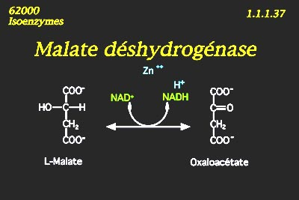
Biochemistry course A1 DV ; Prof A. MEKROUD , 2014/2015
ENZYMOLOGY SECTION
Two - substrate kinetics​
Example of ordered bibi Mechanism:
b
p
has
q

Slide 55
Biochemistry course A1 DV ; Prof A. MEKROUD , 2025/2026
ENZYMOLOGY SECTION
Two - substrate kinetics​
Random bipolar mechanism​​
Other two-substrate enzymes are capable of forming the complex
Enzyme-Substrate A-Substrate B by binding the two substrates (or coenzyme)
free) one after the other but without a fixed order : the probability of starting
by Enzyme-Substrate A or by Enzyme-Substrate B only while
the respective affinities of the enzyme for these two chemical compounds. This is what
which justifies the term "bibilic aleatory " given to this mechanism .

Slide 56
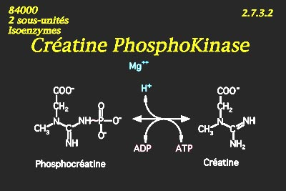
Biochemistry course A1 DV ; Prof A. MEKROUD , 2025/2026
ENZYMOLOGY SECTION
Two - substrate kinetics​
Example of a random bibli mechanism : creatine phosphokinase
has
q
b
p

Slide 57
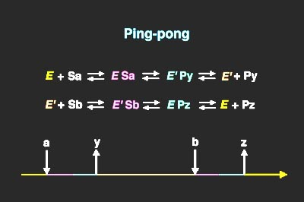
Biochemistry course A1 DV ; Prof A. MEKROUD , 2025/2026
ENZYMOLOGY SECTION
Two - substrate kinetics​
Ping -Pong Mechanism
For other enzymes, the reaction will be catalyzed
in two stages . The complex formed between the enzyme
and substrate A is first transformed into an enzyme
+ product Y, but the enzyme E was​​ chemically
modified into enzyme E' during this first
part of the reaction . The enzyme E' having an affinity
for the second substrate , will form a second
The Enzyme E'-Substrate B complex will be transformed into the Enzyme-Product Z complex in a second part
of the reaction where the enzyme will regain its shape
initial chemical reaction. There is never a ternary complex.
in such a mechanism , but the enzyme (or a coenzyme)
related​ to its structure) undergoes a reversible transformation and
temporary which allows the link between the two substrates.
This is what justifies the name ping-pong that we give
to this mechanism .

Slide 58
Biochemistry course A1 DV ; Prof A. MEKROUD , 2025/2026
ENZYMOLOGY SECTION
Two - substrate kinetics​
Ping -Pong Mechanism
HAS
P
B
Q
E
E A
F P
F
F B
E Q
E

Slide 59
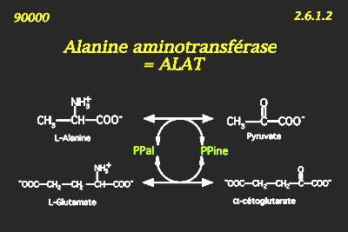
Biochemistry course A1 DV ; Prof A. MEKROUD , 2025/2026
ENZYMOLOGY SECTION
Two - substrate kinetics​
Example of ping-pong : alanine aminotransferase = ALAT
HAS
P
F
E
B
Q

Slide 60
Biochemistry course A1 DV ; Prof A. MEKROUD , 2025/2026
ALT catalyzes the transfer of the amine function of alanine ( amino acid ) ( A )
towards α -ketoglutarate ( α ketone body ) ( B ) which it transforms into glutamate
( Q ).To begin with, ALT binds to alanine and then transfers the amine function
on a bound coenzyme: pyridoxal phosphate (E) which becomes phosphate of
pyridoxamine ( F ) without ceasing to be bound to the enzyme. The enzyme then
issociates from the pyruvate ( α - keto body ) ( P ) .​
In the second step, the enzyme bound to pyridoxamine phosphate, ( F ) forms a
complex with α - ketoglutarate ( B ), then transfers the amine function of the
coenzyme which reverts to pyridoxal phosphate, (E) towards the second substrate
Which is transformed into glutamate ( an amino acid ) ( Q ). Finally, the complex
ALAT-glutamate dissociates
The enzyme and its bound coenzyme have recovered their initial structures.

Slide 61
Biochemistry course A1 DV ; Prof A. MEKROUD , 2025/2026
MODULATION OF ENZYMATIC ACTIVITIES
The initiation of an enzymatic reaction , its progression , and the speed at which it develops are subject to a number of factors. Some of these factors depend primarily on the enzyme itself and its substrate.
Reversibility of enzymatic reactions :​​
Every biochemical reaction is generally a reversible reaction . This property is clear for a number of them in which it is easy to demonstrate a state of equilibrium .
Specificity of enzymatic catalysis :
An enzyme 's activity is exerted only on a particular type of substrate or on a defined biochemical reaction . Several types of specificity are observed .

Slide 62
Biochemistry course A1 DV ; Prof A. MEKROUD , 2025/2026
MODULATION OF ENZYMATIC ACTIVITIES
1. Specificity of action :​​
The enzyme only catalyzes one specific reaction ( or group of reactions ) .
several enzymes will have different actions on the same amino acid
different .​
2. Substrate specificity :​​​
For the same function, for example the hydrolysis of phosphoric esters
In the case of phosphatases, for example Glucose-6-Phosphatase, the
Fructose 1,6-phosphatase, …
3. Stereo specificity of enzymatic catalysis :​​​​
In this case, the enzyme only acts on one of the optical isomers of a substrate .
given​

Slide 63
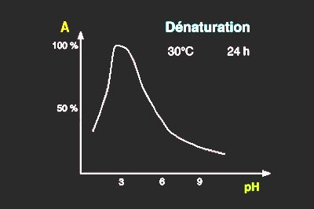
Biochemistry course A1 DV ; Prof A. MEKROUD , 2025/2026
Effect of physical constants
Effect of pH
Denaturing​​
pH plays a role in two different ways . :
either by modifying the secondary or tertiary structure of the enzyme, or by
modifying the electrical charges of the amino acid radicals in the active site.
When an enzyme is stored in a medium with an unfavorable pH
While maintaining its structure, it will undergo denaturation .

Slide 64
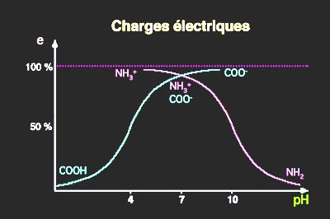
Electric charges​
Biochemistry course A1 DV ; Prof A. MEKROUD , 2025/2026
enzymatic reaction occurs determines the charge
activity of amino acid radicals in the protein . At very acidic pH levels
Most of the ionizable functions of these radicals are in the protonated form
that is to say COOH for the carboxylic acid function and NH3+ for the function
amine. At the most alkaline pH levels, the ionizable functions of these same radicals
are in the form of protonated e , that is to say COO- for the acid function
carboxylic acid, and NH2 for the amine function. At a pH close to neutral , a
The vast majority of these radicals with ionizable functions are charged , which
It facilitates enzyme-substrate or enzyme-coenzyme bonds. Therefore, there is a pH
reaction medium where the radicals from the enzyme's active site will be the most
favorable to enzyme-substrate binding This pH is called the optimum pH of the
reaction​​

Slide 65
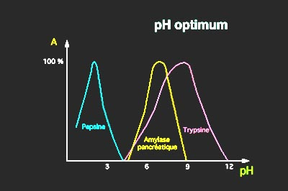
Biochemistry course A1 DV ; Prof A. MEKROUD , 2025/2026
optimal pH
Protein digestion enzymes have different optimum pH values for
the pH conditions prevailing in the light at different floors
of the digestive tract. Thus, pepsin activity is at its maximum in a very
acid like that of the stomach where it is secreted . On the contrary , enzymes
Pancreatic enzymes such as amylase and trypsin have a higher optimum pH for action.
alkaline because in the duodenum where they exert their activity the pH is normally
near 8.

Slide 66
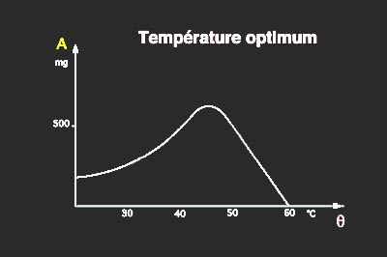
Biochemistry course A1 DV ; Prof A. MEKROUD , 2025/2026
Effect of temperature
optimum temperature​
The effect of the temperature of the environment on the enzymatic reaction
taking place within it. graph representing the quantities of product transformed
by an enzyme (A) depending on the temperature of the incubation medium, it is
an upward curve up to a temperature (here 45°C) where the enzyme's activity is
greatest, then rapidly descending.

Slide 67
Biochemistry course A1 DV ; Prof A. MEKROUD , 2025/2026
MAJOR ENZYMATIC FUNCTIONS:
NOMENCLATURE AND CLASSIFICATION
General principles of nomenclature :
Firstly, any enzyme with the suffix -ase is generally assigned has a simple enzyme.
If it is a more complex enzymatic organization, we he will talk about the enzymatic
system .the substrate or product, followed by the reaction
catalyzed to be terminated by the suffix ase .
2. Foundations of the classification:
Enzymes have a code number , preceded by the letters EC ( Enzyme commission ) .
The first number indicates the class to which the enzyme belongs . All enzymes
are divided into 6 classes:
Oxido - reductases ;​ 2.Transfers ; ​3. Hydrolases; 4. Lyases
5. Isomerases ; 6. Ligases or synthases
A second number indicates the subclass (e.g., in class 1, there is the subclass
1.1. (enzyme acting on a CH-OH), whereas subclass 1.4., enzyme acting
On a CH-NH ₂ )
A third digit defines the nature of the acceptor (e.g., 1.1.1. NAD or NADP acceptor ,
1.1.2. cytochrome as an acceptor, 1.1.3. oxygen as an acceptor …

Slide 68
Intracellular enzymes
Biochemistry course A1 DV ; Prof A. MEKROUD , 2025/2026
Aspartate aminotransferase: AST (liver-muscle)
Alanine aminotransferase: ALT (liver)
Lactate dehydrogenase: LDH (Liver, muscle, heart, brain, kidney)
Gamma-glutamyl-transferase: GGT (liver)
Creatine phosphokinase: CK (muscle)
Ceruloplasmin: Copper
Glutathione peroxidase: GSH-Px(selenium)

