Slide 1
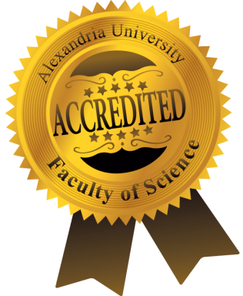
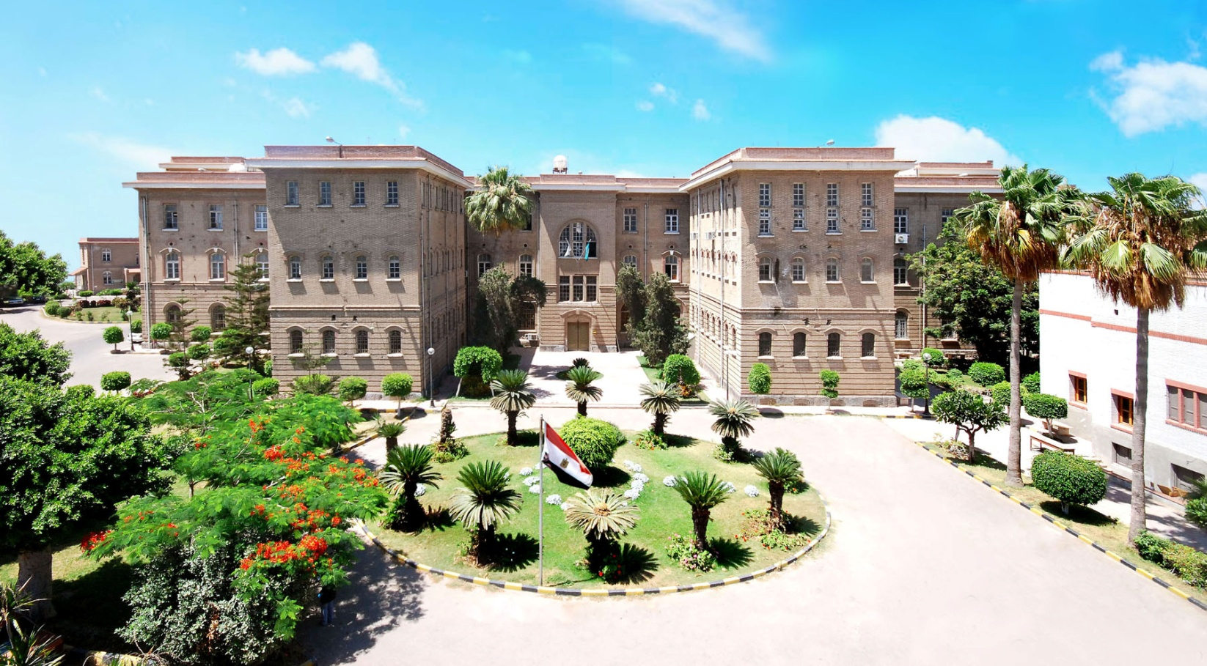
النشر العلمي في الجزائر الشقيق وجامعة الاخوين منتورى قسنطينة نوفمبر 2016
Prof. Dr. Moustafa El-Naggar Professor of Microbial Technology Faculty of Science, Alexandria University
Vice Dean For Graduate Studies & Research Affairs
Editor of J. Biotechnology & Biomaterials, USA
Editor of J. Single Cell Biology, USA
Managing Editor of JTUSCI, Elsevier Publisher.

Slide 2
Alexandria University…..new look

Slide 3
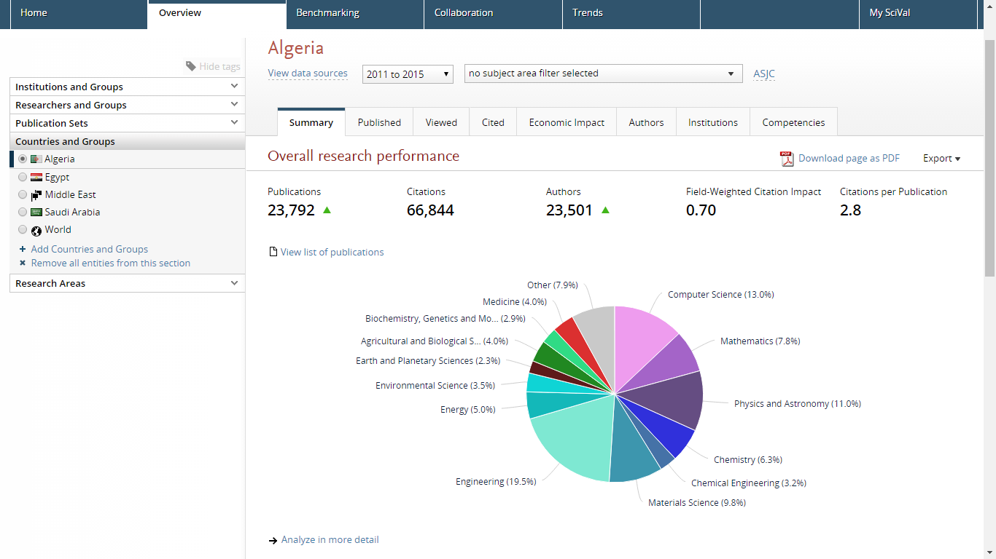

Slide 4
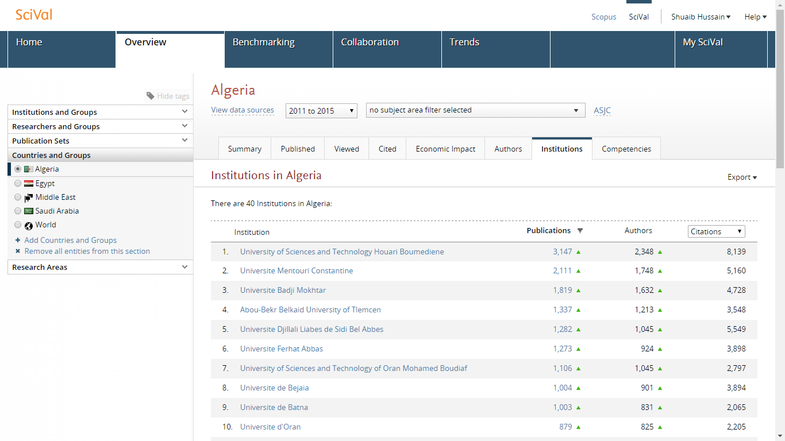
Top 10 Institutes in Algeria

Slide 5
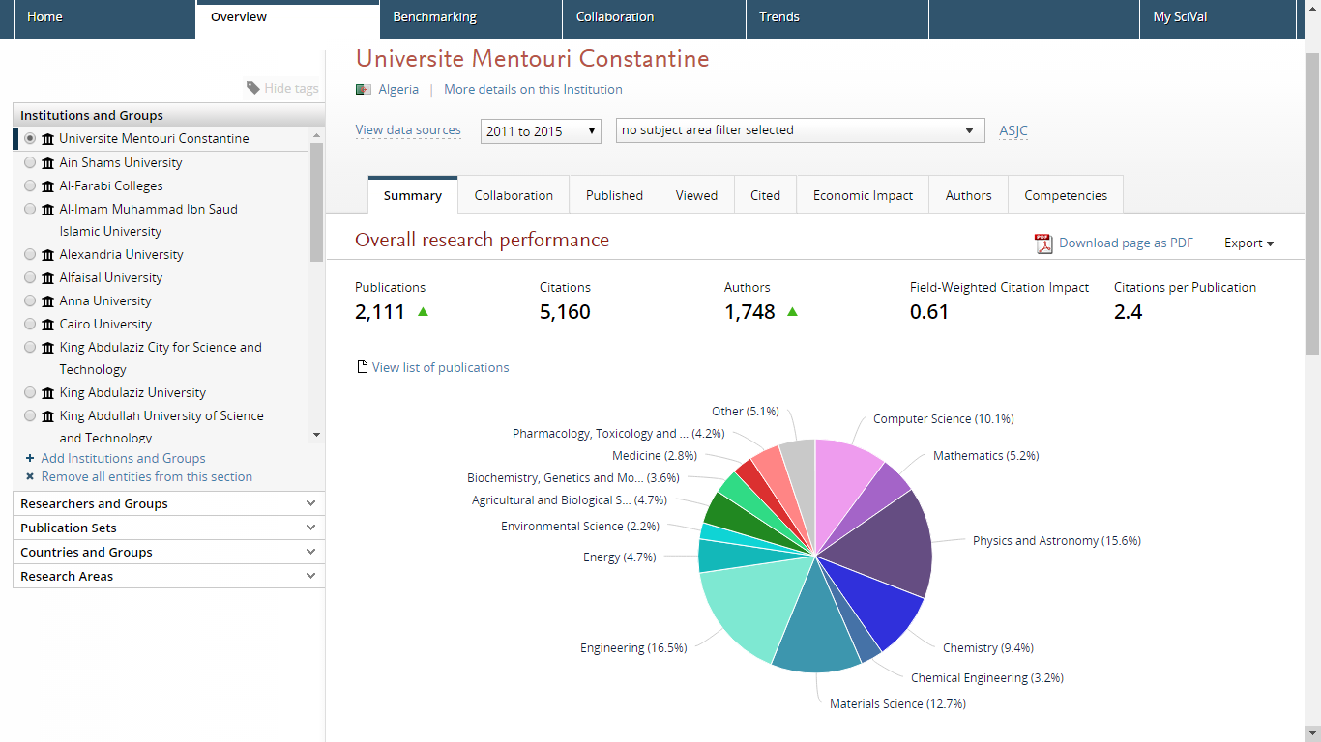
Universite Mentouri Constantine

Slide 6
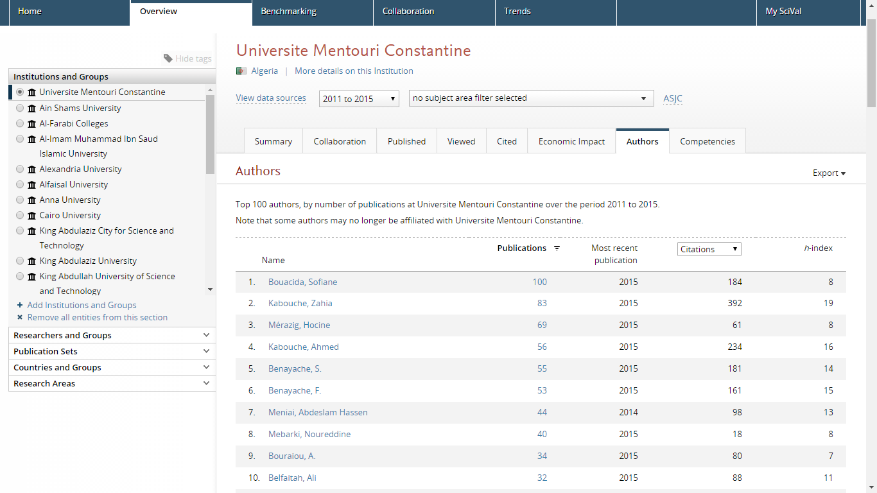
Top 10 Authors of Constantine University

Slide 7
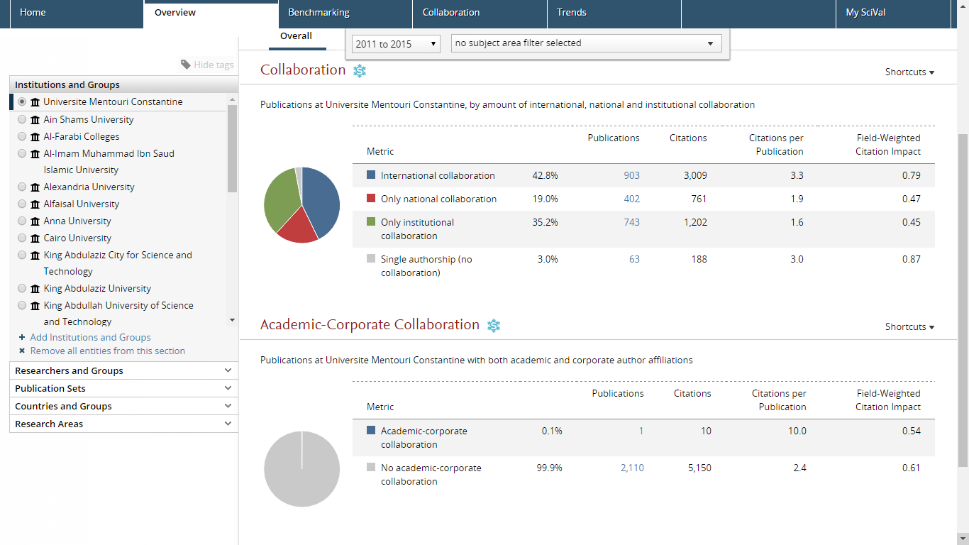

Slide 8
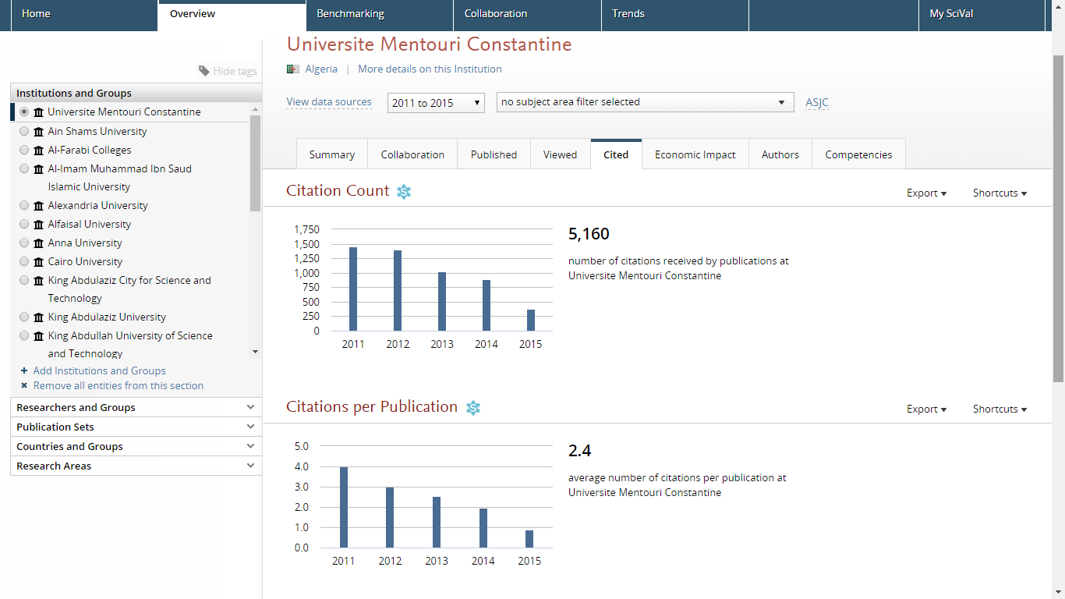

Slide 9
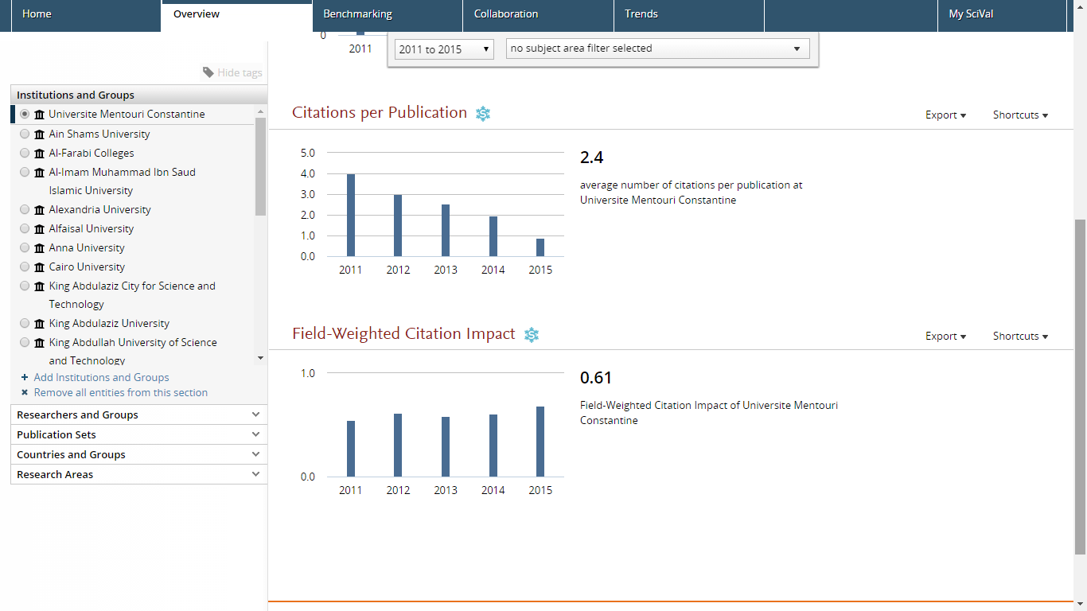

Slide 10
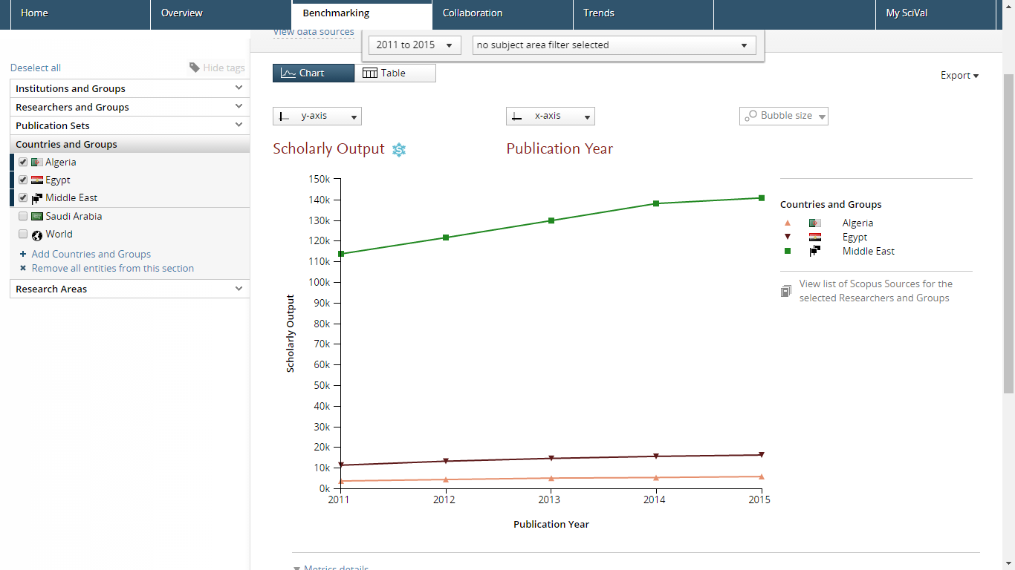

Slide 11
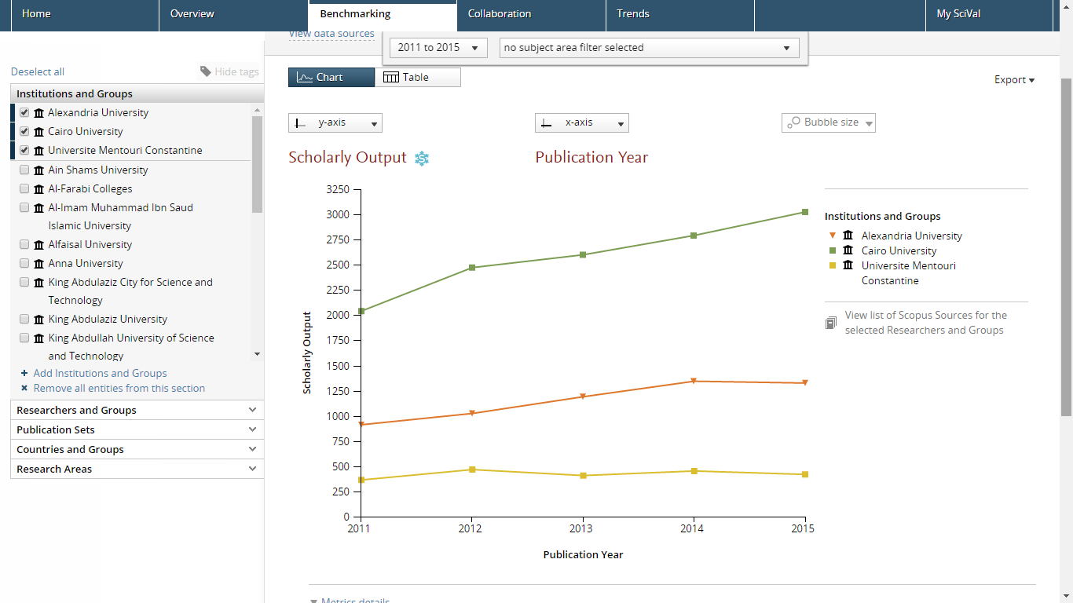

Slide 12
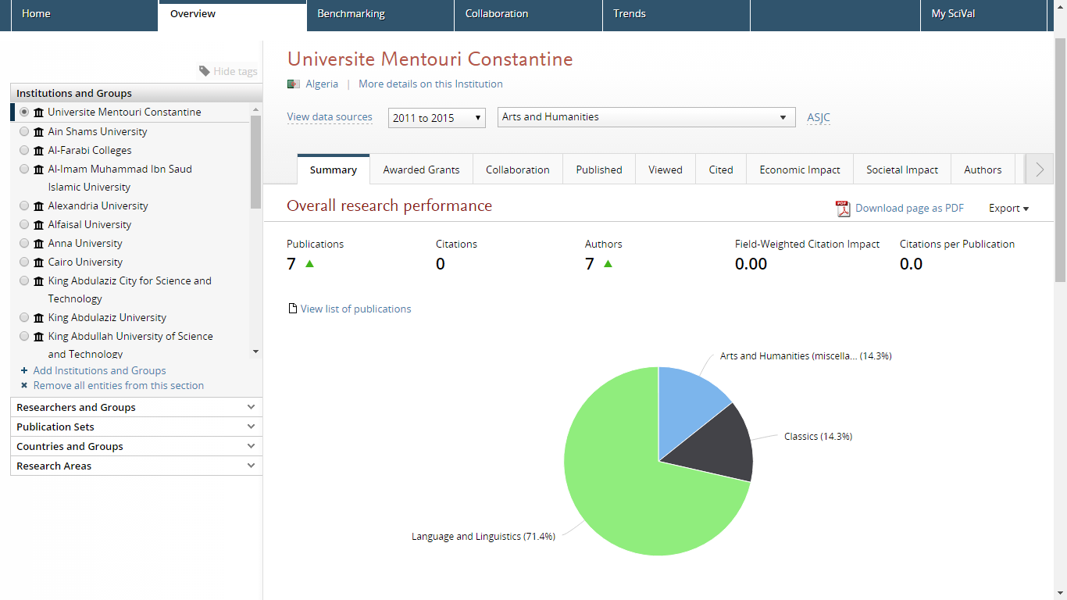

Slide 13
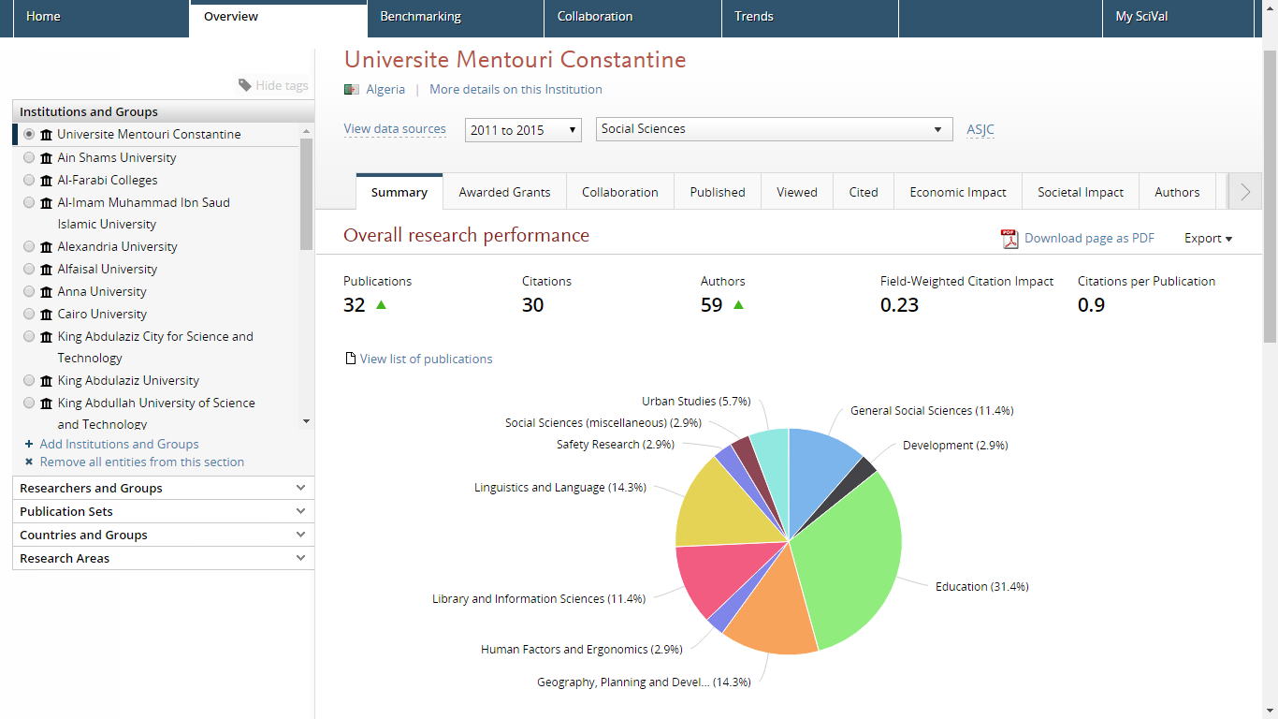

Slide 14
Thank you

